Slide 1
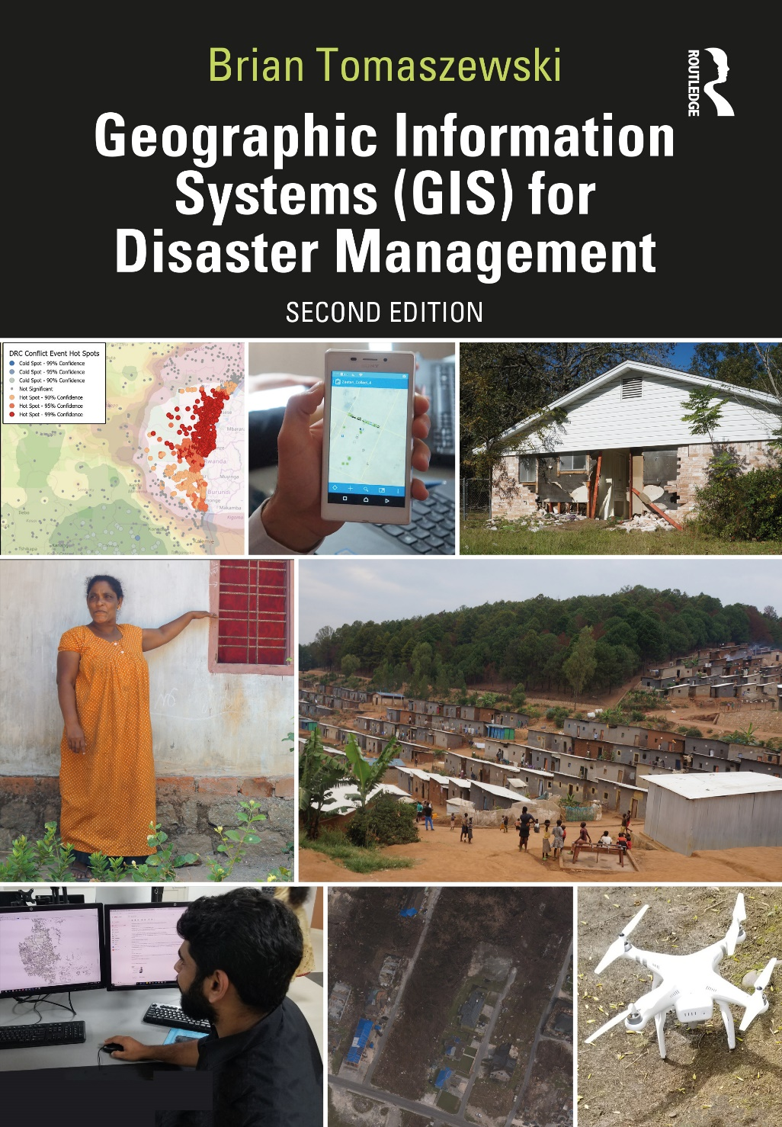
Chapter 9 Geographic Information Systems and Disaster Mitigation for additional materials, see: http://gisfordisastermanagement.com/ Recommended Citation: Tomaszewski, B. 2020. Chapter 9: Geographic Information Systems and Disaster Mitigation. In: Geographic Information Systems for Disaster Management (Second Edition), pp. 357-406. Oxfordshire and New York: Routledge.
Notes:
V1.2

Slide 2
Chapter 9 Objectives
Appreciate the particularly interdisciplinary nature of disaster mitigation and geographic information systems (GIS)
Have a basic understanding of the concepts of vulnerability and resilience and how they relate to GIS
Understand the basics of disaster-mitigation policy and how GIS is relevant to that policy
Be familiar with international organizations focused on disaster mitigation
Have a basic understanding of different social and physical spatial variables that can be used in GIS to model risk, vulnerability, and resilience
Understand basic approaches for developing vulnerability, risk, and resilience indexes using different types of spatial variables.

Slide 3
Introduction
Mitigation interwoven into disaster-recovery activities
Disaster mitigation: “[t]he capabilities necessary to reduce loss of life and property by lessening the impact of disasters” (United States Department of Homeland Security 2016, 1)
GIS and mitigation: modeling of hazard and risk scenarios; identify potential physical, virtual, and social vulnerabilities; mitigated or reduced through increased resilience efforts
Interdisciplinary connections across multiple areas

Slide 4
Vulnerability
“conditions determined by physical, social, economic and environmental factors or processes which increase the susceptibility of an individual, a community, assets or systems to the impacts of hazards” United Nations Office for Disaster Risk Reduction [UNISDR] (2019)
Social vulnerability: disaster consequences deriving from impacts on complex social conditions (Phillips et al. 2010)
Vulnerability context: external environment in which people live; how external forces that operate at varying space–time scales (trends (long term), shocks (sudden/onset), and seasonal (cyclical/recurring), potentially affect livelihoods (Department For International Development [DFID] 1999)

Slide 5
Resilience
Metaphorically opposite side from vulnerability
Ability of a system or community to withstand the impacts of an event and recover to an acceptable or existing or even an improved state in comparison to what was available before an event (United Nations Office for Disaster Risk Reduction (UNISDR) 2019)
Resilience has gained more emphasis: vulnerability has been seen to imply that people are passive victims
GIS: inventory, analyze, visually represent, understand and manage risks

Slide 6
Disaster-Mitigation Policy and International Perspectives on GIS
The United States National Mitigation Framework: “a common platform and forum for coordinating and addressing how the Nation manages risk through mitigation capabilities. This Framework describes mitigation roles across the whole community” (United States Department of Homeland Security 2016, 1)
Seven core capabilities
GIS: Risk and Disaster Resilience Assessment Capability: “Develop analysis tools to provide information more quickly to those who need it and make use of tools and technologies, such as geographic information systems” (United States Department of Homeland Security 2016, 19).

Slide 7
Disaster-Mitigation Policy and International Perspectives on GIS
International Perspectives on Disaster Mitigation: United Nations Office for Disaster Risk Reduction (UNDRR: www.unisdr.org)
“serve as the focal point in the United Nations system for the coordination of disaster reduction and to ensure synergies among the disaster reduction activities of the United Nations system and regional organizations and activities in socio-economic and humanitarian fields. (United Nations Office for Disaster Risk Reduction 2019)”
Sendai Framework (Chapter 5)
Climate change adaptation advocacy campaigns, disaster risk reduction education, gender issues, and sustainable development practice

Slide 8
GIS Techniques for Disaster Mitigation

Slide 9
Spatial Indexing and Modeling of Risk and Vulnerability
Spatial index: numerical or qualitative value assigned to a preexisting spatial unit or geographical region
Example: numerical scale of 1 to 10, with 1 being the lowest and 10 being the highest
Number represents a vulnerability level (determined by different variables and calculations) to a preexisting spatial unit such as state, county, or city or a geographic area
Visually represented using cartographic techniques (Chapter 2): color hue to indicate a risk or vulnerability level

Slide 10
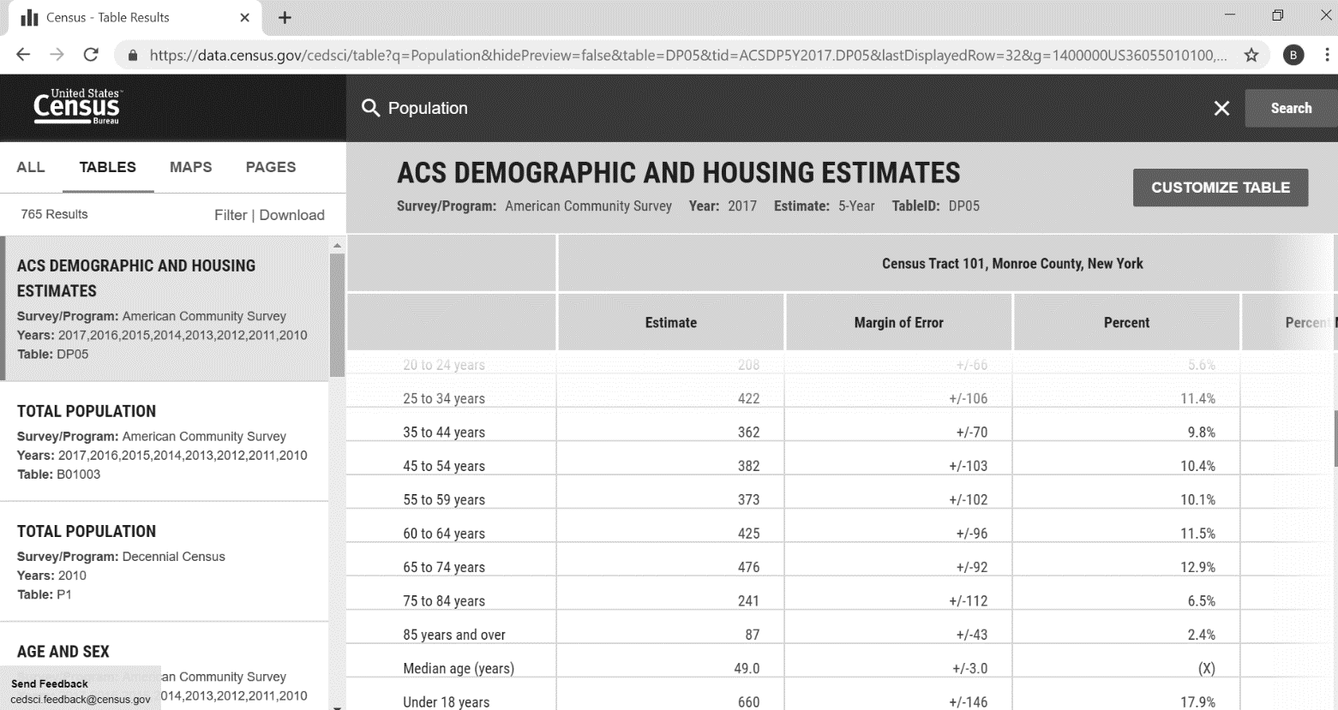
Social Variables
Wide variety of variables can be incorporated into the development of risk and vulnerability spatial indexes
Social fabric of society often where the greatest damage can occur (Mileti 1999)
Examples:
Age (elderly, children)
Gender
Rural/urban
Education level
United States: data on social variables acquired from the US Census Bureau website
US Census Bureau Website – https://data.census.gov

Slide 11
Physical Variables
Physical variables: tied to specific hazard types; important to consider the specific hazard type for spatial index
Examples:
Building material
Slope percentage (%)
Proximity to flood zones
Locations of critical infrastructures
Data on physical variables: example - United States Geological Survey (USGS) Earth Explorer (Chapter 4)

Slide 12
Using GIS to Develop Spatial Indexes of Vulnerability and Risk
GIS site-selection technique
Overlaying and comparing spatial variables weighted/combined to select final candidates
Create a final index score or match site-selection criteria
A generic GIS site-selection framework. Figure by Brian Tomaszewski

Slide 13
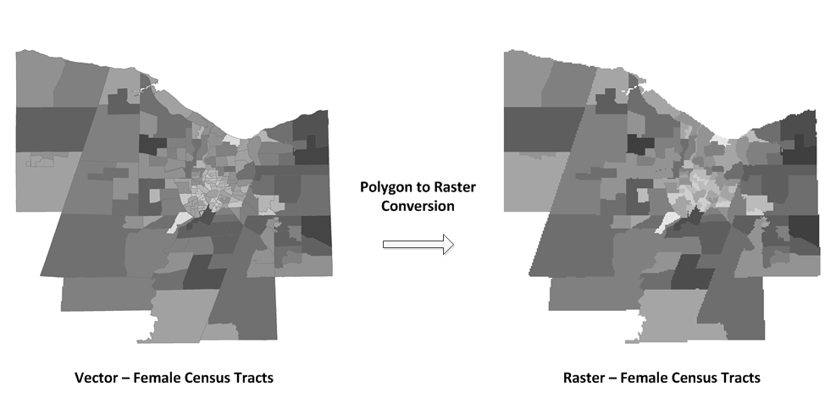
Using GIS to Develop Spatial Indexes of Vulnerability and Risk
Example:
elderly population (as represented by census tract boundaries), with 40% influence
female population (as represented by census tract boundaries), with 40% influence
proximity to hospitals (as represented by place name points), with 20% influence
Vector to Raster Conversion
Example of converting a vector dataset to a raster dataset using a polygon to raster conversion tool. These datasets are both symbolized using a five-class, equal-interval classification scheme. Map by Brian Tomaszewski.

Slide 14
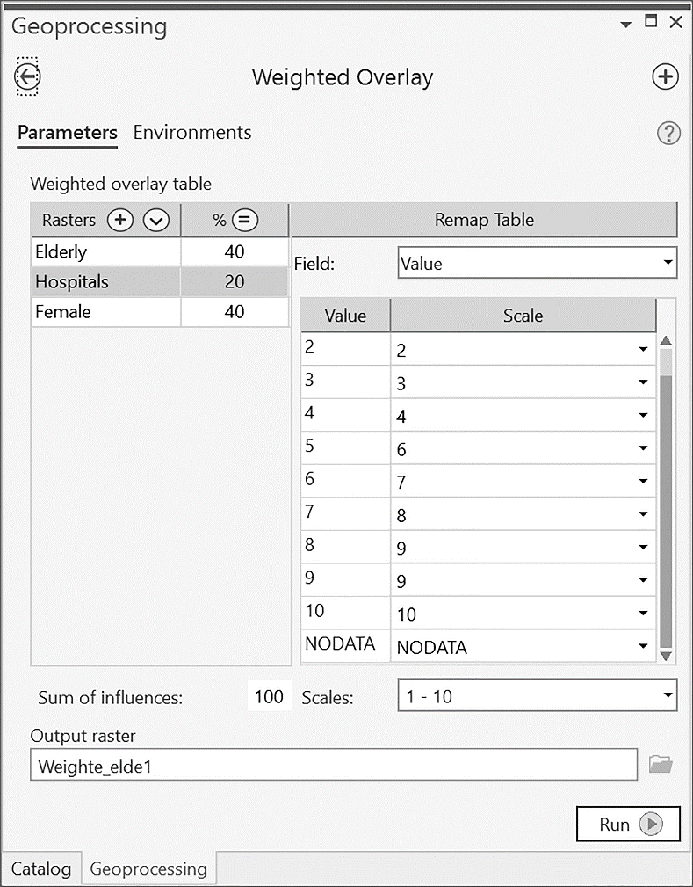
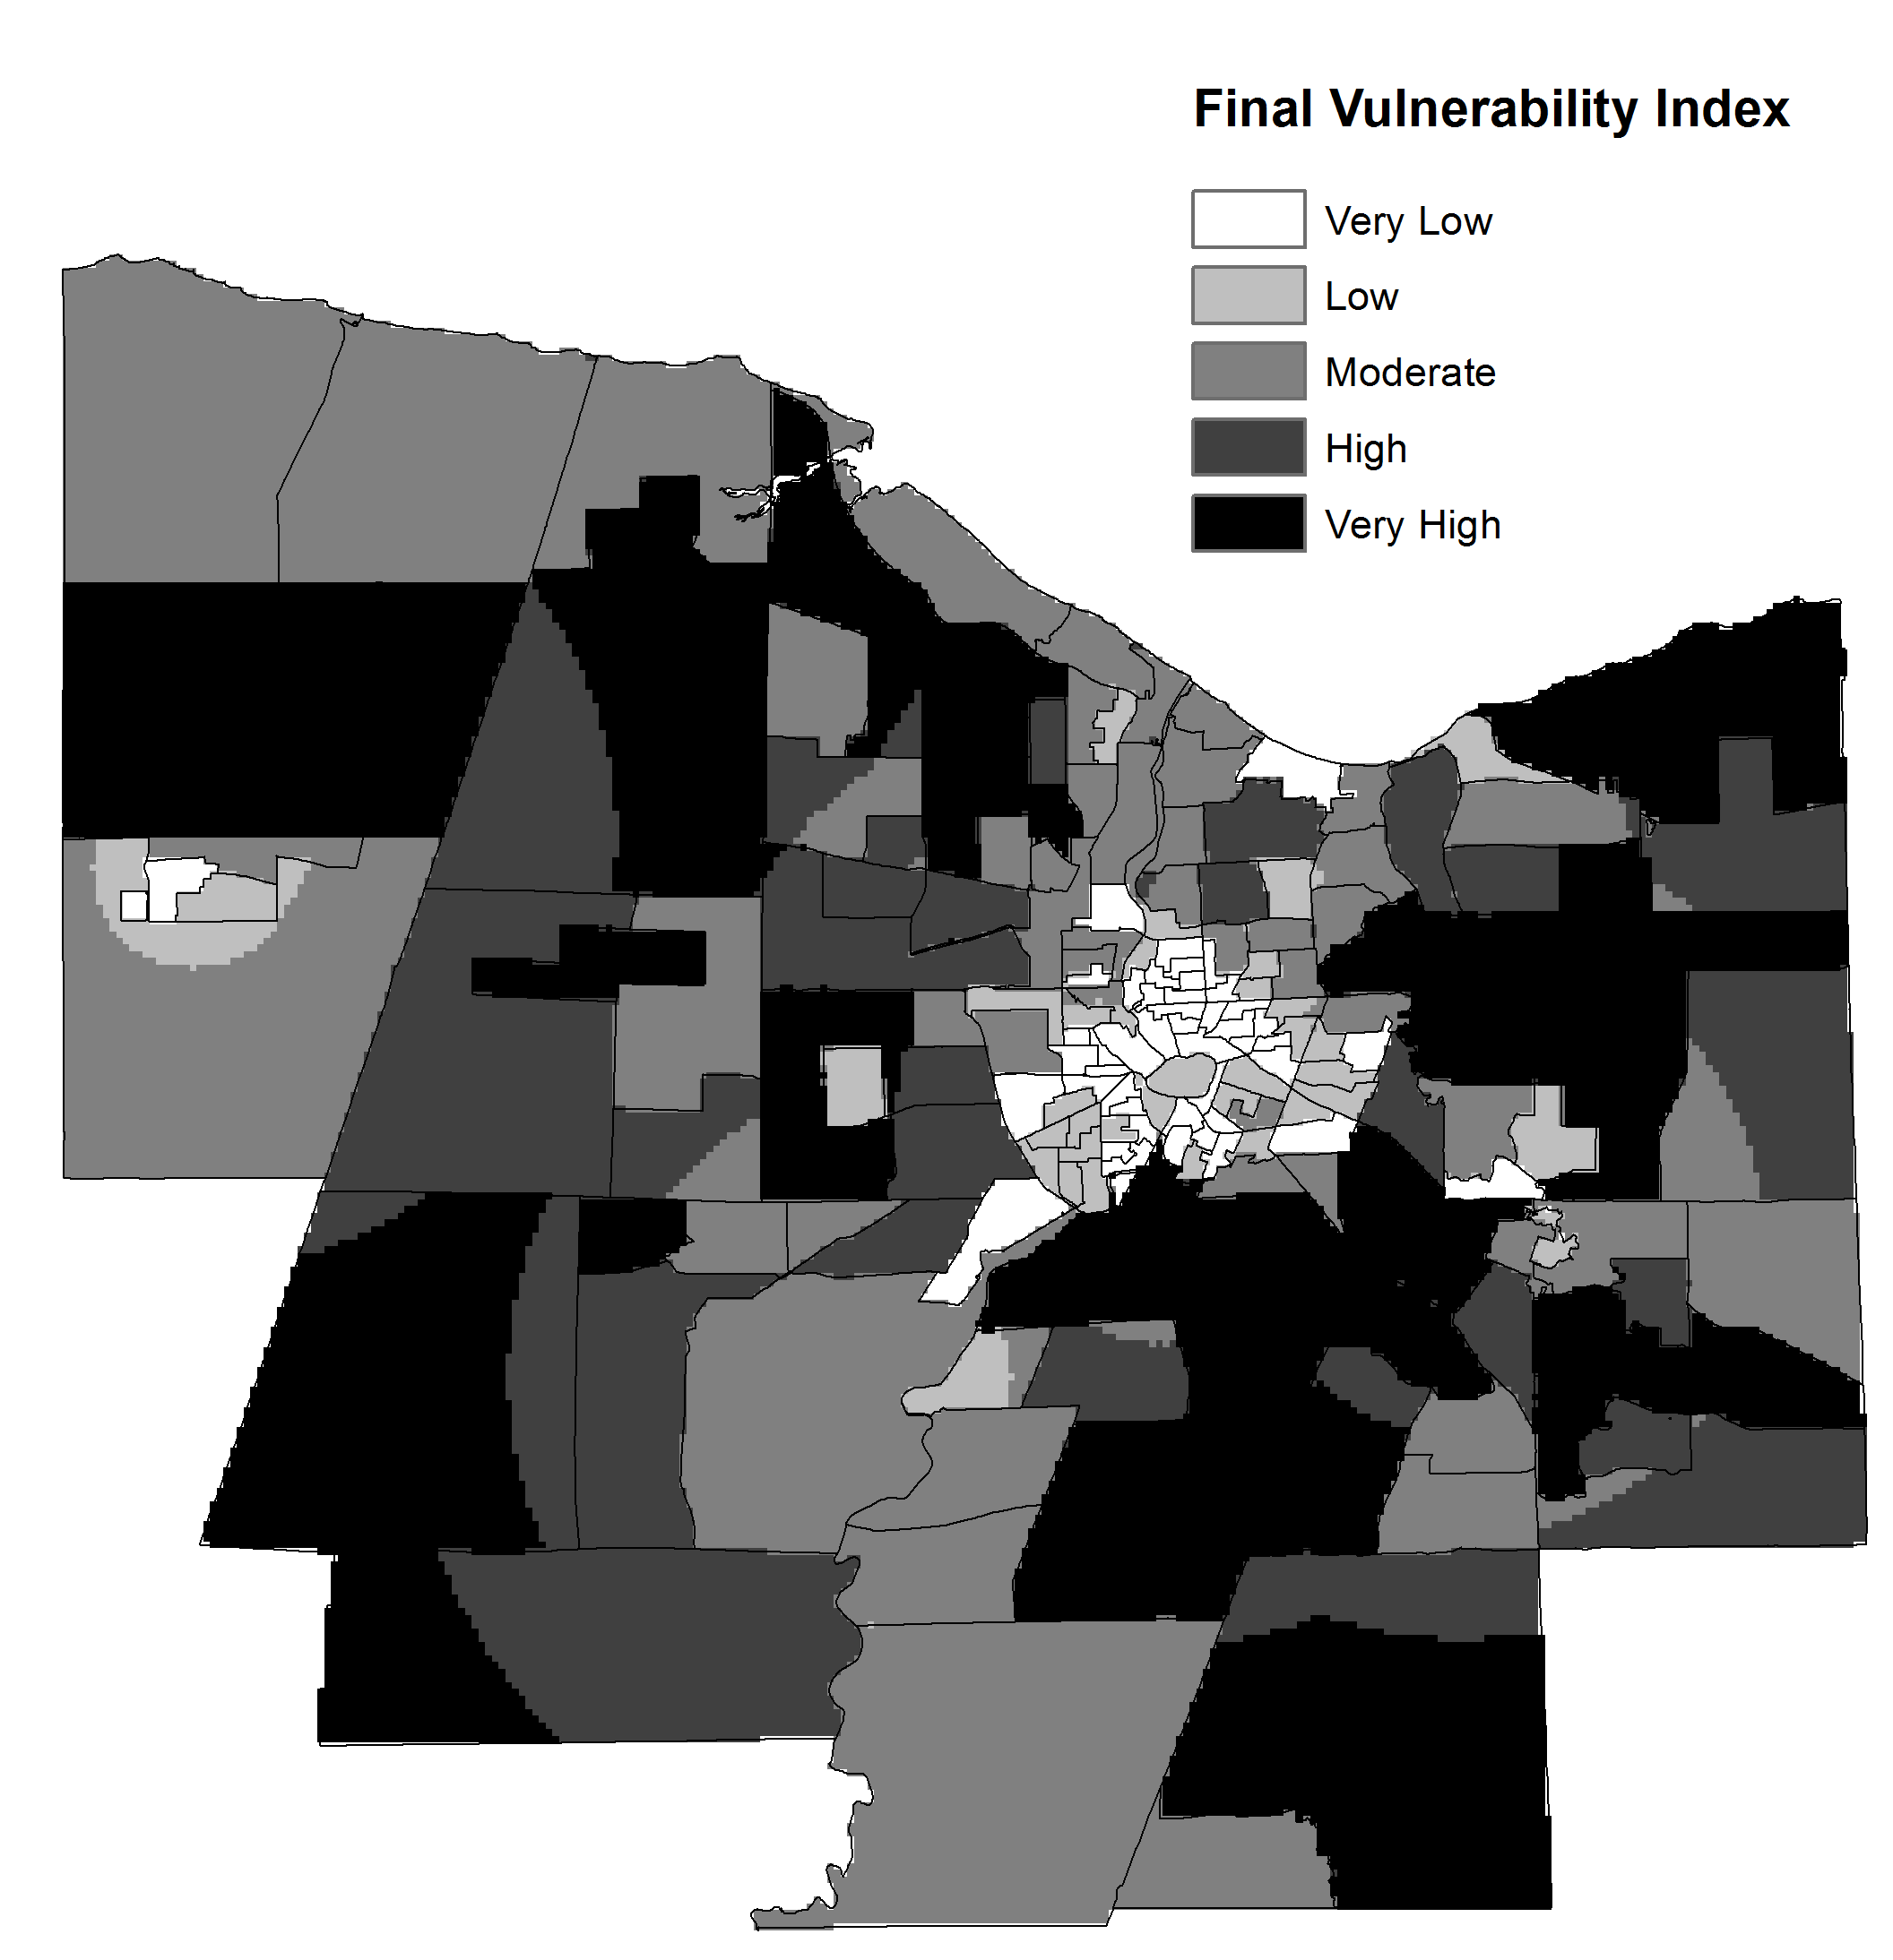
Using GIS to Develop Spatial Indexes of Vulnerability and Risk
Combining and weighting the three variable layers in the Weighted Overlay tool. Copyright © 2019 Esri and its licensors. All rights reserved.
Final vulnerability index map. Map by Brian Tomaszewski

Slide 15
Summary
Important ideas: risk, vulnerability, and resilience
Disaster mitigation: most interdisciplinary aspect of the overall disaster management cycle - GIS is often the unifying platform for combining these perspectives
Disaster-mitigation policy perspectives: US National Mitigation Framework
United Nations Offer for Disaster Risk Reduction
GIS techniques for disaster mitigation: social/physcial variables
How to develop spatial index of vulnerability

Slide 16
Discussion Questions
1. Review the seven core capabilities of mitigation from the National Mitigation Framework, Second Edition, presented in the Disaster-Mitigation Policy section of this chapter. What are some additional, specific uses of GIS you could foresee for supporting these capabilities in addition to the analysis capability specifically mentioned in the National Mitigation Framework? Think creatively and spatially about how GIS can be used and think back to many of the ideas you have learned about previously in this book such as using maps for public communication, geocollaboration, and field data collection and mobile GIS.
2. There are endless ways in which risk and vulnerability can be communicated in map-based formats. Do some Internet searching and find examples of either interactive mapping websites, or published map products that are used to communicate risk and vulnerability. Look back to earlier chapters in this book for ideas from organizations such as UNDRR, UN ReliefWeb, the FEMA GeoPortal, and the United States Geological Survey. When looking at these maps, what specific GIS technologies or range of technologies might you use to create them? For example, if you had a job as the disaster management GIS person for a small town, how might you help citizens in your town create vulnerability maps of their community using free and open-source tools like those discussed in Chapter 3?
3. An idea that has been mentioned before in this book is that GIS, for all of its benefits, also has limitations in that it reduces reality to computer-based representations that often cannot convey or represent the subtleties and idiosyncrasies of geographic context. In this regard, how might GIS be used to incorporate local knowledge such as knowledge of people’s communities, social bonds with one another, local environmental knowledge, and other factors not easily conveyed in computer-based representation in order to gain deeper perspectives about disaster risks that can be used to inform disaster-mitigation activities (see Kemp [2008] and Tran et al. [2009] as a starting point)? How might some of the tools and technologies, such as those of crisis mapping and crowdsourcing, be used to capture this local spatial knowledge to inform disaster mitigation?

Slide 17
Chapter 9 Exercises
Exercise 9.1 – Creating a Displacement Natural Disaster Resilience Index
Developing a spatial index using refugee natural disaster resilience in Rwanda as a case study
A video walkthrough tutorial of this exercises is available from the book’s companion website: http://gisfordisastermanagement.com

Slide 18
References Used in the Slides
Department for International Development (DFID) (ed.). “Framework - Section 2.1.” In Sustainable Livelihoods Guidance Sheets. London: Department For International Development (DFID), 1999.
Mileti, D.S. Disaster by Design: A Reassessment of Natural Hazards in the United States . Washington, DC: Joseph Henry Press, 1999.
Phillips, B.D., D. Thomas, A. Fothergill, and L. Blinn-Pike . Social Vulnerability to Disasters. Boca Raton, FL: CRC Press, 2010.
United Nations Office for Disaster Risk Reduction. Our Mandate, 2019. Accessed September 10, 2020. https://www.unisdr.org/who-we-are/mandate.
United Nations Office for Disaster Risk Reduction (UNISDR). Terminology Resilience, 2019. Accessed July 7, 2019. https://www.unisdr.org/we/inform/terminology#letter-r.
United Nations Office for Disaster Risk Reduction (UNISDR). Terminology – Vulnerability, 2019. Accessed July 8, 2019. https://www.unisdr.org/we/inform/terminology#letter-v.
United States Department of Homeland Security. National Mitigation Framework. 2nd ed. National Incident Management System, 2016.

