Slide 1
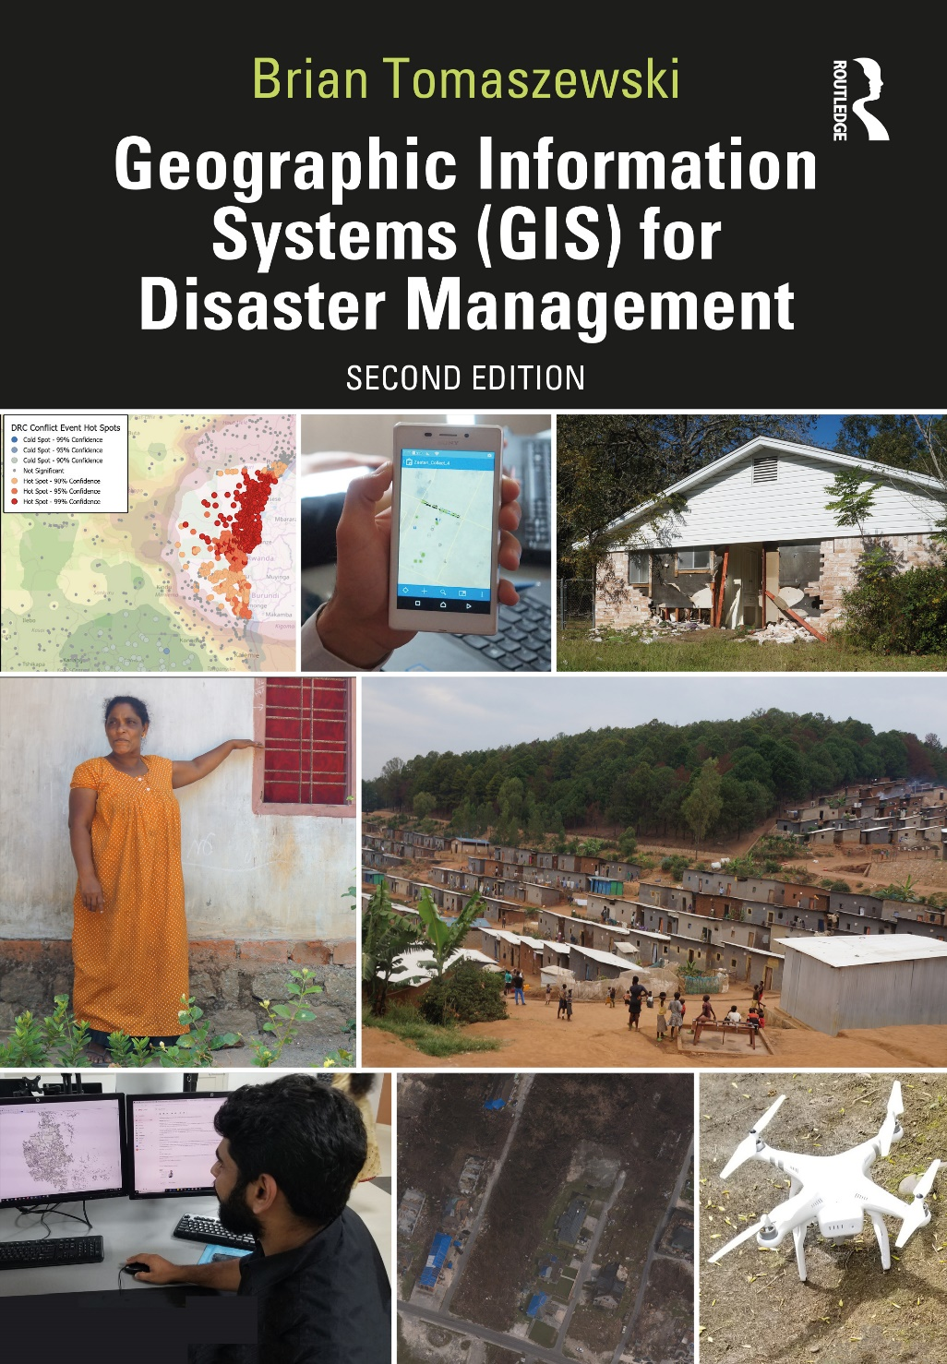
Chapter 8 Geographic Information Systems and Disaster Recovery for additional materials, see: http://gisfordisastermanagement.com/ Recommended Citation: Tomaszewski, B. 2020. Chapter 8: Geographic Information Systems and Disaster Recovery. In: Geographic Information Systems for Disaster Management (Second Edition), pp. 321-356. Oxfordshire and New York: Routledge.
Notes:
V1.2

Slide 2
Chapter 8 Objectives
Understand the different time scales at which disaster recovery operates and the implications of those time scales for the use of geographic information systems (GIS) and disaster recovery
Discern various geographical aspects of disaster recovery and how those geographical aspects might be uniquely supported with GIS
Understand the concept of Geocollaboration and how this theoretical idea is particularly relevant to disaster recovery and also to the use of GIS in other disaster management phases
Identify specific GIS techniques that can be used to support disaster recovery such as networking and routing for restoring critical infrastructure
Understand the unique role that GIS can play in recovery planning processes that involve community members
Discern the overlaps between disaster recovery and disaster mitigation and how GIS and corresponding spatial data can serve both disaster recovery and mitigation needs

Slide 3
Introduction
Recovery: transition of the built environment, business, people, and their communities back to a state of acceptable operation after a disaster event
Long-term planning and commitment to achieve recovery goals
Operate at varying space and time scales
GIS capacity: remain available and operational for the duration of long-term disaster recovery

Slide 4
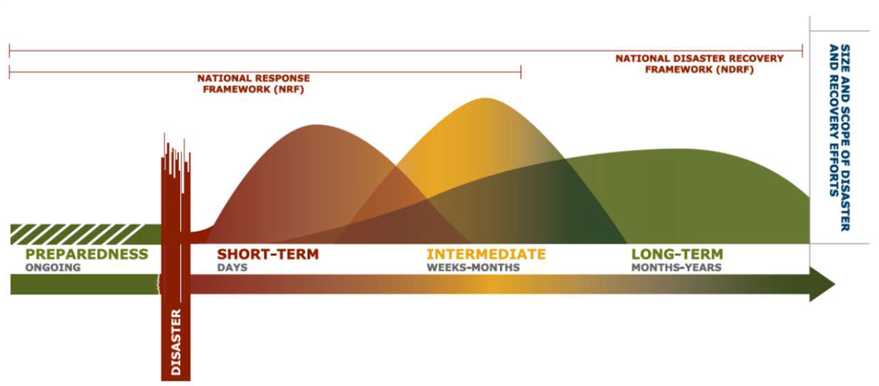
Geographical Aspects of Disaster Recovery
The Recovery Continuum. Source: Federal Emergency Management Agency [FEMA] 2016, 5.

Slide 5
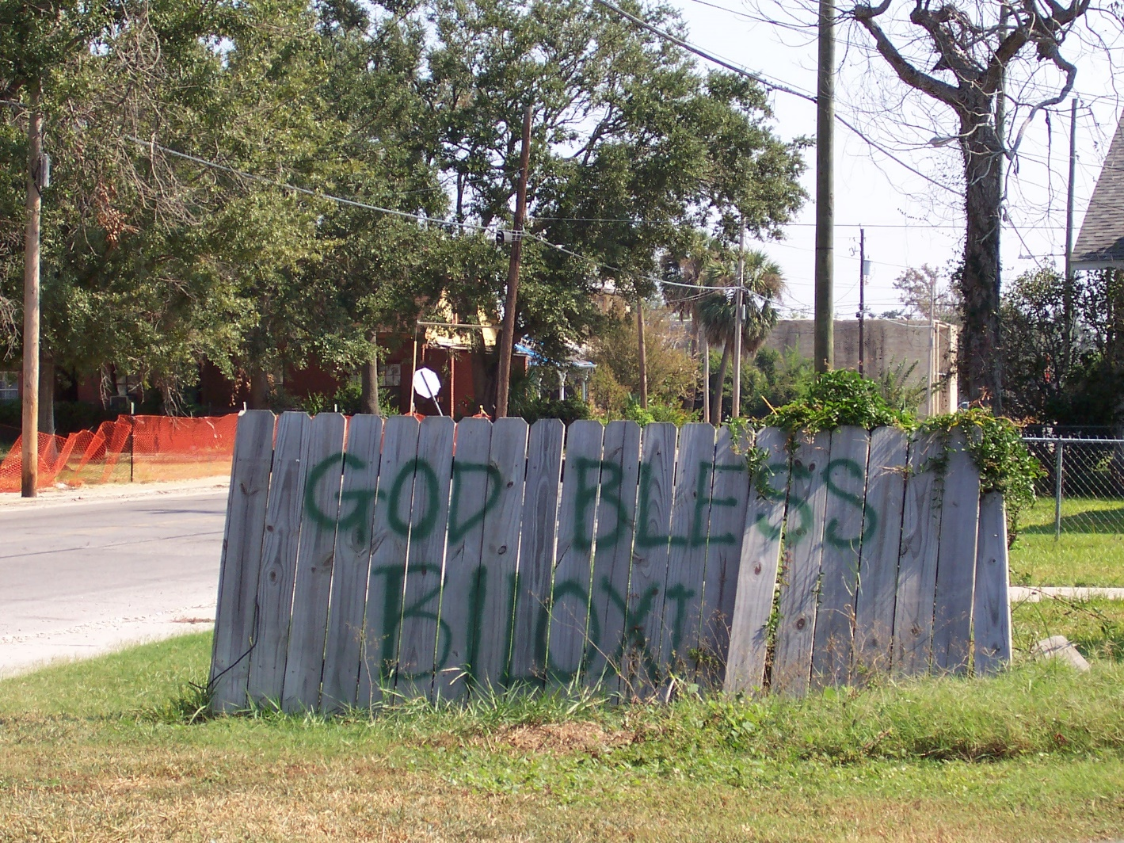
Geographical Aspects of Disaster Recovery
Restoring people’s pride in their sense of community
Sense of place
A damaged wooden fence containing the message “GOD BLESS BILOXI” (Mississippi). This picture was taken in 2006, or 1 year after 2005’s Hurricane Katrina event where the beginning phases of long-term recovery were just starting in Biloxi. Photo by Brian Tomaszewski.

Slide 6
Resilient Recovery
Global Facility for Disaster Reduction and Recovery (GFDRR): integrate disaster risk-reduction measures into disaster recovery to protect development gains
Qualitative analyses of country experiences in disaster recovery suggest that there are four progressive stages for a country to achieve the successful integration of disaster risk reduction into disaster recovery measures: (a) integrating disaster risk reduction into recovery needs assessments; (b) sustained commitment to disaster risk reduction during recovery planning; (c) incorporating disaster risk reduction in the design and implementation of recovery programs; and (d) translating the gains of resilient recovery into sustainable development. (Mundial 2015, 10)

Slide 7
Using GIS to Support Disaster-Recovery Tasks

Slide 8
Geocollaboration
Using maps, spatial representations, and map annotations to facilitate processes of collaboration that themselves are spatial in nature (Tomaszewski 2010)
Disaster recovery: means to coordinate the spatial activities of a variety of actors involved in long-term recovery (Emrich, Cutter, and Weschler 2011)

Slide 9
Geocollaboration
MacEachren (2005) framework:
1. The object of collaboration
2. Provide support for human dialogue, information sharing, negotiation, and discussions
3. Support for coordinated activity

Slide 10
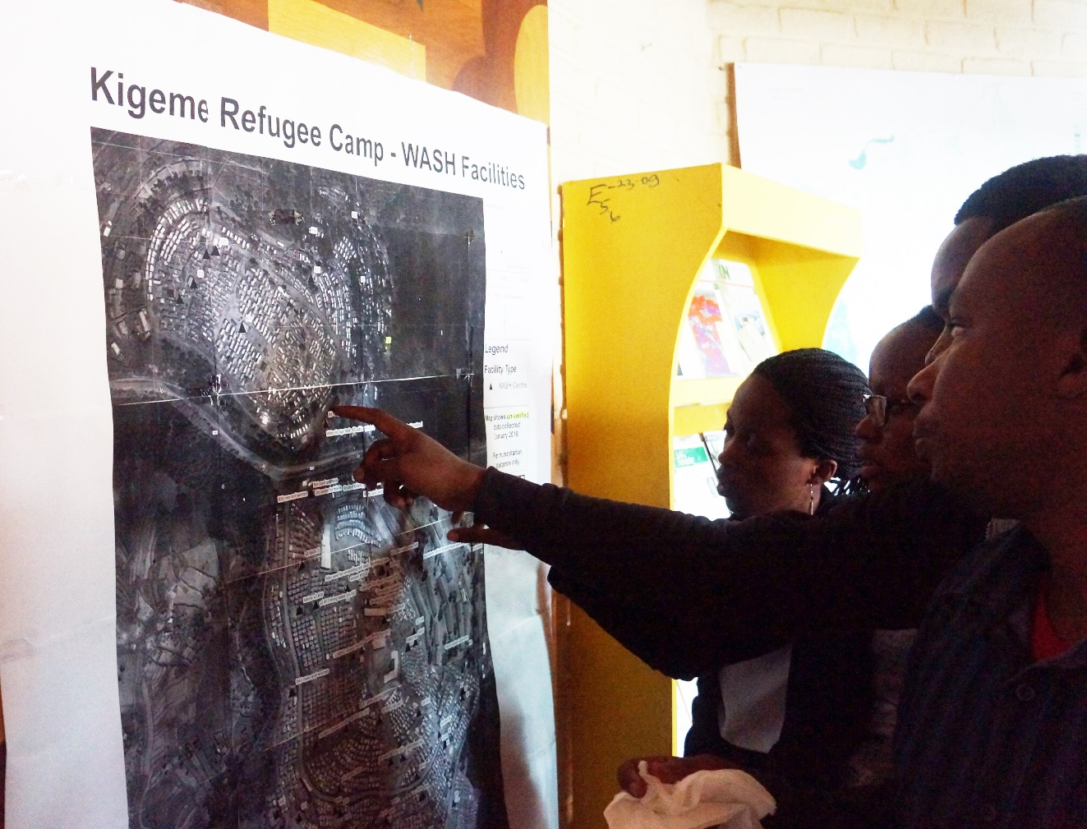
Geocollaboration
1. The object of collaboration
Reviewing refugee camp water and sanitation facilities (WASH) in Rwanda. In this image, the humanitarian professionals are using a map as the object of collaboration to review WASH facilities as part of a long-term humanitarian recovery process focused on refugees from the Democratic Republic of Congo (DRC) living in Rwanda. Photo by Brian Tomaszewski.

Slide 11
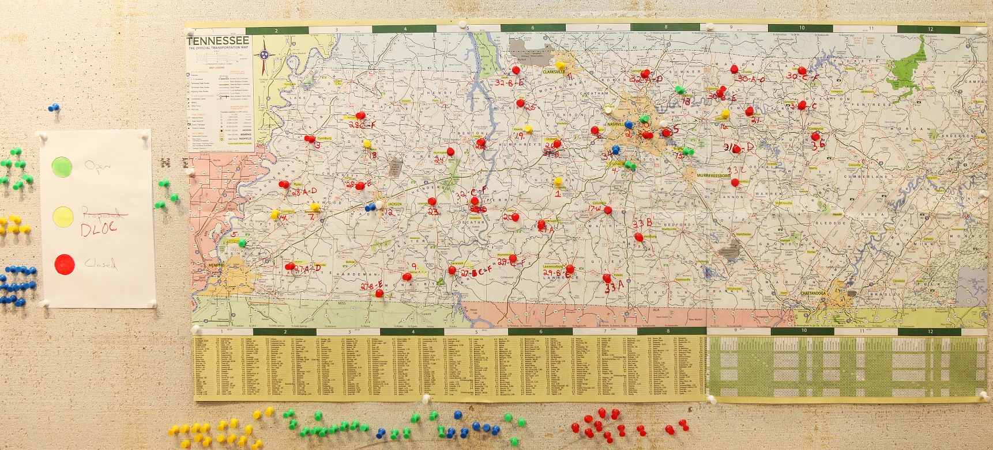
Geocollaboration
2. Provide support for human dialogue, information sharing, negotiation, and discussions
A 2010 image of a paper map of Tennessee used as a base map to show the locations of disaster-recovery centers using artifacts such as push pins that signified the open, proposed, or closed status of a disaster-recovery shelter during major statewide storm and flooding events. This is a classic example of a low-tech, but highly effective way that maps and artifacts placed on the maps such as the push pins or hand-drawn map items can be used for dialog and information sharing among disaster-recovery teams. Source: Public Domain – https://commons.wikimedia.org/wiki/File:FEMA_-_44675_-_Logistics_Maps_Locations_of_Disaster_Recovery_Centers.jpg

Slide 12
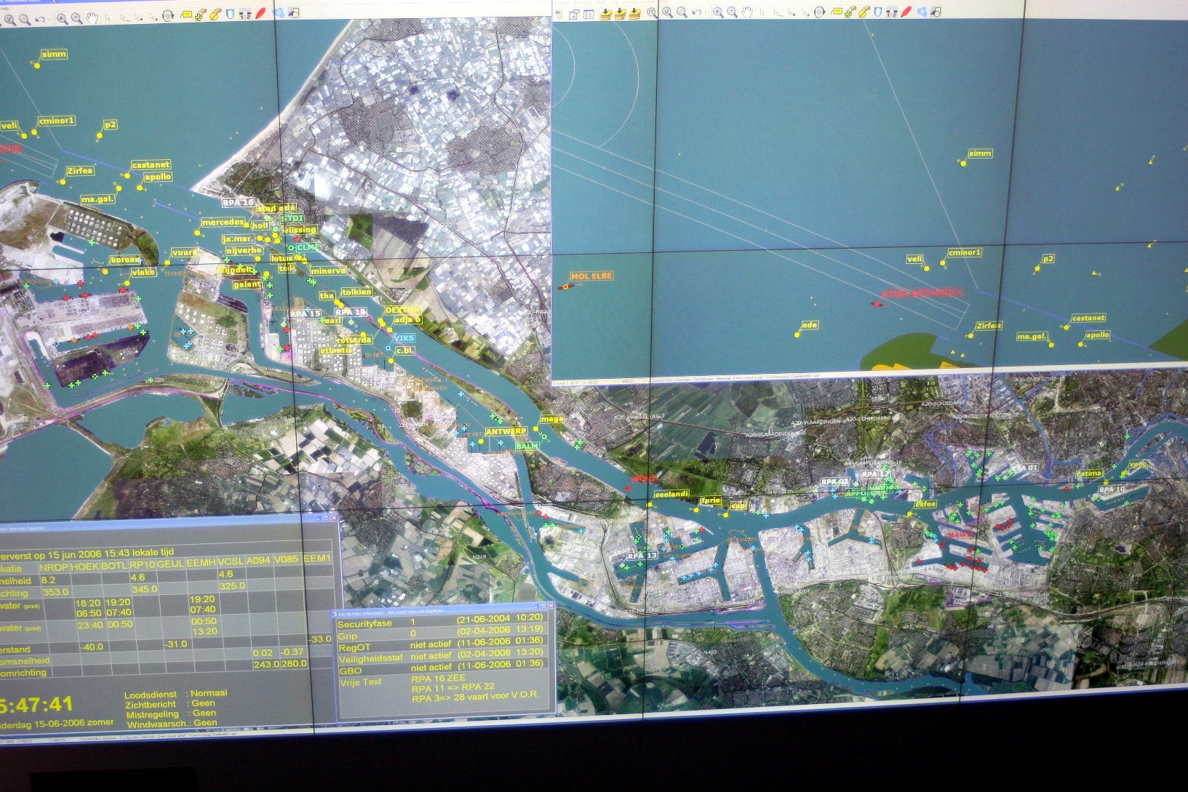
Geocollaboration
3. Support for coordinated activity
A picture of the large map display from the port of Rotterdam in the Netherlands. Photo by Brian Tomaszewski.

Slide 13
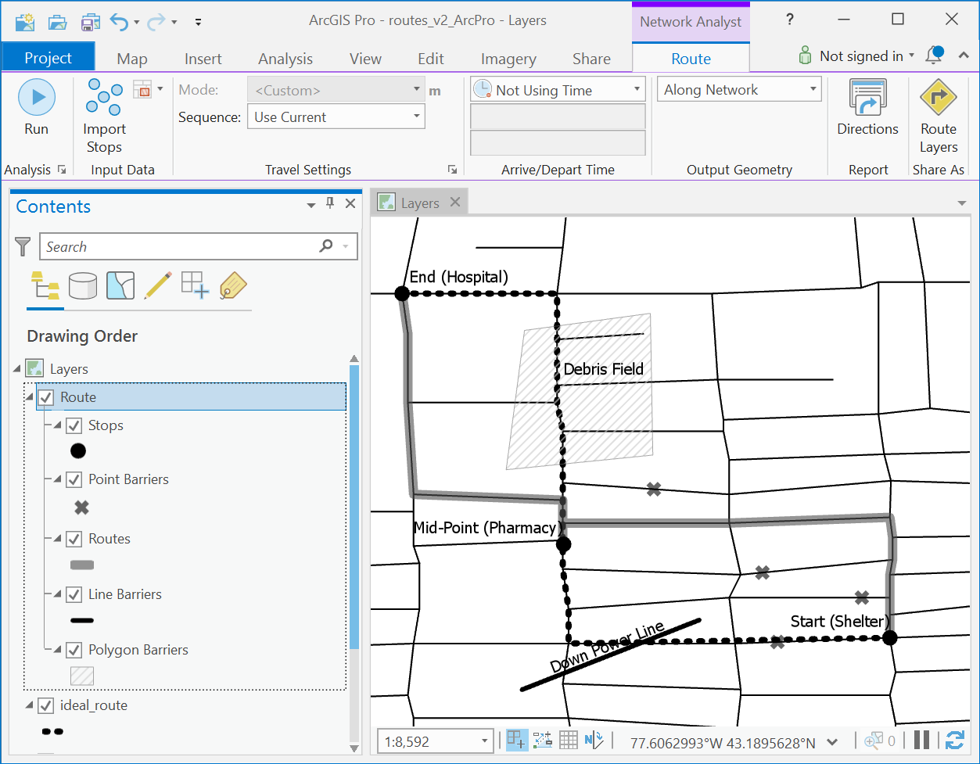
Networking and Routing for Restoring Critical Infrastructure
GIS: important role in critical infrastructure vulnerability planning and restoration activities
Visualization of physical proximity and the distribution of critical capabilities across a region
Networking and Routing
The networking analysts tool environment inside of ArcGIS Pro 2.2. Copyright © 2019 Esri and its licensors. All rights reserved.

Slide 14
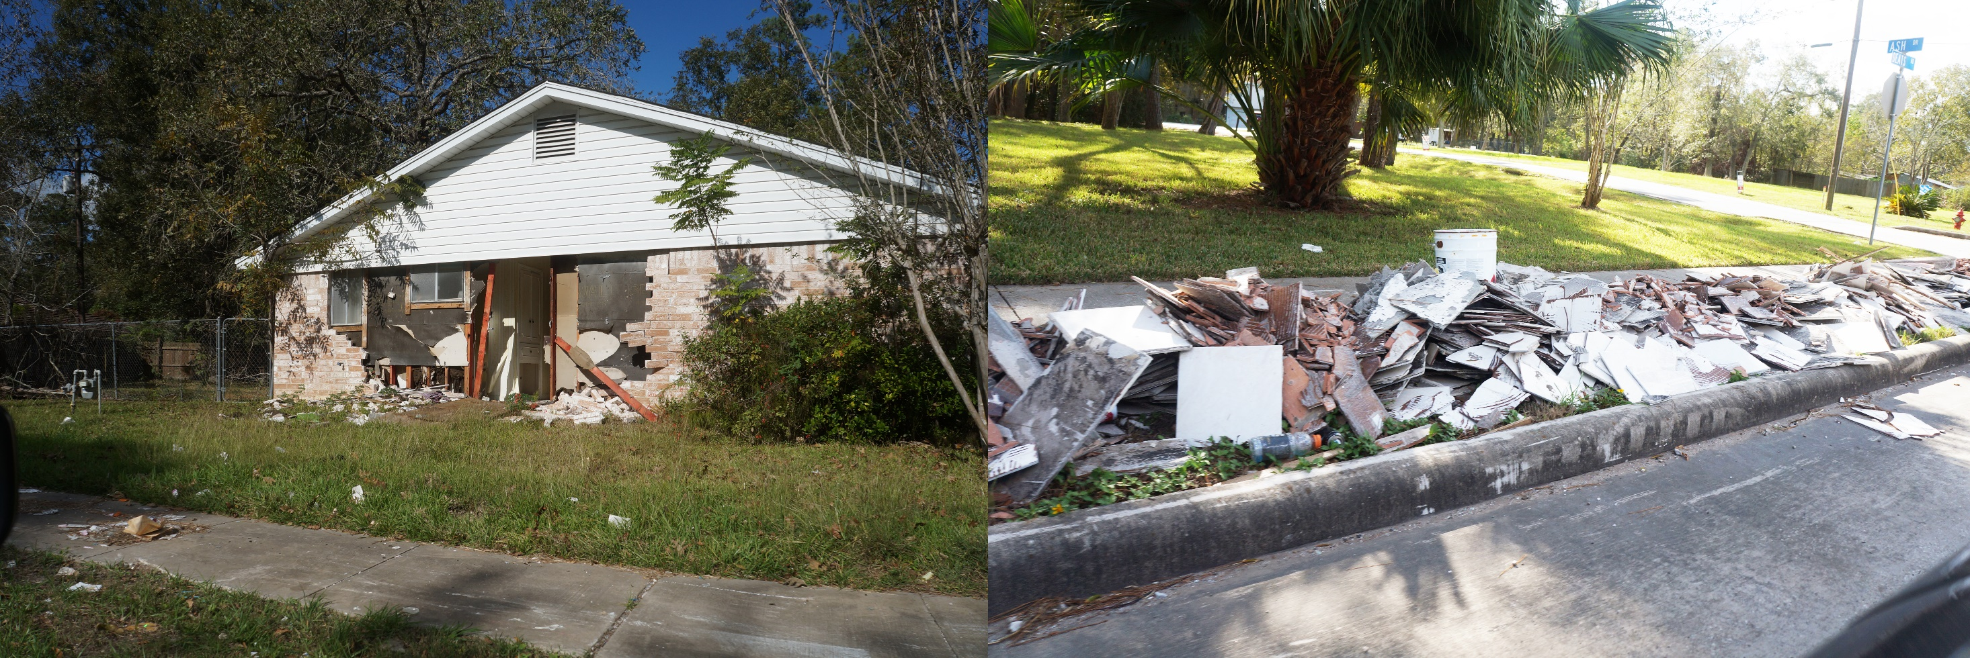
Debris Cleanup
Debris cleanup in Dickinson, Texas, after Hurricane Harvey. Photos by Brian Tomaszewski.

Slide 15
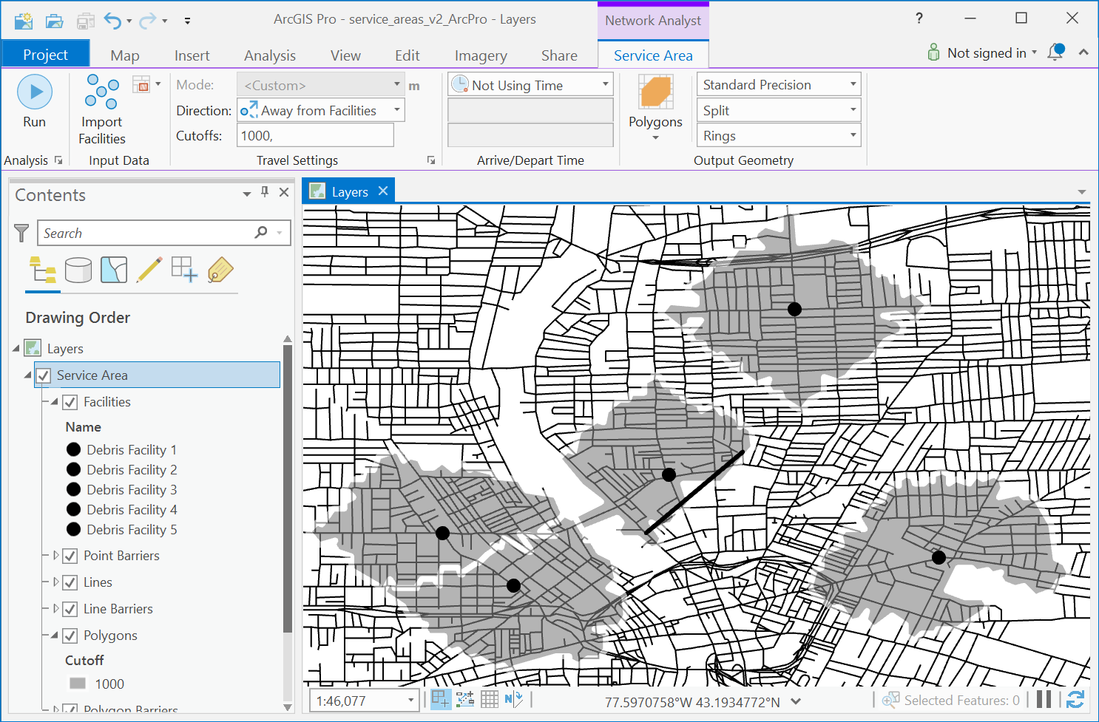
Debris Cleanup
Planning: volume and type of debris; where specific debris can be moved; much time debris removal will take/resources
Sustainable debris cleanup
GIS: for planning debris-cleanup activities/networking algorithms
Debris cleanup service area network algorithm output results – areas 1,000 meters from debris-collection points. Copyright © 2019 Esri and its licensors. All rights reserved.

Slide 16
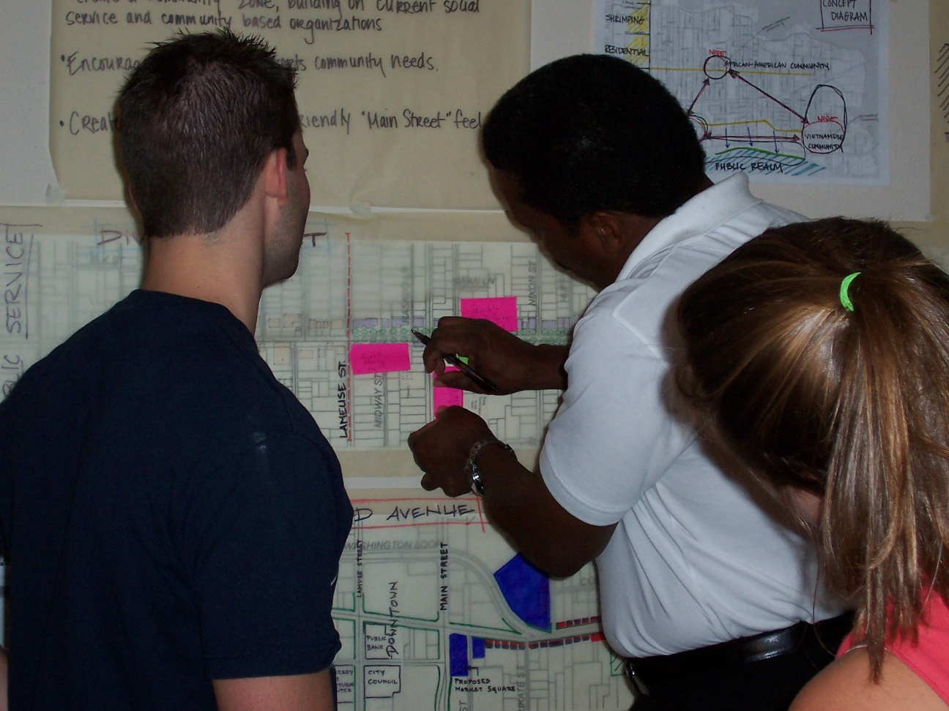
Recovery Planning
Involvement for a wide range of stakeholders ranging from individual citizens to local businesses after a disaster has affected a community (Federal Emergency Management Agency [FEMA] 2011; Phillips, Neal, and Webb 2016)
Opportunity for the broader public to engage with the products of GIS, if not GIS technology itself
Using paper maps and annotations for a recovery-planning session in 2006 Biloxi, Mississippi, post-Katrina. Photo by Brian Tomaszewski.

Slide 17
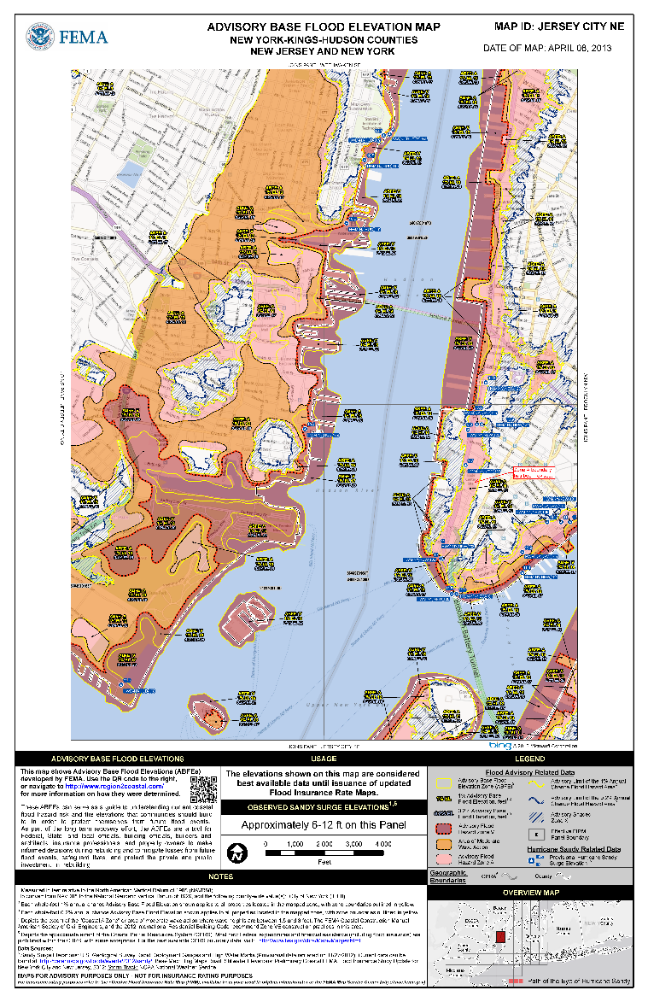
Transition from Recovery to Mitigation
Disaster-mitigation activities: intertwined with disaster-recovery activities
Geographical context recovered/restored/replaced: optimal time to incorporate mitigation strategies
Example: moving houses outside of flood zones
A revised Advisory Base Flood Elevation map around the New York City region created after 2012 Hurricane Sandy to mitigate against future risk. Note how the map points out Hurricane Sandy surge elevations. (Figure source: https://data.femadata.com/NationalDisasters/Hurricane%20Sandy/RiskMAP/Public/NJ/Hudson/pdf/Jersey_City_NE.pdf.)

Slide 18
Summary
Short-term and long-term disaster recovery: implications for the specific use of GIS for disaster recovery
Geographical aspects of disaster recovery: transition periods - resilient recovery, the transition from temporary housing to permanent housing, and debris-removal activities
Restoring the community’s sense of place after a disaster
Geocollaboration: use spatial and visual artifacts to support group work
Networking algorithms: restoring critical infrastructure and defining service areas for debris cleanup
GIS for community recovery-planning activities
Transition from recovery to mitigation

Slide 19
Discussion Questions
1. Although the US National Disaster Recovery Framework does not specifically discuss GIS, what are some ideas for the use of GIS for disaster recovery that you can find in the National Disaster Recovery Framework?
See www.fema.gov/national-disaster-recovery-framework to find the National Disaster Recovery Framework.
How do those ideas tie in with the US National Response Plan that you first learned about in Chapter 7?
2. With the advent of modern collaboration tools such as Facebook and Twitter, how would you utilize the ideas of Geocollaboration to take advantage of modern social networking and collaboration tools with a spatial focus for disaster recovery?
3. How might you design a technological solution utilizing GIS to support the activities outlined in Figure 8.8, which were based on a paper map and pushpins?
4. How might the ideas of crowd sourcing and crisis mapping like those discussed in Chapter 7 be used for community recovery-planning activities?

Slide 20
Chapter 8 Exercises
Exercise 8.1 – Sustainable Debris Removal with Networking Analysis
Generate service areas and routes related to a disaster-recovery event using networking-analysis tools
A video walkthrough tutorial of this exercises is available from the book’s companion website: http://gisfordisastermanagement.com

Slide 21
References Used in the Slides
Emrich, Christopher T., Susan L. Cutter, and Paul J. Weschler . “GIS and Emergency Management.” In The SAGE Handbook of GIS & Society. London: Sage, 2011, pp. 321–43.
Federal Emergency Management Agency (FEMA). National Disaster Recovery Framework, Redlands, CA, 2011.
Federal Emergency Management Agency (FEMA). National Disaster Recovery Framework. 2nd ed. Washington, DC, 2016.
MacEachren, Alan M. “Moving Geovisualization Toward Support for Group Work.” In Exploring Geovisualization, edited by J. Dykes, A. MacEachren, and M.J. Kraak . New York: Elsevier, 2005, pp. 445–461.
Mundial, Banco. Resilient Recovery: An Imperative for Sustainable Development. Washington, DC: The World Bank, 2015.
Phillips, B.D., D.M. Neal, and G.R. Webb . Introduction to Emergency Management . 2nd ed. Boca Raton, FL: CRC Press, 2016.
Tomaszewski, B. “Geocollaboration.” In Encyclopedia of Geography, edited by B. Warf . Sage, 2010, pp. 1209–1211.

