Slide 1
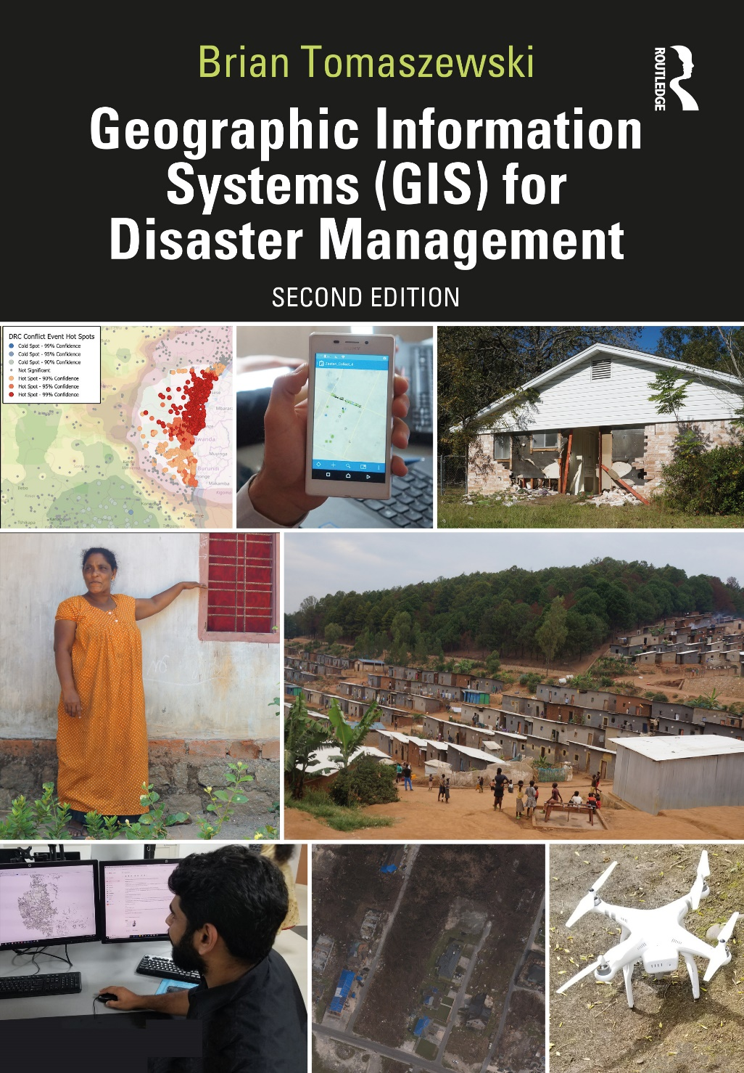
Chapter 7 Geographic Information Systems and Disaster Response for additional materials, see: http://gisfordisastermanagement.com/ Recommended Citation: Tomaszewski, B. 2020. Chapter 7: Geographic Information Systems and Disaster Response. In: Geographic Information Systems for Disaster Management (Second Edition), pp. 287-320. Oxfordshire and New York: Routledge.
Notes:
V1.2

Slide 2
Chapter 7 Objectives
Understand the basics about disaster-response policy in the United States
Be familiar with concepts related to international disaster response laws, rules, and principals (IDRL)
Discern various geographical aspects of situation awareness
Understand what spatial data deluge means and identify various geographic information systems (GIS) techniques for handling spatial data deluge during a disaster response
Understand basic concepts related real-time GIS and Internet of Things (IoT) for disaster management
Be familiar with concepts related to disaster-response GIS product development
Understand how GIS can be used for disaster-response damage-assessment tasks
Be familiar with various GIS technology used for field data collection
Identify opportunities for and barriers to incorporating the public and volunteers in disaster-response mapping through crisis mapping

Slide 3
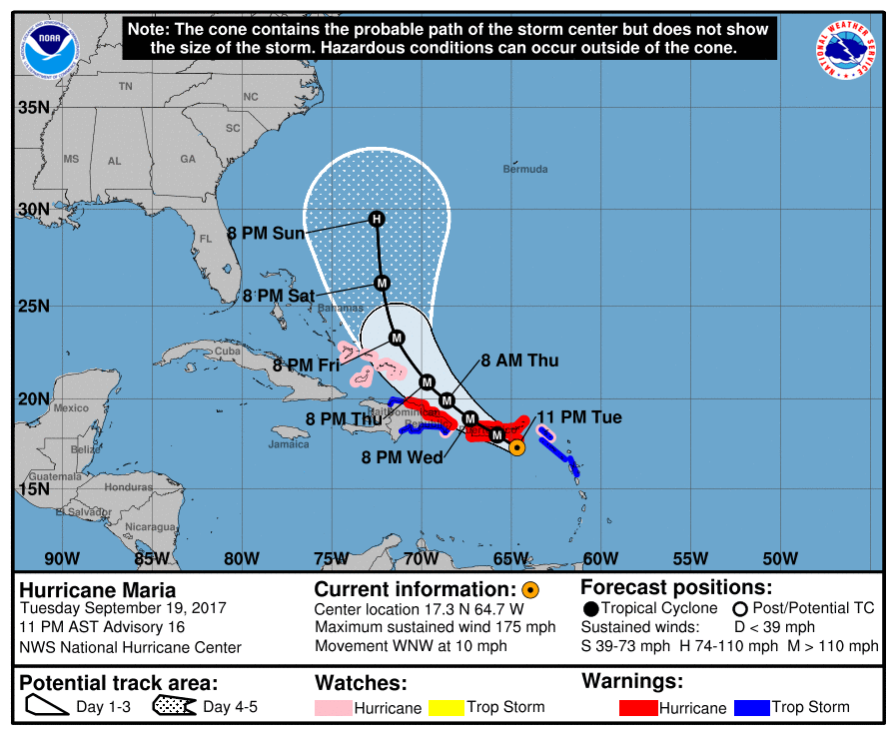
Introduction
Disaster response: perhaps most widely known disaster management cycle phase
Most publicly visible use of GIS and mapping: news media
Images of large command centers and emergency operations centers: large screens/maps/ situation awareness and coordination activities
Hurricane Maria tracking map from 2017. Maps like this are commonly used to portray disaster situations as they unfold and serve to inform and alert disaster responders and the public about oncoming disasters. Image source: Public Domain, www.nhc.noaa.gov/archive/2017/MARIA_graphics.php

Slide 4
Disaster-Response Policy in the United States: National Response Framework (NRF)
“a guide to how the Nation responds to all types of disasters and emergencies” (United States Department of Homeland Security 2016, i)
NRF defines 15 core response capabilities
Many spatial in nature: transportation, infrastructure, and situation assessment
GIS is explicitly mentioned as an integrating technology: “.. functionality provided by geographic information systems can be applied across multiple response core capabilities..” (United States Department of Homeland Security 2016, 27)

Slide 5
International Disaster-Response Laws, Rules, and Principles (IDRL)
Guide improvement of international humanitarian frameworks that guide humanitarian assistance in disaster zones (Haider 2013)
Not a comprehensive or unified framework
GIS perspective: technology assistance and geographic information data sharing between host countries and outside specialist groups

Slide 6
Geographical Aspects of Situation Awareness
Time-sensitive nature of disaster response: maps and other spatial support devices kept up to date in an evolving situation
Generate disaster-response GIS products readable and consumable for relevant audiences that need them

Slide 7
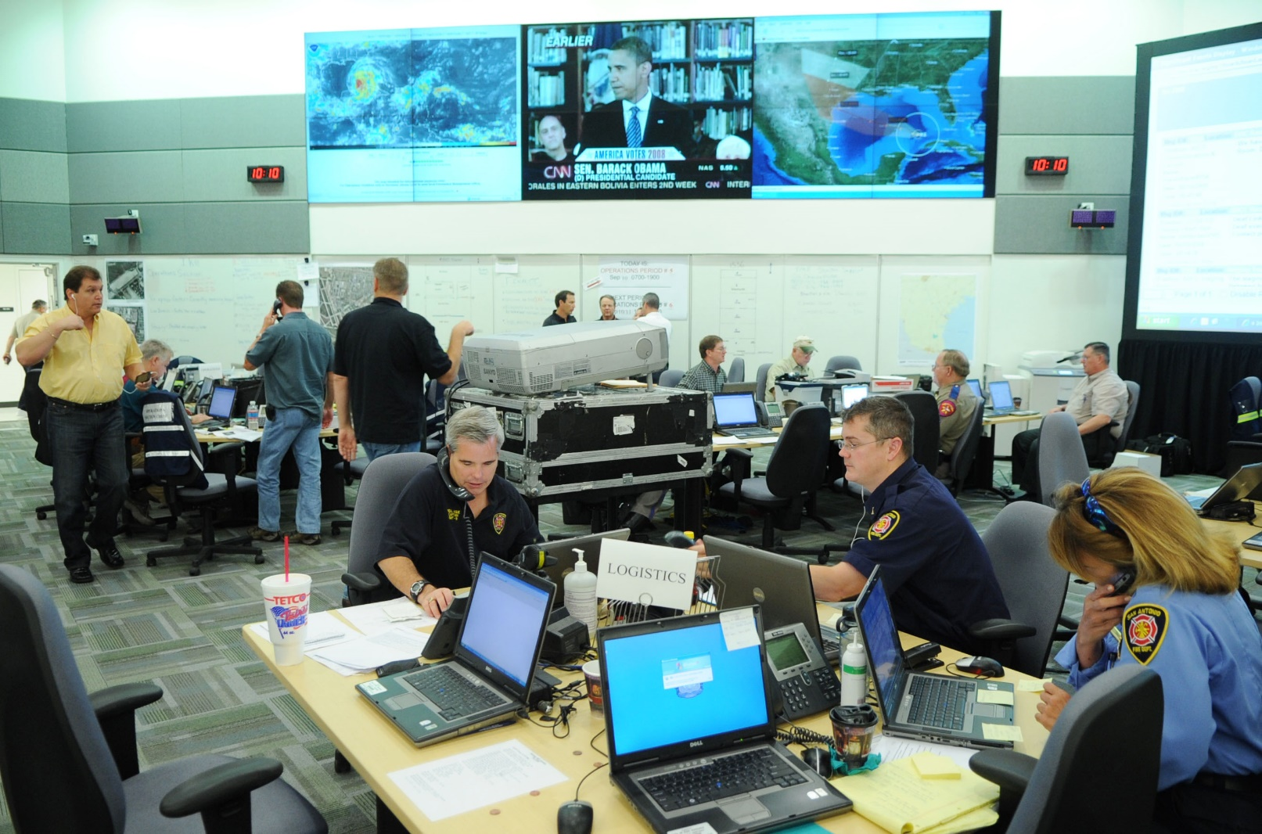
Maps and Emergency Operation Centers
Example of Incident Command System (ICS) (Chapter 5)
Two large monitors top center of the image: displaying real-time maps of the hurricane’s progress
EOC: dedicated GIS supervisor or analyst tasked with providing real-time updates
An emergency operations center (EOC). (Source: Public Domain.)

Slide 8
GIS and Disaster Warnings
Between disaster planning and disaster response: map provide public with spatial representations of disaster warnings that can provide the initial disaster-response situation awareness
Smartphones, tablet computers, and other technologies: people connected together in real time - weather information, real-time earthquake information, news feeds, and social media posts
Evacuation orders

Slide 9
Spatial Data Deluge
Overall volume of digital, spatially referenced data/disaster-response coordination: overwhelming, data cannot be processed/acted upon/actionable
Routine problem in large disasters
Aggregate data by identifying potential clusters of data that are of interest

Slide 10
Thematic Maps
Chapter 2
Oldest examples of handling large volumes of geographic data – class breaks/aggregated data
Choropleth maps, proportional symbol maps, and isarithmic maps
Exercise 2-2: Basic Thematic Map-Making with GIS Software

Slide 11
Density Mapping or “Heat Mapping”
Defining areas based on the density or count of features
Not the same as hot spot mappings (see Chapter 6)
Understanding where patterns are emerging from large data input volumes
Point density mapping of 311 calls related to flooding in Houston, Texas, during 2017’s Hurricane Harvey. Darker shades represent higher and lighter shades lower 311 call volume. Note that multiple 311 might be located on single point as per the nature of how 311 calls are logged, thus creating higher density. Maps by Brian Tomaszewski.

Slide 12
Real-Time GIS and Internet of Things (IoT)
Real-time GIS: Spatial data/inputs incorporated into a GIS for decision-making as soon as the data themselves have been created
Internet of Things (IoT): connection of sensors, hardware, virtual devices, and other “everyday” devices through networks and the Internet (Wortmann and Flüchter 2015)
Hypothetical example of combining various real-time data streams and IoT devices for real-time GIS disaster response. Figure by Brian Tomaszewski

Slide 13
Disaster-Response GIS Products
A disaster-response GIS product framework. Figure by Brian Tomaszewski.

Slide 14
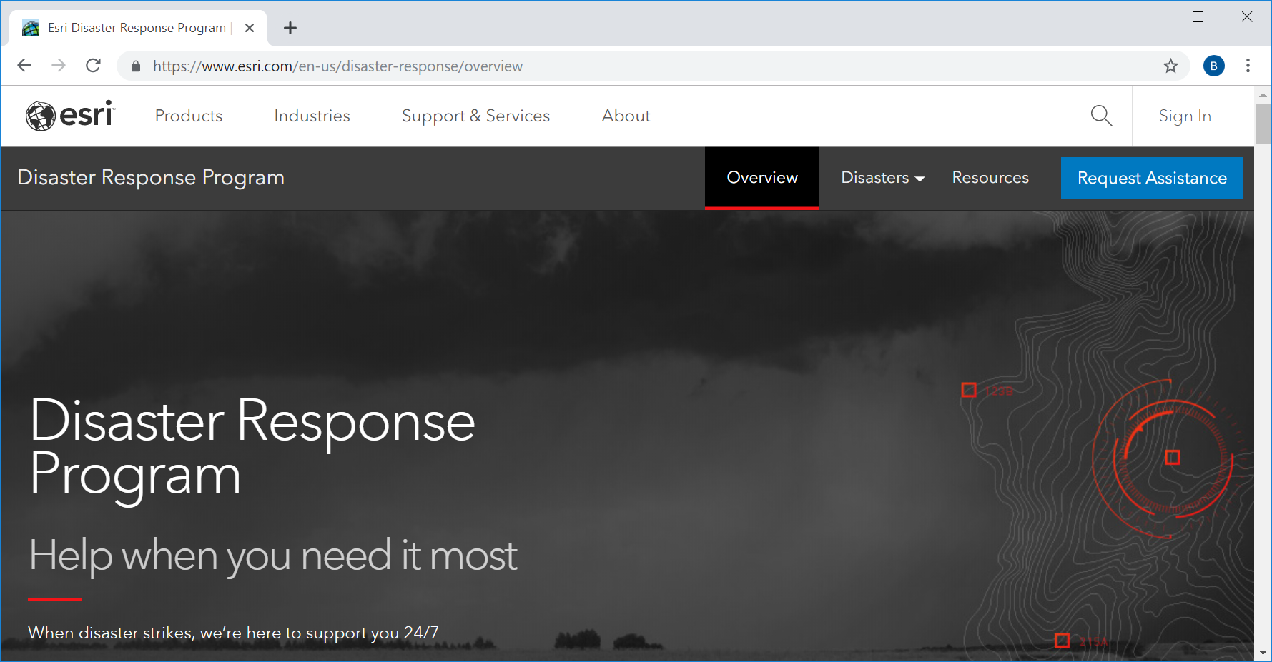
Online Disaster-Response Geographic Data Streams
Google Crisis Response team (https://crisisresponse.google): SOS Alerts in Search
Google Crisis Map: http://google.org/crisismap/weather_and_events
Google Person Finder: https://google.org/personfinder/
Facebook Crisis Response service: www.facebook.com/about/crisisresponse/
The Esri Disaster Response Program – www.esri.com/en-us/disaster-response/overview. Copyright © 2019 Esri and its licensors. All rights reserved.

Slide 15
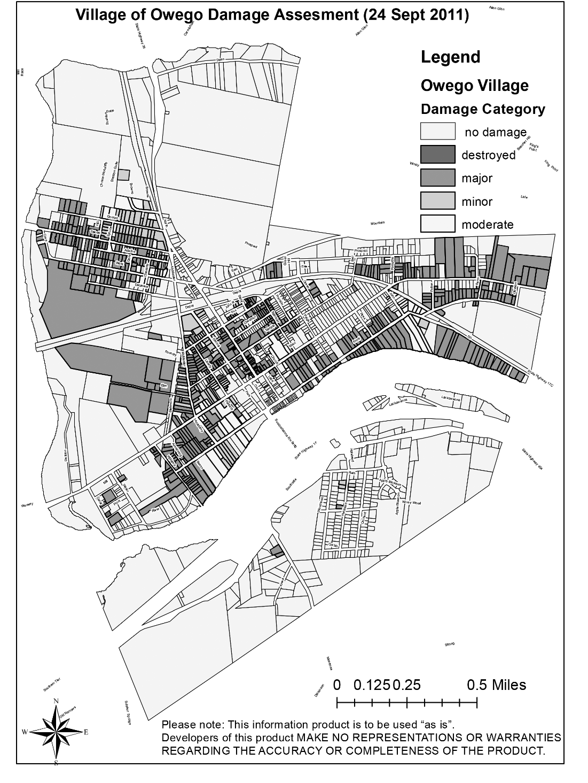
GIS and Damage Assessment
Collecting data on the level of destruction, causalities, and other factors during a disaster to gauge the level of response and recovery needed
A flood damage assessment map of building damage levels. This map was created during a 2011 flooding incident in Owego, New York, and is representative of the kind of mapping done for damage assessment. Map by Brian Tomaszewski.

Slide 16
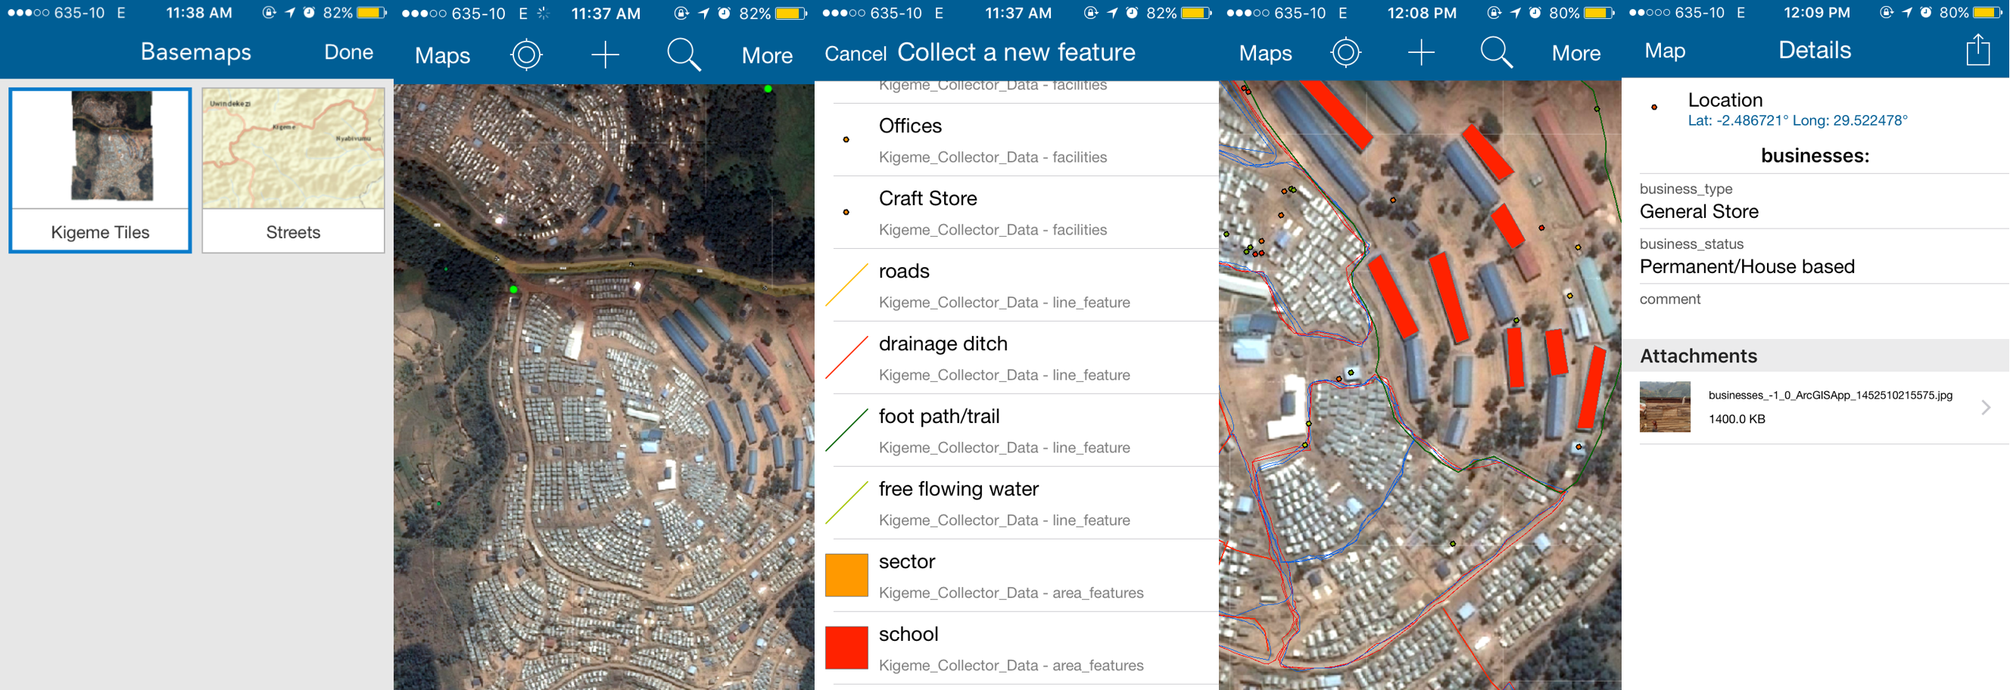
Field Data Collection and Mobile GIS
Examples of ArcGIS Collector for refugee camp field mapping. Screenshot copyright © 2019 Esri and its licensors. All rights reserved.

Slide 17
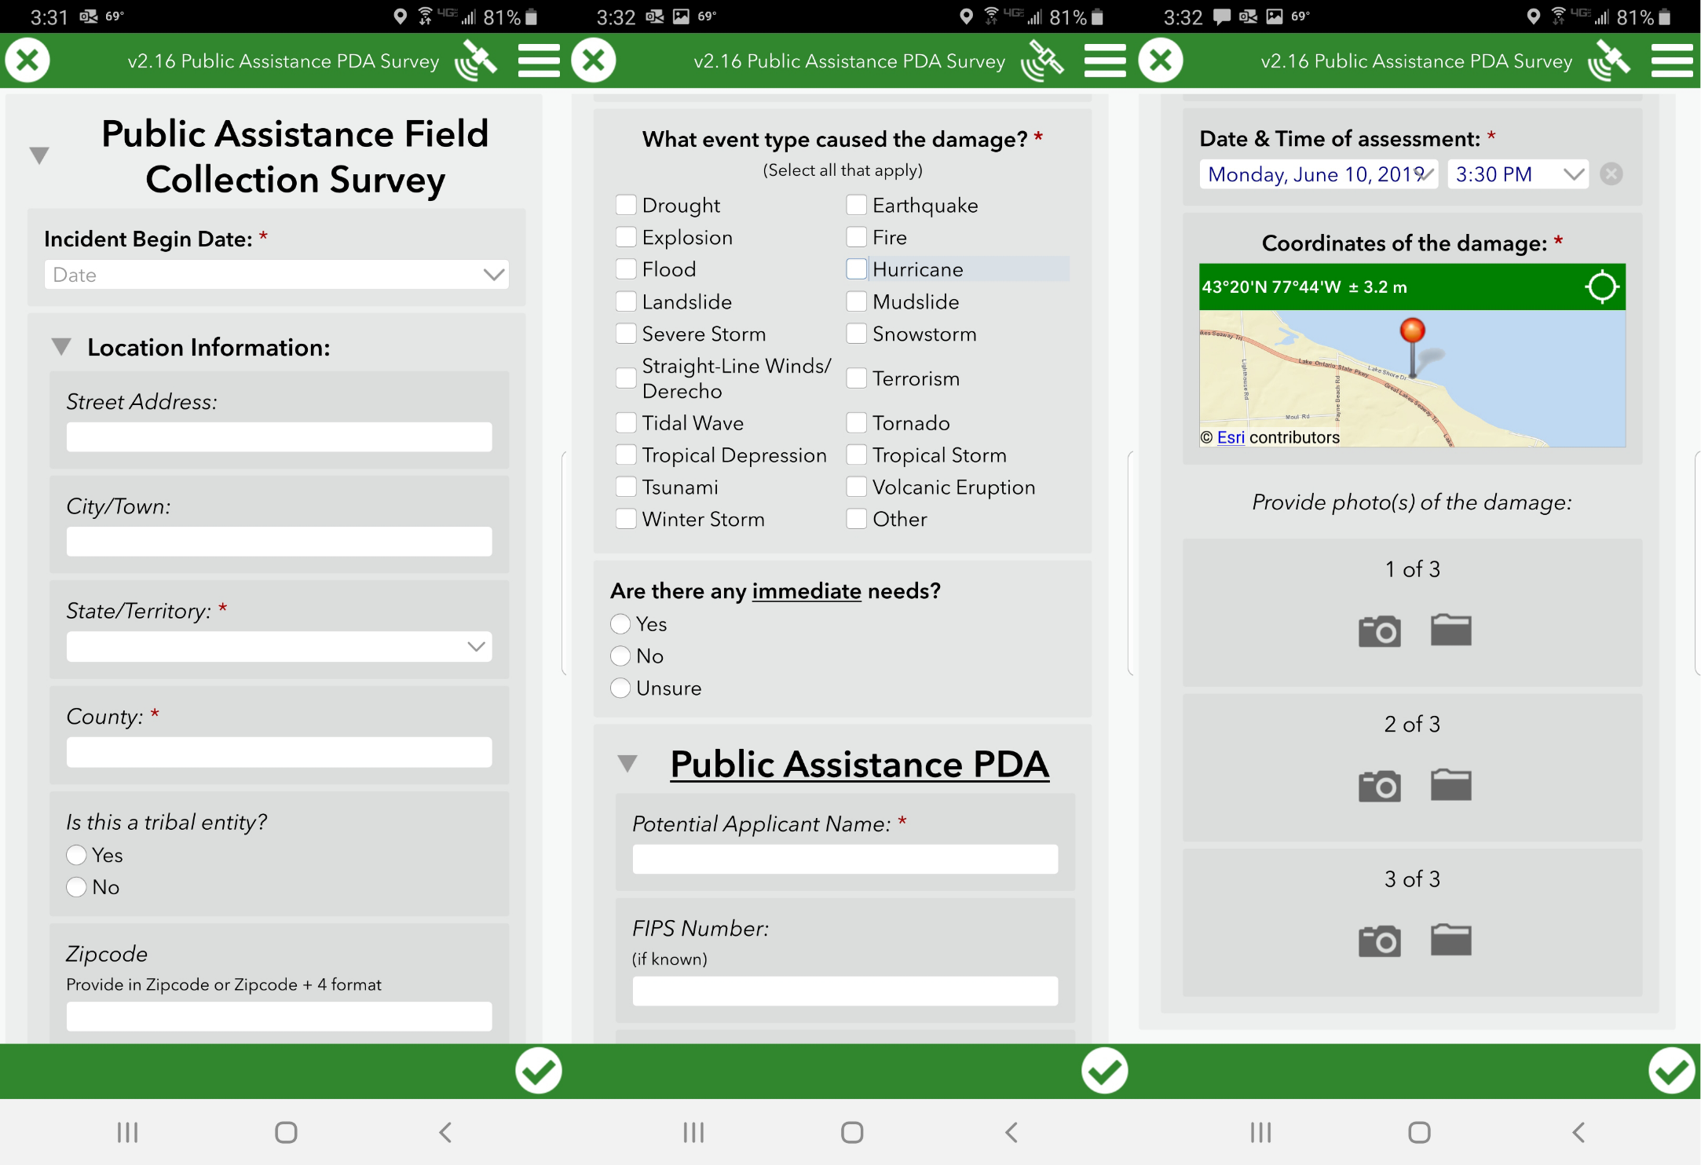
Field Data Collection and Mobile GIS
Sample screenshots of the FEMA Public Assistance Preliminary Damage Assessment Forms inside Esri’s Survey123 App. Screenshot copyright © 2019 Esri and its licensors. All rights reserved.

Slide 18
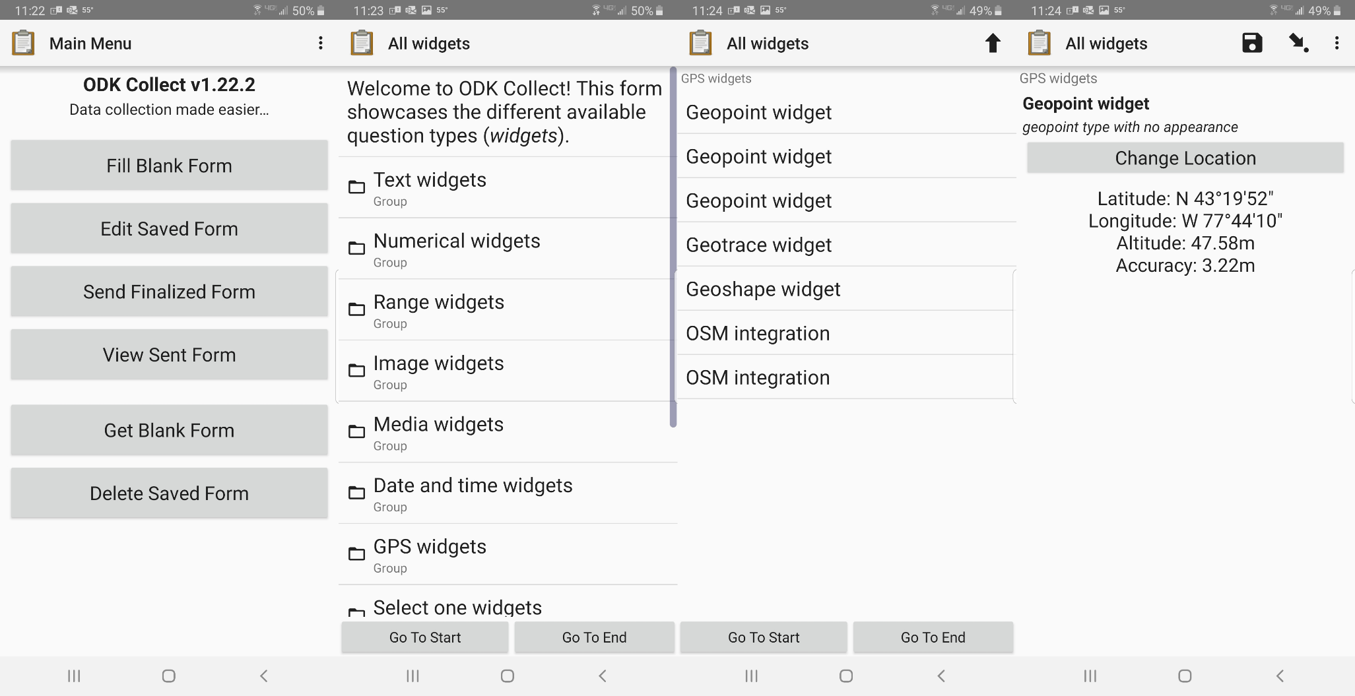
Field Data Collection and Mobile GIS
Open Data Kit (ODK) Collect screen and location widgets.

Slide 19
The Public and Disaster-Response Mapping: Crisis Mapping and Citizen Reporting
“Crisis mapping”: nonprofessional disaster management people involved in disaster response
Online, crowd-sourced mapping
Important role in international crisis situations: lack of on-the-ground media coverage/restrictive government control of information - information gaps
Drawbacks: reliability and verifiability of information collected
Ushahidi: https://www.ushahidi.com

Slide 20
Summary
Disaster-response policy in the United States and GIS
International disaster-response laws, rules, and principles (IDRL)
Geographical aspects of situation awareness
Spatial data deluge:
“Heat” mapping
Real-time GIS and Internet of Things (IoT) for disaster response
Disaster-response GIS product development
Corporate IT world and disaster response
Mobile GIS capabilities for field data collection
Role of the public in disaster-response mapping

Slide 21
Discussion Questions
Refer back to the 15 core response capabilities outlined in Table 7.1. Look through each of those core capabilities, and come up with specific GIS tasks and scenarios that you could imagine being used to support the specific capability, for example, developing a transportation GIS database that could be used to support core functionality 4 (critical transportation). As always, you are encouraged to think spatially about how GIS can be used as a support device to engage spatial aspects of these core response capabilities. Use the Internet or other research tools at your disposal to find specific case studies of GIS applications for disaster response that might fit the core response capability that you are investigating to help ground your ideas in a real-world context, or perhaps form the basis for new original research you might conduct.
Use the Internet to find information about your local emergency management services, and see if you can determine if your town, county, city, or state has its own EOC. Contact your local officials to see if they would give you a tour of the EOC and find out how they use GIS to support EOC activities.
Besides the example of wildfires given in the GIS and Disaster Warnings section, what other kinds of specific natural hazards can you think of that would have a sensitive evacuation order trigger point? Based on the natural hazard you think of, what kind of GIS model might you develop to determine when exactly to issue an effective disaster warning or evacuation order that people will believe and trust?

Slide 22
Chapter 7 Exercises
Exercise 7.1 – 311 Hurricane Harvey Call Data Heat Mapping with Kernel Density
Develop heat maps related to a disaster-response event
A video walkthrough tutorial of this exercises is available from the book’s companion website: http://gisfordisastermanagement.com

Slide 23
References Used in the Slides
Haider, H. International Legal Frameworks for Humanitarian Action: Topic Guide . Birmingham, UK: GSDRC, University of Birmingham, 2013.
United States Department of Homeland Security. National Response Framework. 3rd ed. Washington, DC: National Incident Management System, 2016.
Wortmann, Felix, and Kristina Flüchter . “Internet of Things.” Business & Information Systems Engineering 57, no. 3 (2015): 221–224.

