Slide 1
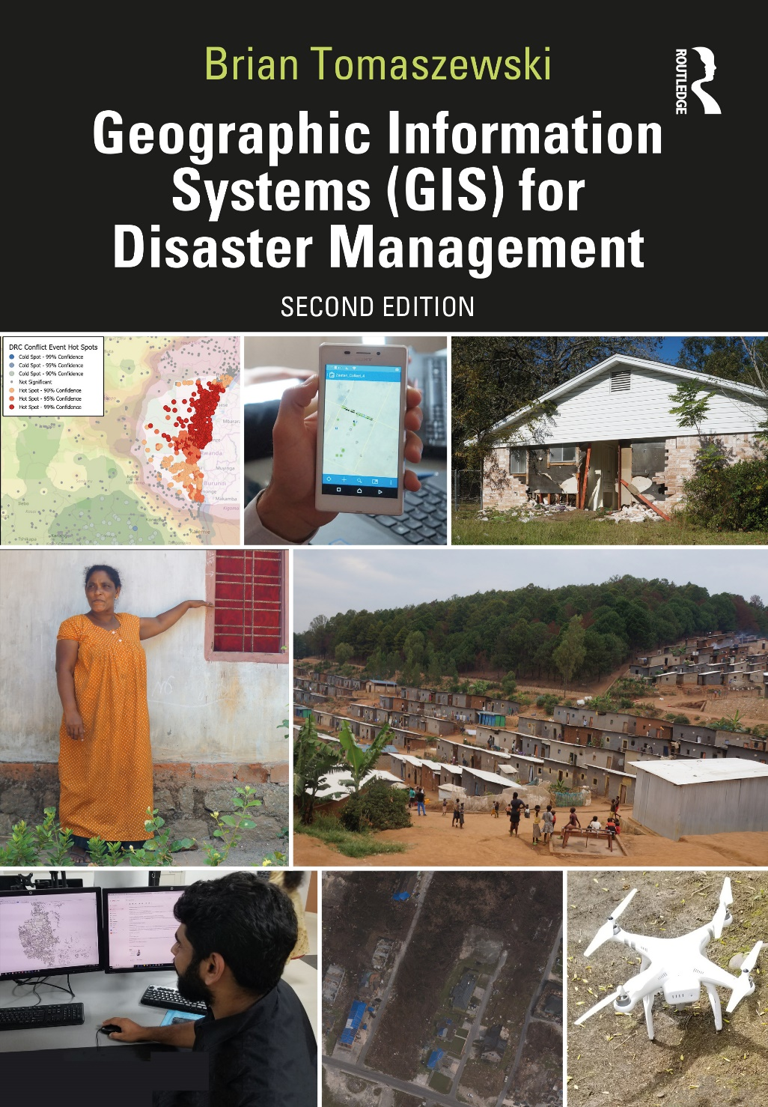
Chapter 4 Geographic Information Systems and Allied Technologies for additional materials, see: http://gisfordisastermanagement.com/ Recommended Citation: Tomaszewski, B. 2020. Chapter 4: Geographic Information Systems and Allied Technologies. In: Geographic Information Systems for Disaster Management (Second Edition), pp. 153-192. Oxfordshire and New York: Routledge.
Notes:
V1.2

Slide 2
Chapter 4 Objectives
Describe (1) the different segments of GPS, (2) the basic ideas of how GPS provides a location on the earth’s surface, and (3) causes of GPS receiver inaccuracy and methods for improving GPS receiver accuracy
Explain basic principles of Unmanned Aerial Systems (UAS) for emergency management
Identify legal and privacy issues with UAS
Describe basic principles of remote sensing
Identify commonly used remote-sensing products
Describe international disaster management remote-sensing mechanisms
Describe important ideas with indoor navigation

Slide 3
Introduction
Four allied technologies and concepts:
Global Positioning Systems (GPS)
Unmanned Aerial Systems (UAS) or “drones”
Remote-sensing
Indoor navigation and positioning
International and other support mechanisms: remote sensing for disaster management applications
Indoor navigation and positioning

Slide 4
Global Positioning Systems (GPS)
Fundamentally linked with GIS
Important to have a basic understanding of how GPS works in a disaster management context
Use GPS effectively: troubleshoot GPS problems

Slide 5
GPS Basics
Definition: the system to calculate the position or coordinate on the earth’s surface
Three segments:
Space segment
Control segment
User segment

Slide 6
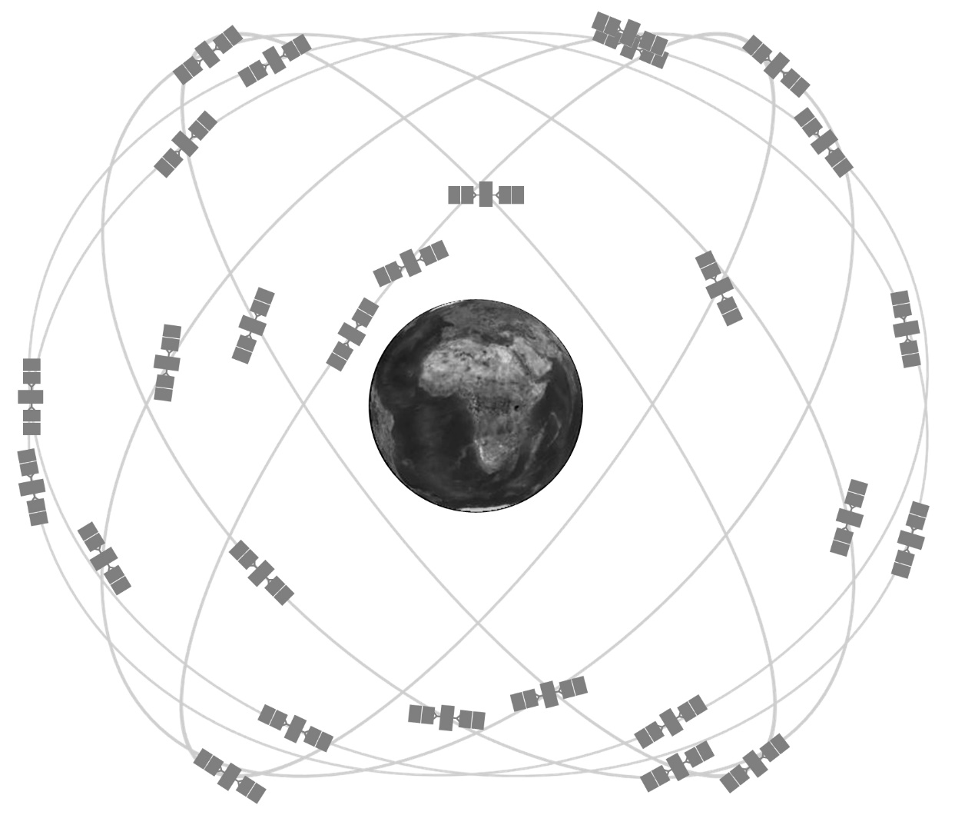
Space Segment
Satellites operated by the USA: constellation of at least 24 satellites
Follows one of six distinct orbits around the earth at a distance of 20,200 km (12,550 miles)
Satellite circles the earth in 12 hours: visible any time/anywhere on the earth
Satellites continually broadcasting codes to GPS receivers
The GPS satellite constellation. Figure from: GPS.gov [2018], Public Domain.

Slide 7
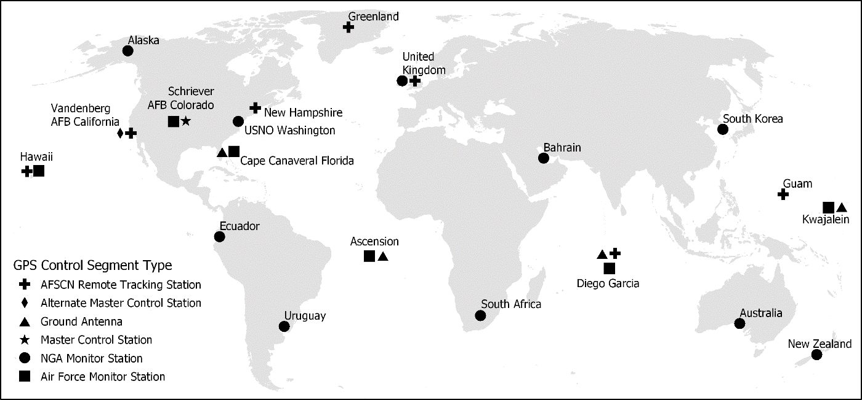
Control Segment
Global network of ground facilities:
Track GPS satellites
Monitor their transmissions
Perform analyses
Send commands and data to the constellation
The GPS control segment. Map by Brian Tomaszewski based on GPS.gov [2018]

Slide 8
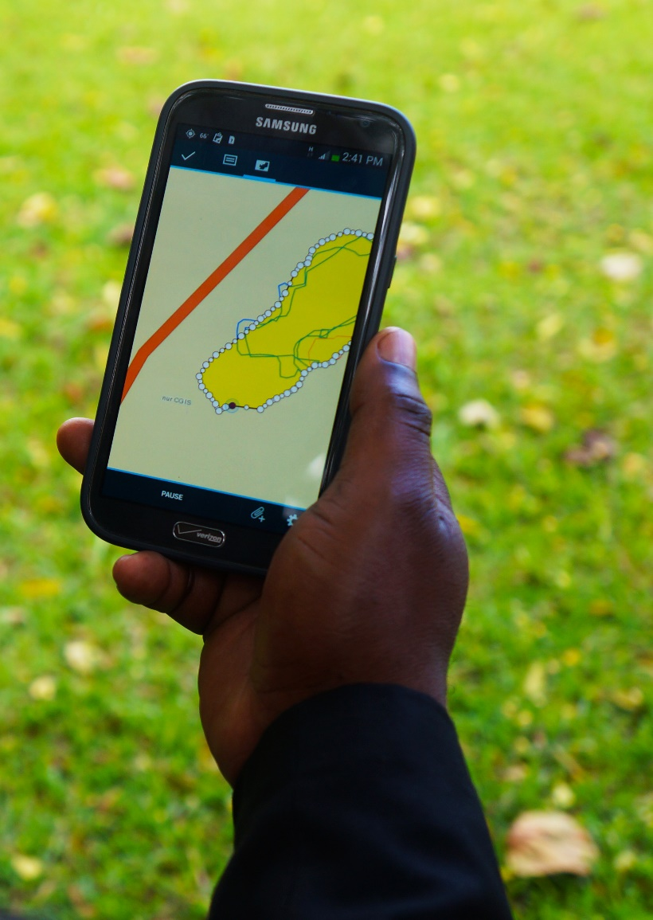
User Segment
Many applications of GPS technology in everyday use
GPS: “invisible technology” - integrated into daily life
Hardware devices: GPS receivers - not GPS unto themselves
Use of GPS on a smartphone mapping application. The ubiquitous integration of GPS receivers into smartphones has created numerous opportunities to incorporate GIS and GPS into mobile field mapping applications. Photo by Brian Tomaszewski.

Slide 9
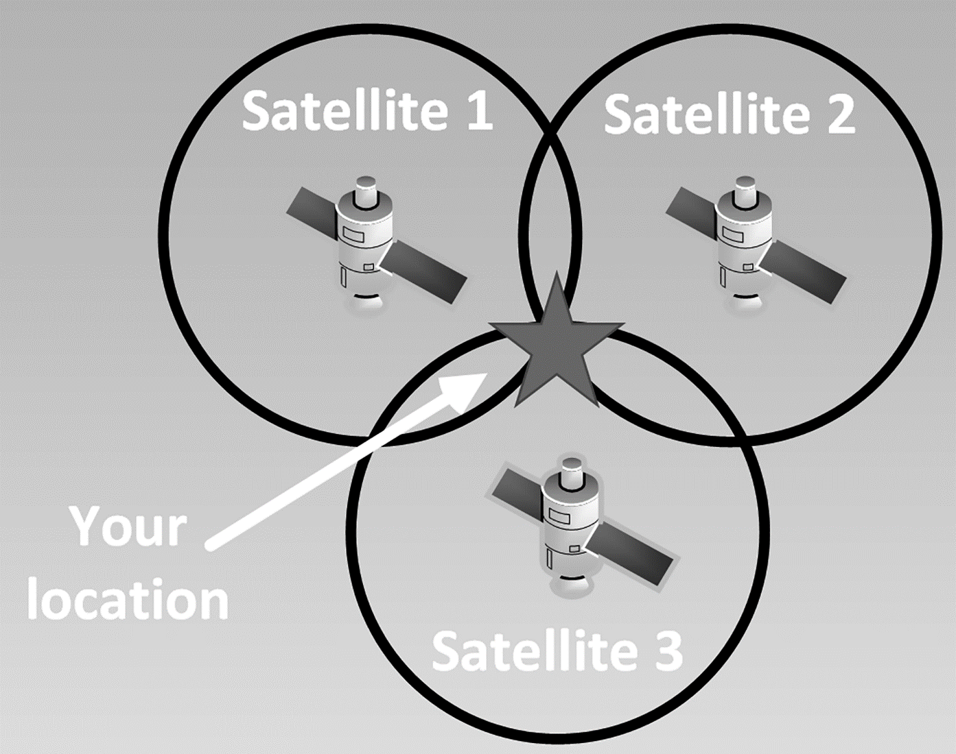
How GPS Works
GPS is a ranging system: trilateration
Trilateration: finding the location of a point using distances based on the geometry of shapes (circles) or GPS receivers, spheres
GPS receivers determine their positions based on trilateration or the intersections of at least three imaginary spheres at known distances from a GPS receiver. Figure by Brian Tomaszewski.

Slide 10
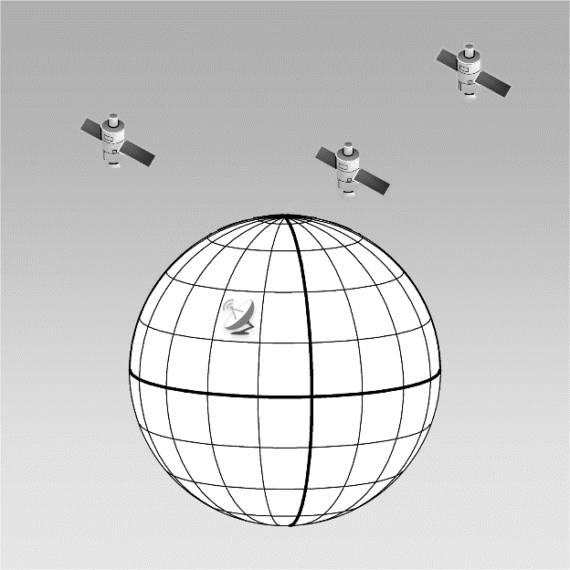
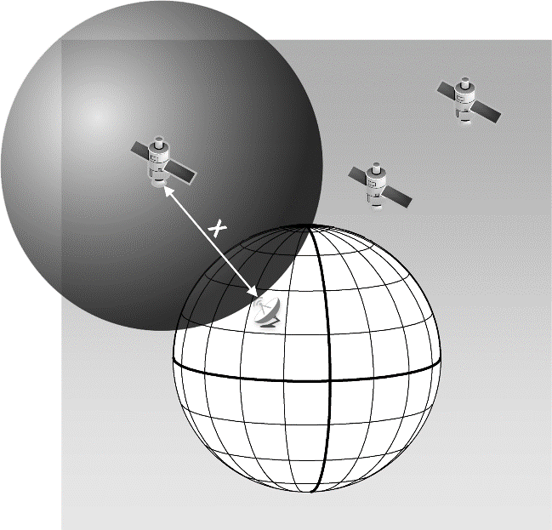
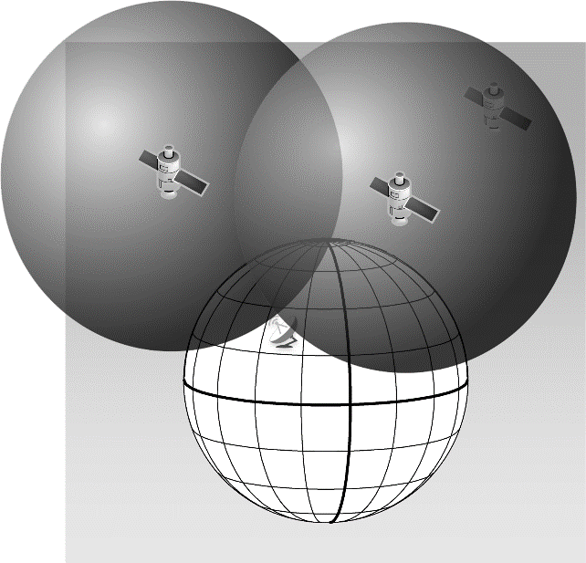
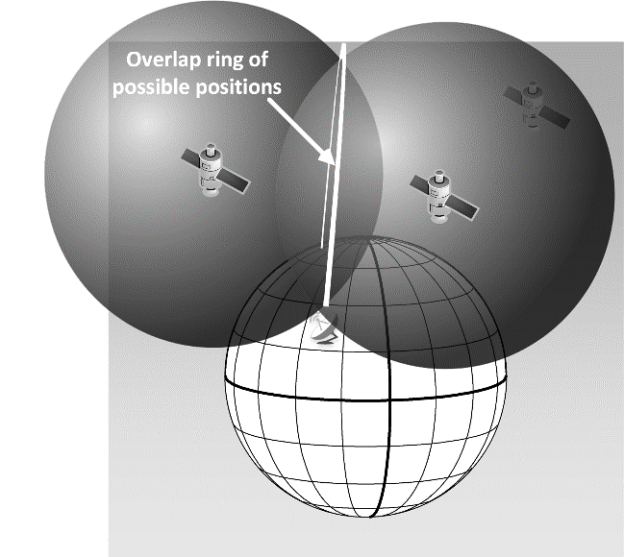
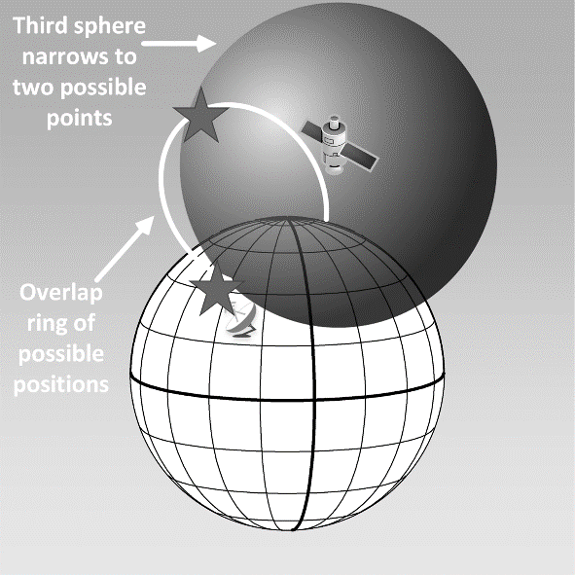
GPS Steps
Step 1: Need three satellites to obtain a position
Step 2: Determine satellite/receiver distance, imaginary sphere
Step 3: Narrowing position to two imaginary spheres
All figures
by Brian Tomaszewski.
Step 4: Sphere overlap defines possible positions
Step 5: Final position: ranging from a third satellite made

Slide 11
GPS Accuracy and Causes of GPS Inaccuracy
GPS receivers:
Low-end or recreational grade: cost US$100–400, accuracy of 10–20 feet or 3–15 meters
Mapping grade: cost US$1,000–10,000, accuracy of 5–15 feet or 2–5m and can do sub-meter real-time, centimeter accuracy with post-processing
Survey-grade: cost US$10,000–25,000; sub-meter to centimeter real-time, sub-centimeter accuracy with post-processing

Slide 12
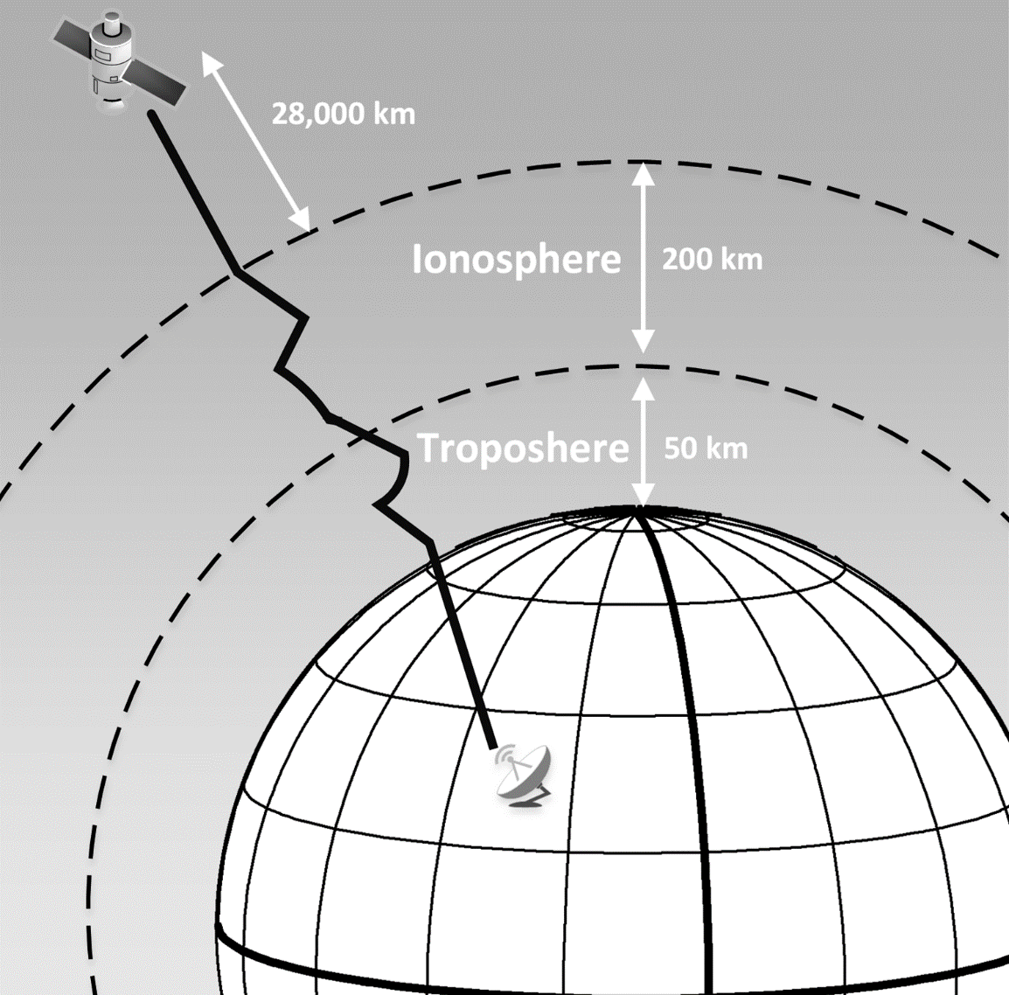
GPS Accuracy and Causes of GPS Inaccuracy
Atmosphere delay: satellite signal bounces around traveling through the ionosphere and the troposphere.
Figure by Brian Tomaszewski.

Slide 13
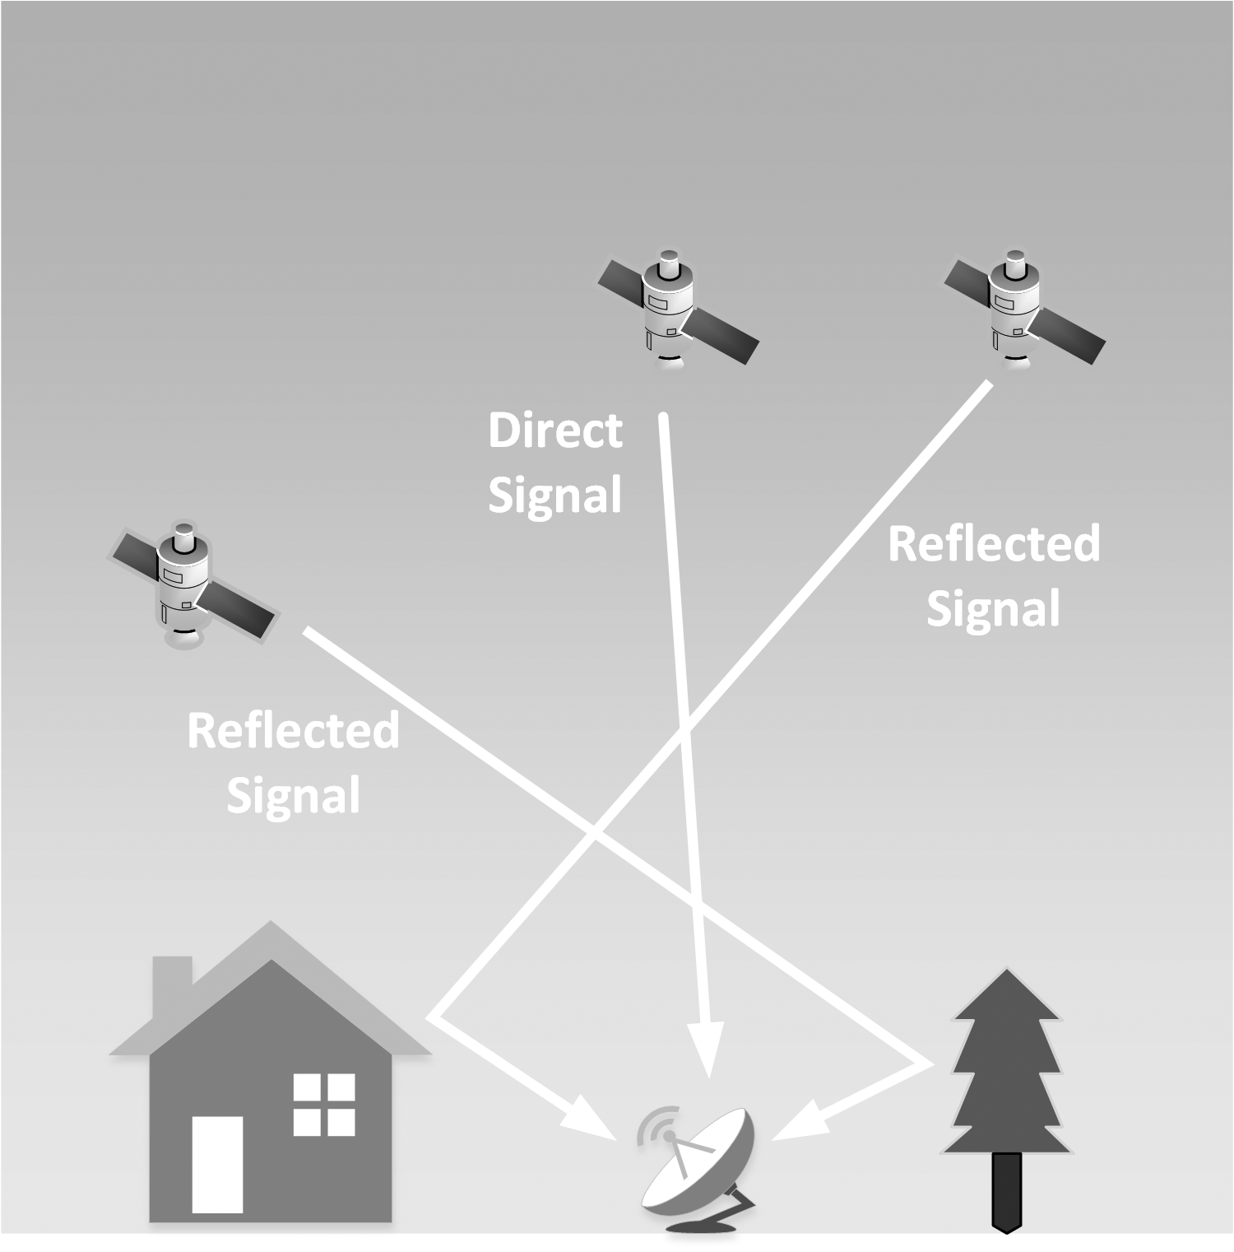
GPS Accuracy and Causes of GPS Inaccuracy
Multipath error: GPS signal reflected off objects before reaching the receiver
Figure by Brian Tomaszewski.

Slide 14
GPS Signal Correction
Differential correction: Compare GPS receiver data with well-known point location
Wide Area Augmentation System (WAAS): augment GPS receivers with precise locational information

Slide 15
GPS and GIS
Used in conjunction with one another
Data collection: mission planning
Disaster management example:
list of terms to describe levels of damage
satellite availability
post-processing
compiling other datasets

Slide 16
GPS in Disaster Management
GPS: industry standard for disaster management
Diverse applications:
recording locations of damaged buildings, power lines and trees
locations of fire
tracking how potential earthquakes may be developing due to tectonic straining

Slide 17
Unmanned Aircraft Systems or “Drones”
Fundamental paradigm shift: how data collected in real time and by a wider variety of disaster management stakeholders
Disaster management professionals to the general public

Slide 18
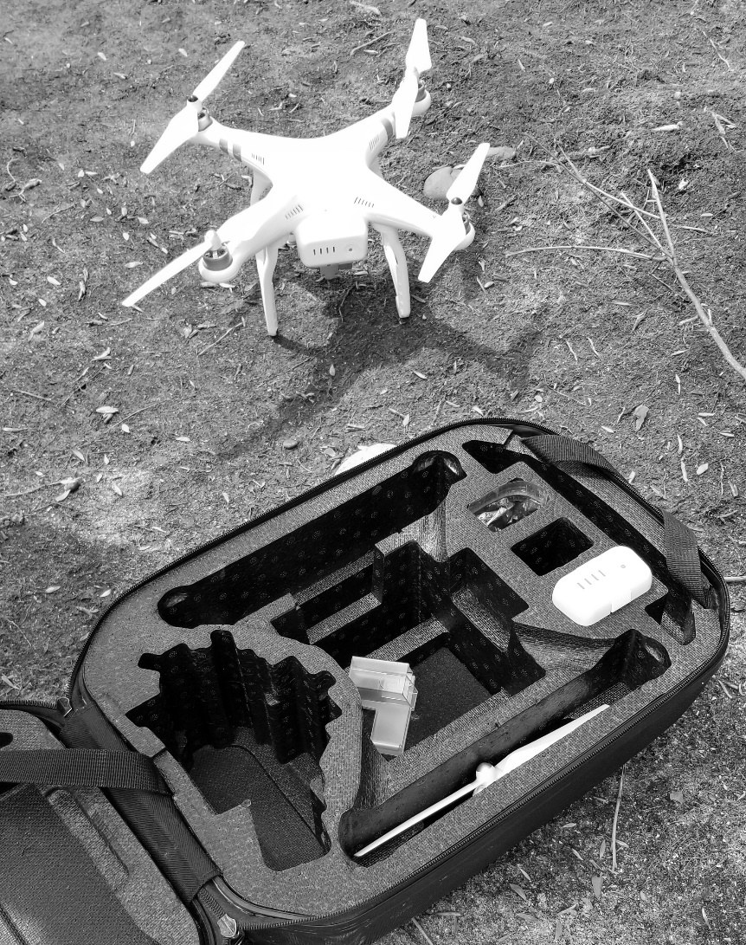
What Are UAS?
“An unmanned aircraft system (UAS), sometimes called a drone, is an aircraft without a human pilot onboard – instead, the UAS is controlled from an operator on the ground” (Federal Aviation Administration 2018).
A DJI Phantom drone being used to map lake silting. This particular unit cost US$600 in 2019 and includes features such as an integrated camera and GPS-based navigation support. Photo by Brian Tomaszewski.

Slide 19
UAS Common Features
Consumer-grade:
high-quality, integrated camera
robust batteries
integrated GPS support
platform-specific apps as well as customizable application programming interfaces (APIs)
Professional-grade:
often based on fixed-wing aircraft
longer flight times
handle greater payloads
requires specialized training and pilot licensing from the Federal Aviation Administration (FAA) (USA)

Slide 20
UAS and GIS
Like GPS: UAS vital data acquisition role for GIS
Rapid capture of high-resolution imagery
Key issues: post-processing of continuous images (orthomosaics)
Orthomosaics: images geographically referenced to their real-world positions; distortions within the images due to camera angles and other factors removed (Humphrey 2016)

Slide 21
UAS in Disaster Management
Can span all disaster management phases
Proper planning and consideration of issues: regulatory environments, privacy, feasibility, and agency coordination - vital for successful UAS disaster management implementation
Privacy: acquiring images of people and place without consent
Public perception and concerns of UAS: government surveillance (Price 2016)

Slide 22
Remote Sensing
Integral to GIS for disaster management
Remote sensing: acquisition of information about an object without being in physical contact with it
Science of acquiring, processing, and interpreting images that record the interaction between electromagnetic energy and matter

Slide 23
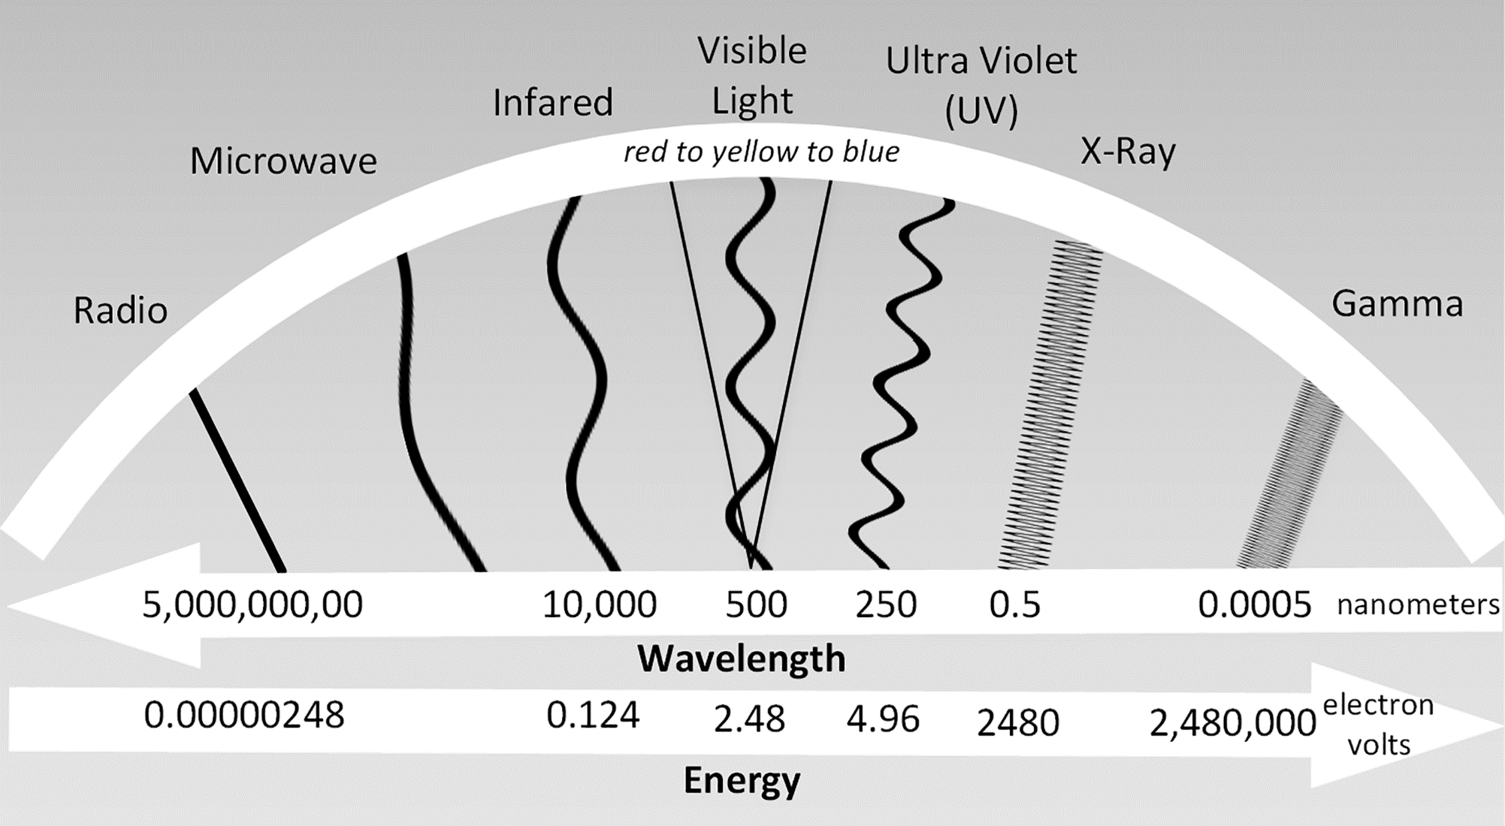
Electromagnetic Energy
The electromagnetic spectrum (EMS). Energy forms on the left side of the spectrum have longer wavelengths. Figure by Brian Tomaszewski.

Slide 24
Remote Sensing Concepts
Transmissivity: degree to which electromagnetic energy can pass through the atmosphere - example?
Spectral Response Patterns: the energy magnitude a given phenomenon emits or reflects across various wavelengths - example?

Slide 25
Remote Sensing Concepts
Spatial Resolution: measure of the fineness of detail visible in a remote-sensing image; determines the size of the smallest area that can be resolved by the sensor - example?
Spectral Resolution: sensor’s ability to discriminate fine spectral differences in terms of the smallest band or portion of the electromagnetic spectrum in which objects are discernable

Slide 26
Remote Sensing Concepts
Radiometric Resolution: how good a sensor is at measuring small differences in the magnitude, or brightness, of radiation within the ground area corresponding to a single pixel - example?
Temporal Resolution: how frequently imagery is collected over the same location or area, also known as the revisit time - example?

Slide 27
Passive and Active Remote Sensing
Passive: sun’s energy is reflected off an object for visible wavelength sensors or absorbed into and reflected back to a sensor for non-visible wavelengths like thermal infrared (Natural Resources Canada 2015) - Shortcomings?
Active: energy is emitted from a sensor to a target of interest; emitted energy is reflected and recorded (Natural Resources Canada 2015) - Benefits?

Slide 28
Change Detection
Most fundamental uses of visible remote-sensing imagery
Pixels in different images from different time periods are compared with one another
Can also operate on comparisons of varying time scales
Example of change detection in GIS disaster management: before and after disaster impact imagery such as areas impacted by floods (Eguchi et al. 2008)

Slide 29
Change Detection
Change detection of settlements in the Za’atari refugee camp. The camp received a mass influx of refugees in 2013 during the height of the Syrian conflict. The images show how the camp quickly changed in terms of open spaces and neatly aligned structures for incoming refugees (left, 17 January 2013), to the creation of new tents and movements of structures as people arrived (middle, 27 February 2013), to tents being removed and structures completely rearranged (right, 4 May 2013) when compared to their original positions on 17 January 2013. ((Tomaszewski et al. 2015, Satellite images courtesy of the DigitalGlobe Foundation.)

Slide 30
Remote-Sensing Product Examples in the Disaster Management Context
Landsat: https://landsat.gsfc.nasa.gov/
Advanced Spaceborne Thermal Emission and Reflection Radiometer Global Digital Elevation Map (ASTER GDEM): https://asterweb.jpl.nasa.gov/gdem.asp
Sentinel 1-5: https://sentinel.esa.int/web/sentinel/home
TerraSAR (Synthetic Aperture Radar)-X: https://terrasar-x-archive.terrasar.com/
Digital Globe: www.digitalglobe.com/ecosystem/open-data

Slide 31
Remote Sensing and International Disaster Management Support Mechanisms
International Charter on Space and Major Disasters: a worldwide collaboration, through which satellite data are made available for the benefit of disaster management. By combining Earth observation assets from different space agencies, the Charter allows resources and expertise to be coordinated for rapid response to major disaster situations; thereby helping civil protection authorities and the international humanitarian community. (The International Charter: Space and Major Disasters 2019). Link: https://disasterscharter.org/
United Nations Platform for Space-based Information for Disaster Management and Emergency Response (UN-SPIDER): officially mandated UN program with a mission focused on building capacity for the use of space-based information within the full disaster management cycle (Backhaus et al. 2010). Link: https://un-spider.org/

Slide 32
Remote Sensing and International Disaster Management Support Mechanisms
ZKI – Germany: German Center for Satellite Based Crisis Information (Zentrum für Satellitengestützte Kriseninformation [ZKI]): At ZKI Earth Observation data such as satellite or aerial imagery as well as geo data are acquired and analyzed in order to generate up-to-date situational awareness information before, during or after a disaster situation or in case of major events. All crisis information is produced according to the ZKI users’ requirements and provided, for instance, as maps, geo-pdf, web services or text dossiers. (Deutschen Zentrums für Luft- und Raumfahrt (DLR) n.d.). Link: https://www.dlr.de/eoc/en/desktopdefault.aspx/tabid-12937/22595_read-51635/
NASA Disasters Program: Disasters Applications area promotes the use of Earth observations to improve prediction of, preparation for, response to, and recovery from natural and technological disasters. Disaster applications and applied research on natural hazards support emergency preparedness leaders in developing mitigation approaches, such as early warning systems, and providing information and maps to disaster response and recovery teams. (National Aeronautics and Space Administration [NASA] n.d.). Link: https://disasters.nasa.gov/

Slide 33
Indoor Navigation and Positioning
Tracking locations of people or objects inside of buildings
Variety of approaches: Wi-Fi beacons, radio signals, dead reckoning, other approach that allows accurate navigation (Curran et al. 2011)

Slide 34
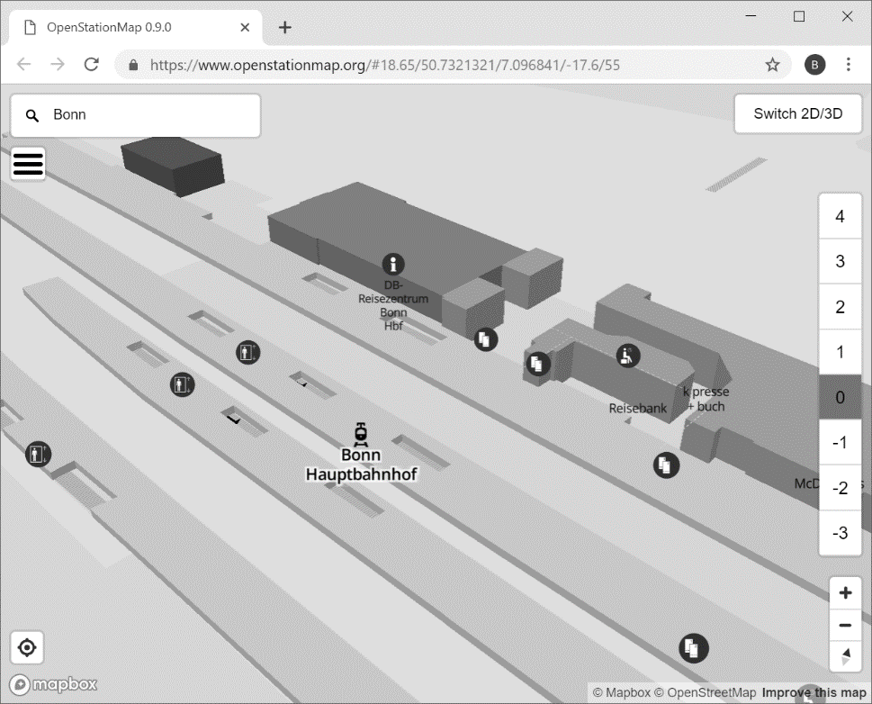
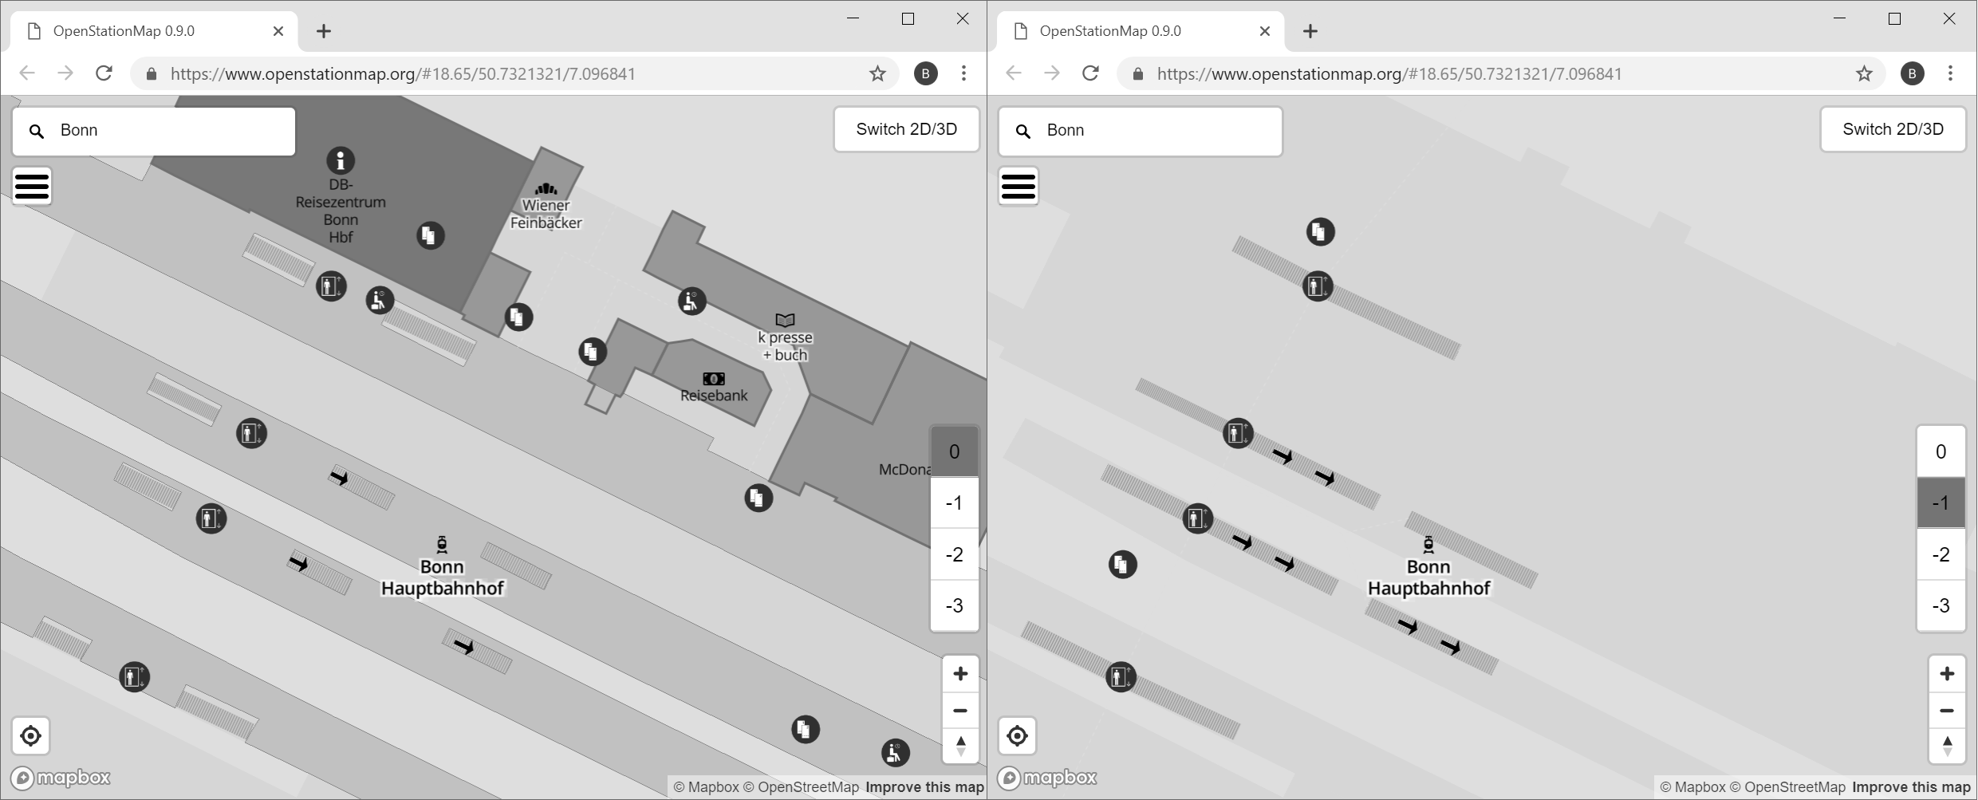
Indoor Navigation and Positioning
Digital indoor navigation tools (3D maps) more commonplace
A 3D view of the Bonn, Germany, main train station from the Open Station Map (www.openstationmap.org) project.
Comparing level 0 (left) and level –1 (right) on an indoor map (www.openstationmap.org).

Slide 35
Indoor Navigation and Positioning Research
Positioning within an indoor space: long recognized as a problem – examples?
Digital positioning indoor space approaches:
Radio tracking
Dead reckoning
Counting steps taken
Simultaneous Localization and Mapping (SLAM)
Visual markers that can be decoded by a camera
Wireless access point fingerprinting
Benefits and drawbacks?

Slide 36
Summary
Four allied technologies and concepts:
Global Positioning Systems (GPS)
Unmanned Aerial Systems (UAS) or “drones”
Remote-sensing
Indoor navigation and positioning
International and other support mechanisms: remote sensing for disaster management applications
Indoor navigation and positioning

Slide 37
Discussion Questions
1. What are the potential issues with GPS in emergency management in terms of the various segments? For example, inaccuracy problems? Equipment problems?
2. Find and discuss a UAS disaster management case study. Specifically, try and find a case study that discusses (1) benefits, (2) drawback, and (3) program implementation issues with implementing UAS for emergency management. Additionally, you need not restrict the case study to the United States. For example, UAS are more frequently used for international humanitarian operations. See https://reliefweb.int/report/vanuatu/drones-humanitarian-action-case-study-no10-using-drones-disaster-damage-assessments as an example of what you are looking for. How sustainable are the UAS approaches being used? For example, will they provide long-term solutions or will underlying program implementation issues hinder progress?
3. Find and discuss a remote-sensing emergency-management case study. Specifically, try and find a case study that discusses (1) a wide variety of imagery products for emergency management and (2) offers public imagery datasets that can be used and incorporated into GIS tools as you learned about in Chapter 3. Use the case studies from Table 4.1 as a starting point but find your own examples.
4. Look through the many charter activations on the International Charter on Space and Major Disasters website. How useful do you think the maps provided are? When looking at the maps, make a particular note of when the actual disaster occurred and when the final map products were delivered. Do you think there is too much of a time gap between the two?

Slide 38
Chapter 4 Exercises
Exercise 4.1 – Obtaining Free Remote-Sensing Imagery (Landsat) from USGS Earth Explorer
How to obtain free remote-sensing imagery that can be used in disaster management applications

Slide 39
References Used in the Slides
Curran, Kevin, Eoghan Furey, Tom Lunney, Jose Santos, Derek Woods, and Aiden McCaughey . “An Evaluation of Indoor Location Determination Technologies.” Journal of Location Based Services 5, no. 2 (2011): 61–78.
Eguchi, Ronald T., Charles K. Huyck, Shubharoop Ghosh, and Beverley J. Adams . “The Application of Remote Sensing Technologies for Disaster Management.” In Paper Read at the 14th World Conference on Earthquake Engineering, Beijing, China, 2008.
Federal Aviation Administration. Unmanned Aircraft Systems, 2018. Accessed August 15, 2018. https://www.faa.gov/uas/
GPS.gov. Control Segment, 2018a. Accessed July 9, 2018. https://www.gps.gov/systems/gps/control/
Humphrey, Devon. “Getting Started with UAS.” Arcuser 19, no. 2 (2016): 30–31
Price, Darren E. Unmanned Aircraft Systems for Emergency Management: A Guide for Policy Makers and Practitioners. Monterey, CA, USA, Naval Postgraduate School Monterey United States, 2016.
Natural Resources Canada. Temporal Resolution, 2014. Accessed February 9, 2019. https://www.nrcan.gc.ca/earth-sciences/geomatics/satellite-imagery-air-photos/satellite-imagery-products/educational-resources/9365
Natural Resources Canada. Passive vs. Active Sensing, 2015a. Accessed March 10, 2019. https://www.nrcan.gc.ca/node/14639
Natural Resources Canada. Spectral Resolution, 2015b. Accessed November 4, 2018. https://www.nrcan.gc.ca/node/9393
Tomaszewski, B., Mohamad, F. A. & Hamad, Y. 2015. Refugee Situation Awareness: Camps and Beyond. In: VIDAN, A. & SHOAG, D. (eds.) Humanitarian Technology: Science, Systems and Global Impact 2015, HumTech2015. Boston, MA.

