Slide 1
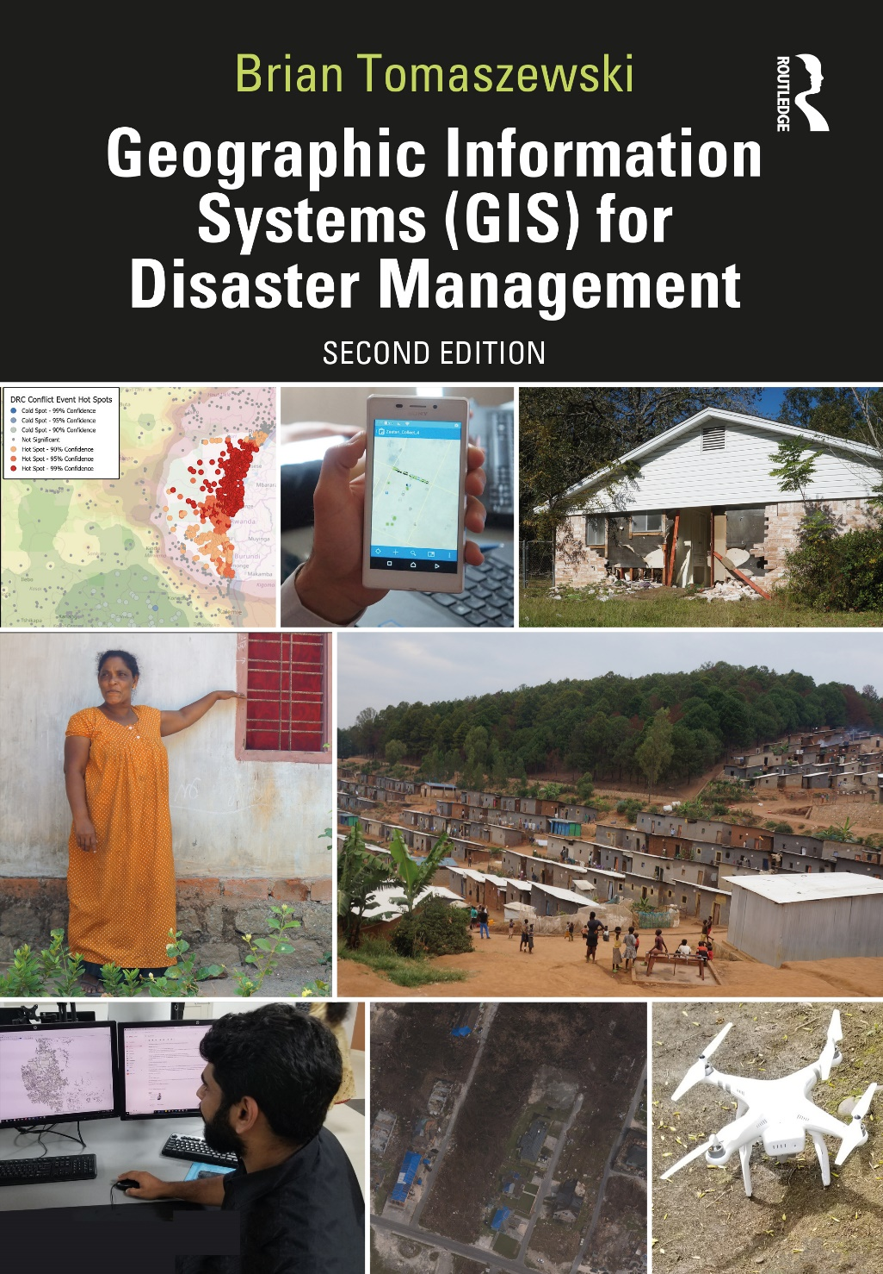
Chapter 3 Geographic Information Systems for additional materials, see: http://gisfordisastermanagement.com/ Recommended Citation: Tomaszewski, B. 2020. Chapter 3: Geographic Information Systems. In: Geographic Information Systems for Disaster Management (Second Edition), pp. 93-152. Oxfordshire and New York: Routledge.
Notes:
V1.2

Slide 2
Chapter 3 Objectives
Understand the components of GIS
Understand the concept of layers in GIS
Be familiar with common GIS functions and how they relate to disaster management
Be familiar with common GIS data storage formats
Understand some of the limitations of GIS
Understand what GIS metadata is and why it is important
Identify and discern a variety of specific GIS technologies that are relevant to disaster management

Slide 3
Introduction
Chapter formally presents Geographic Information Systems (GIS)
What a GIS is and what it can and cannot do
Most important and time -consuming aspect of working with a GIS—GIS data
Specific GIS technology (commercial, open -source, and open/web-based GIS software)
Part of the book most likely to change quickly as specific GIS technology is constantly and rapidly changing
Foundational concepts learned this chapter should serve to keep your skill and knowledge set relevant as specific GIS software products change

Slide 4
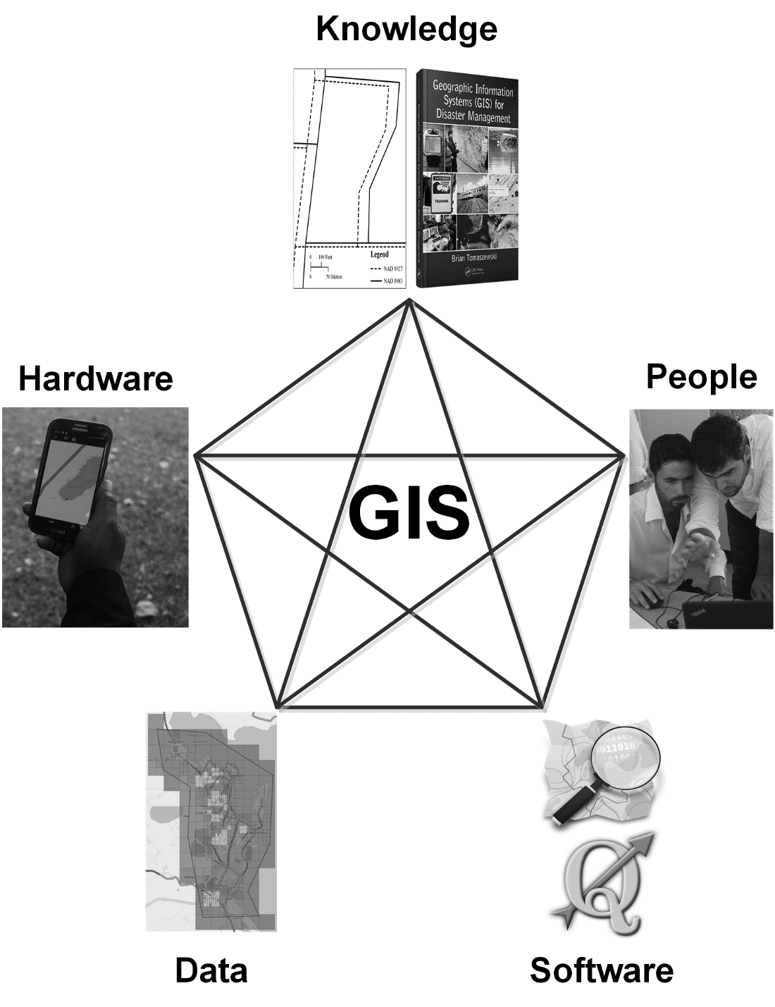
What is GIS?
System that is a whole constructed of parts:
Software
Hardware
People
Knowledge
Data
Network
Figure by Brian Tomaszewski

Slide 5
Organizing the World Geographically: Map Layers
Core power of GIS: ability to organize data into one common geographic view
GIS organization of data geographically: map layers
Overlay any number of digital map layers together: reference them to a common geography
Figure by Brian Tomaszewski

Slide 6
What Can You Do (and Not Do) with GIS software?
GIS software: Many powerful tools that can serve numerous functions

Slide 7
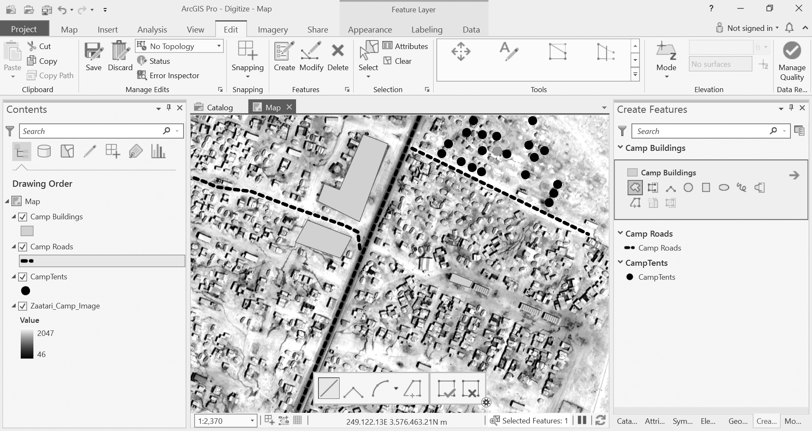
Data and Spatial Asset Management
GIS is often used to create spatially referenced data
Creation of spatial data can involve many activities such as digitizing features from images
Digitizing features from images from the Za’atari Refugee Camp. (Figure Copyright © 2019 Esri and its licensors. All rights reserved.)

Slide 8
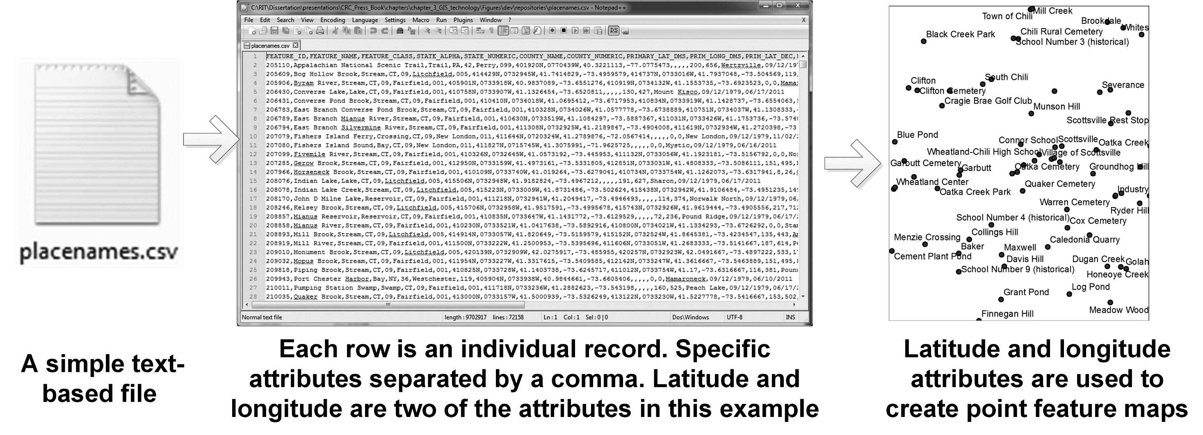
Storage Formats - CSV
Figure by Brian Tomaszewski

Slide 9
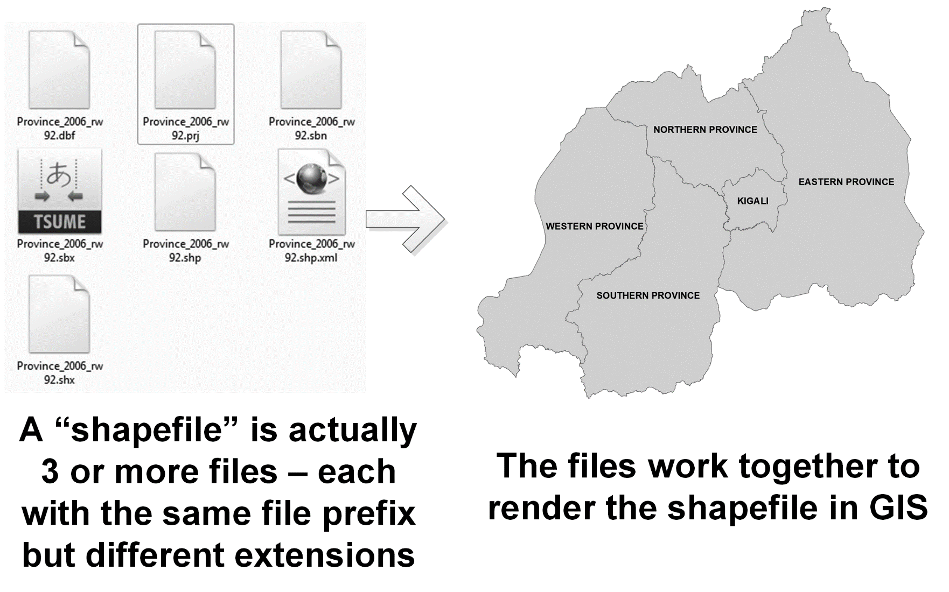
Storage Formats - Shapefile
Figure by Brian Tomaszewski

Slide 10
Storage Formats - KML
Figure by Brian Tomaszewski

Slide 11
Storage Formats - Imagery
Figure by Brian Tomaszewski

Slide 12
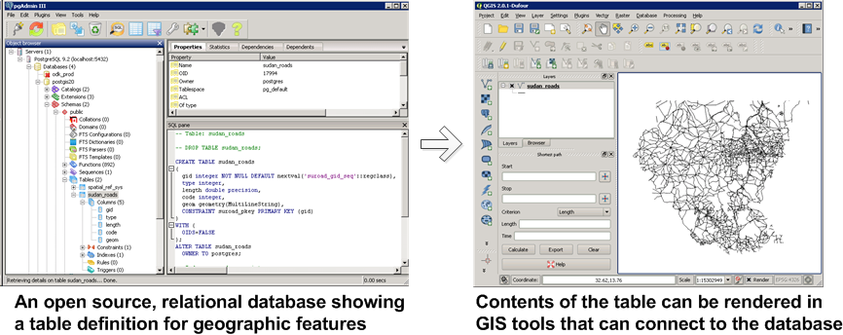
Storage Formats – Relational Database
Figure by Brian Tomaszewski

Slide 13
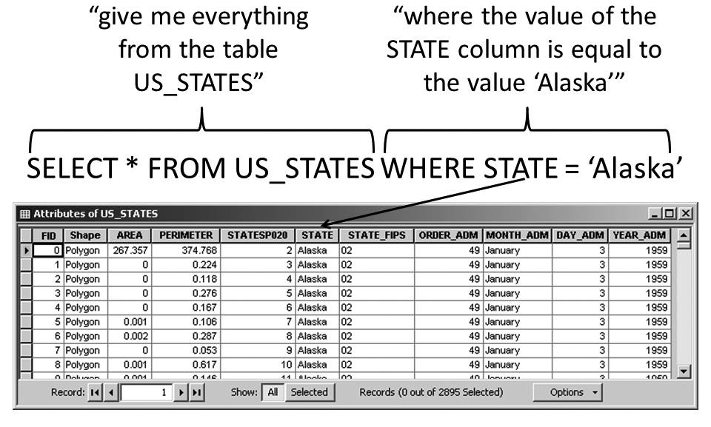
Data Querying and Table Joining
Query: asking a question of a dataset
SQL: Structured Query Language
Figure by Brian Tomaszewski

Slide 14
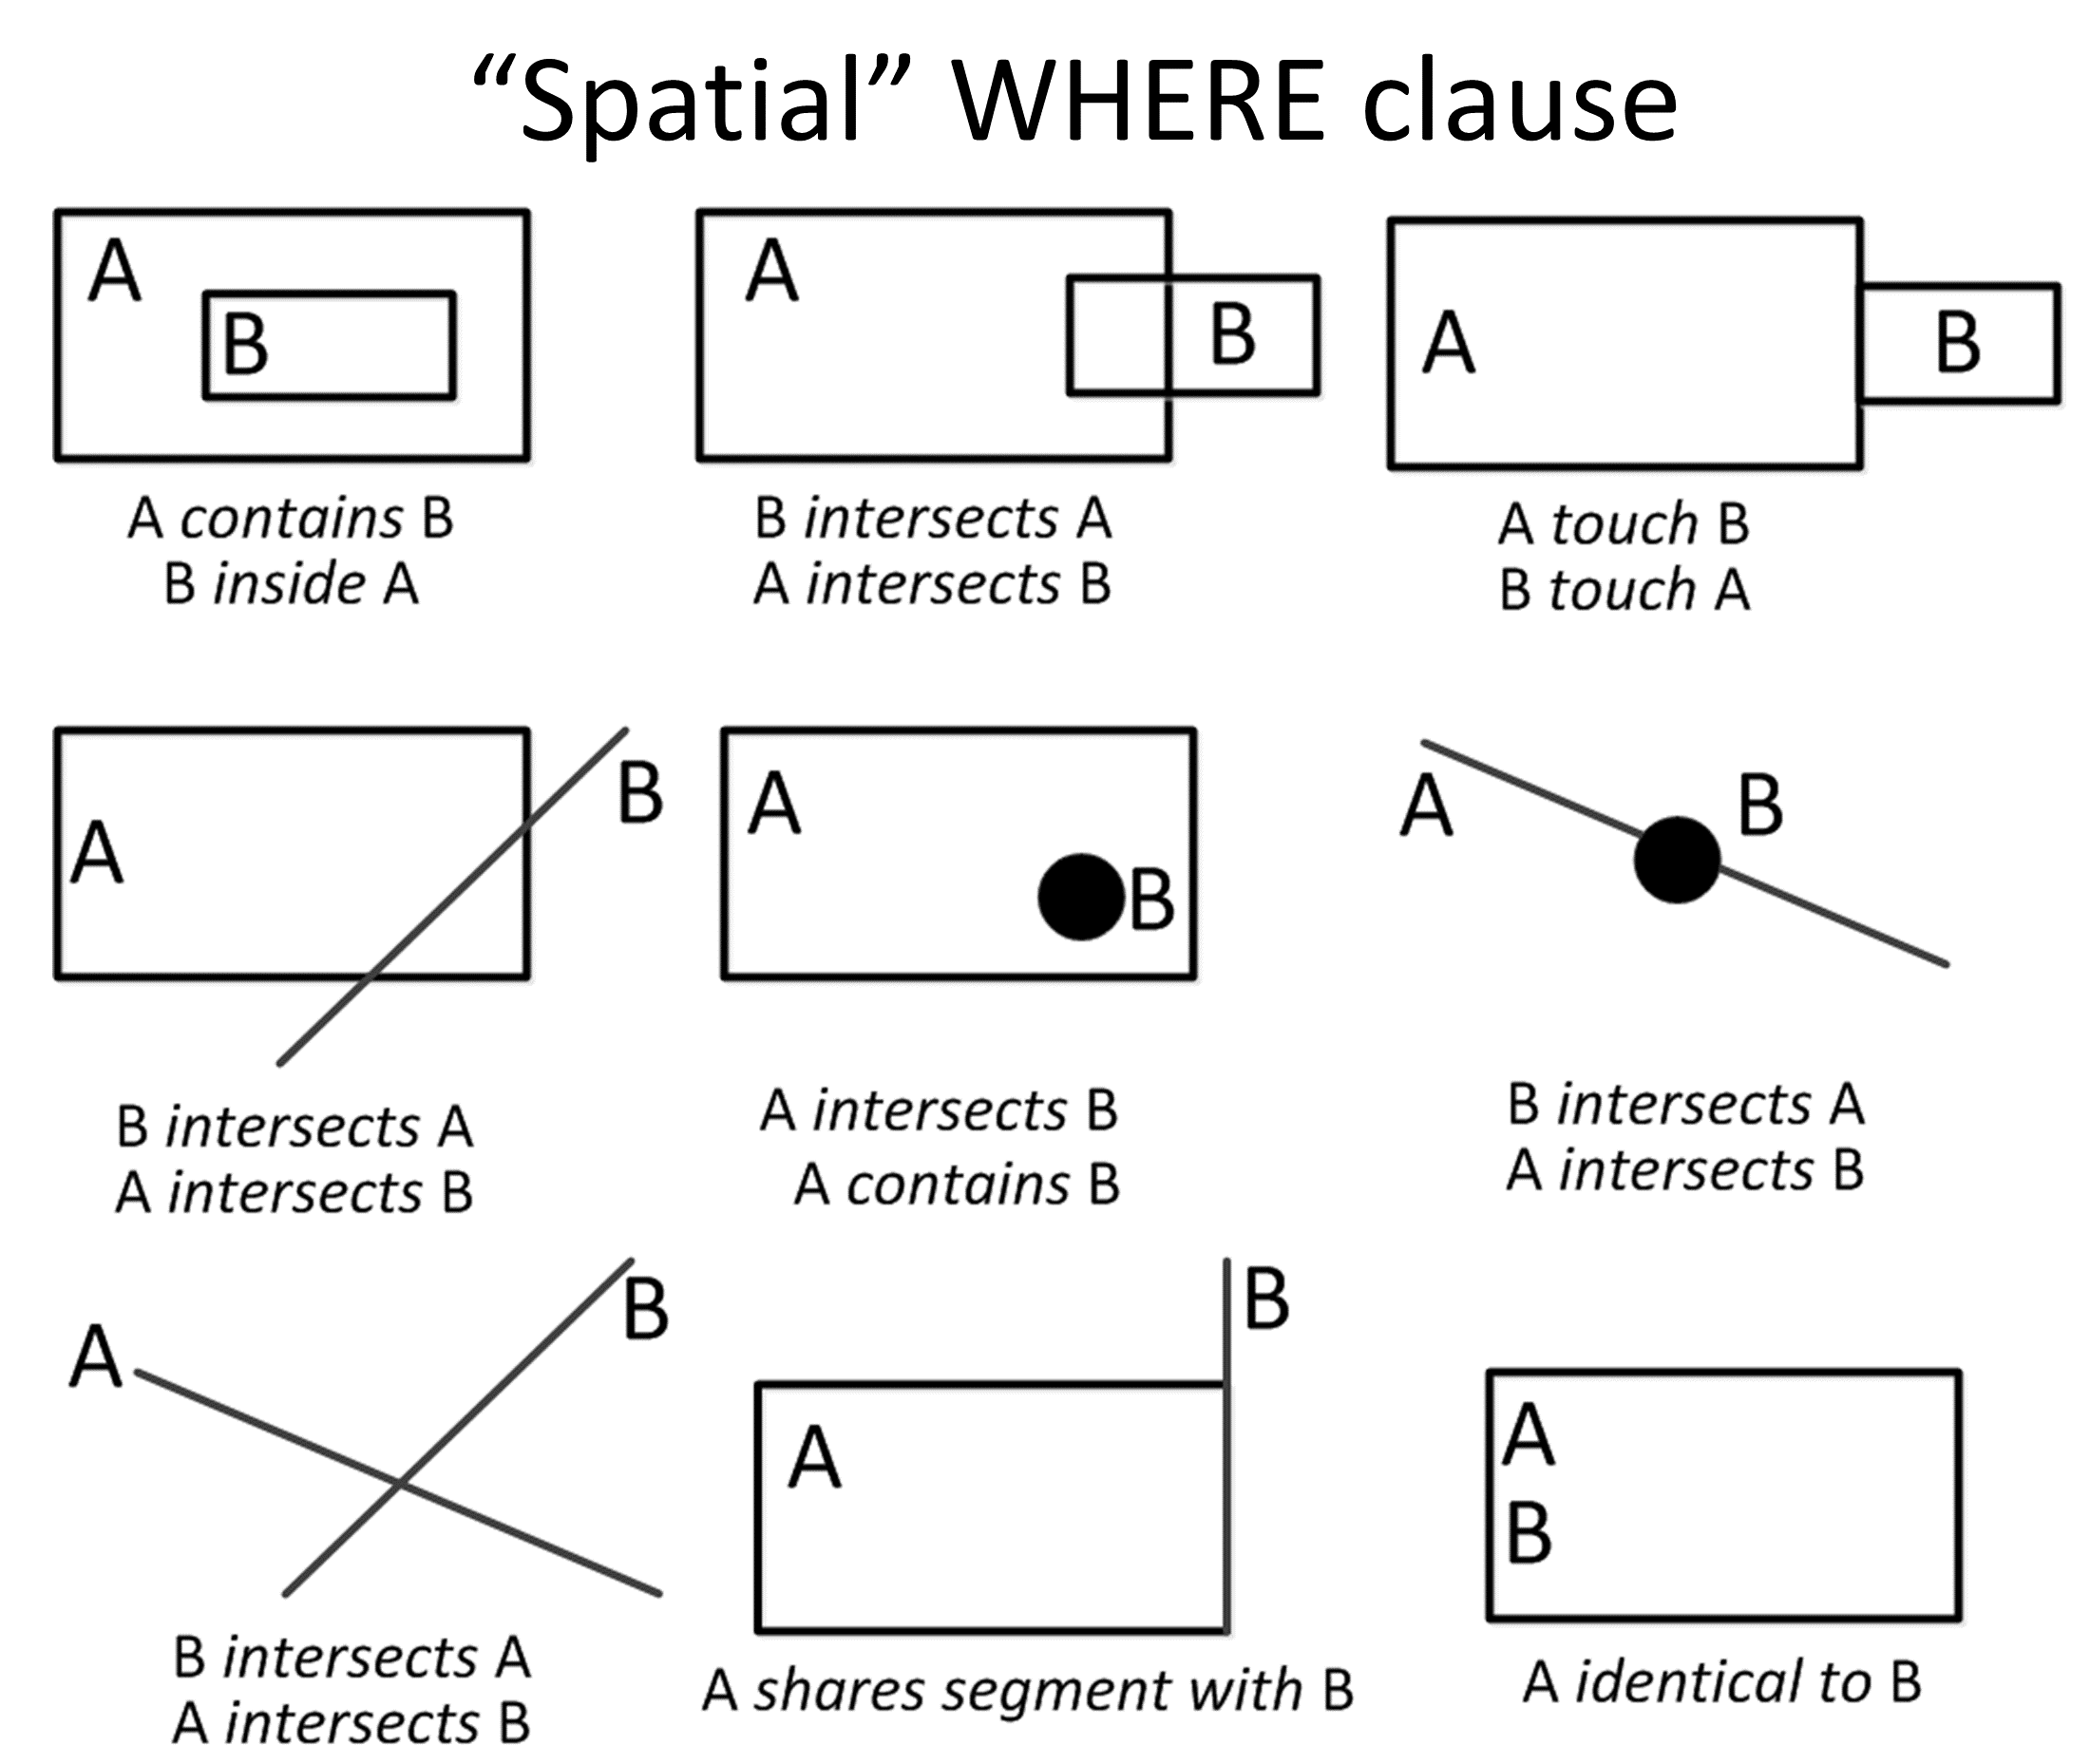
Spatial Query Operators
Review the help system of the GIS tool you are using to determine what spatial querying options are available to you
Figure by Brian Tomaszewski

Slide 15
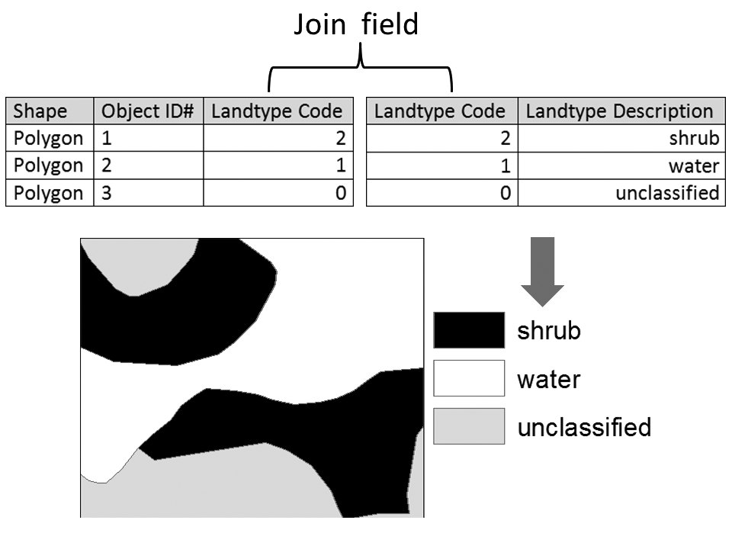
Table Join
Two tables are combined based on a common field in both tables
Table joins are covered in Exercise 3-1: Basic Table Join which includes a video tutorial supported by the books’ companion website (gisfordisastermanagement.com)
Figure by Brian Tomaszewski

Slide 16
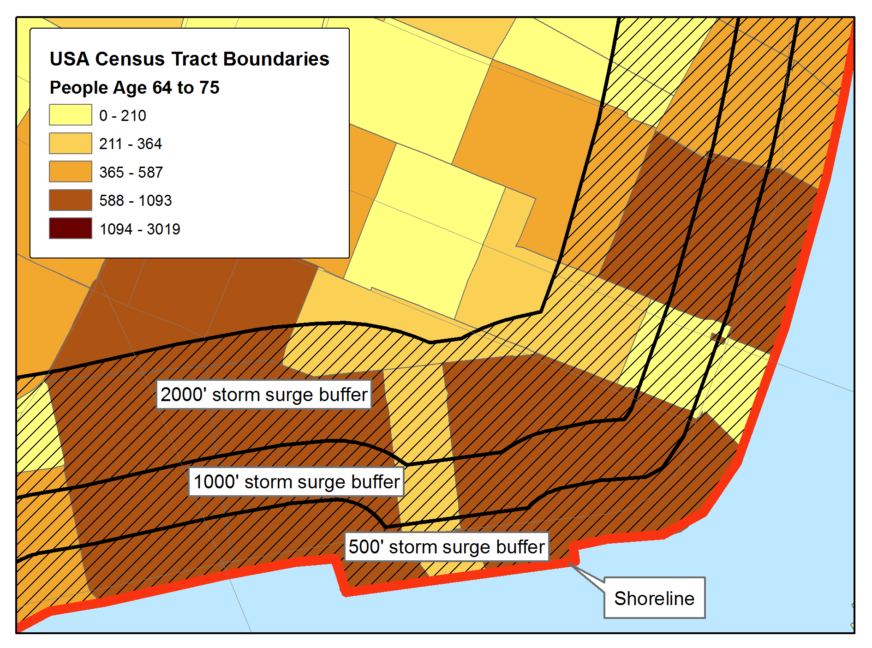
Spatial Analysis
Use of GIS to investigate geographically or spatially oriented ­questions or problems
Disaster management lends itself well to providing specific examples of GIS analysis: fundamentally spatial nature of disasters
Buffer example – calculating distances from a shoreline to understand potential impacts on vulnerable populations. Figure by Brian Tomaszewski.

Slide 17
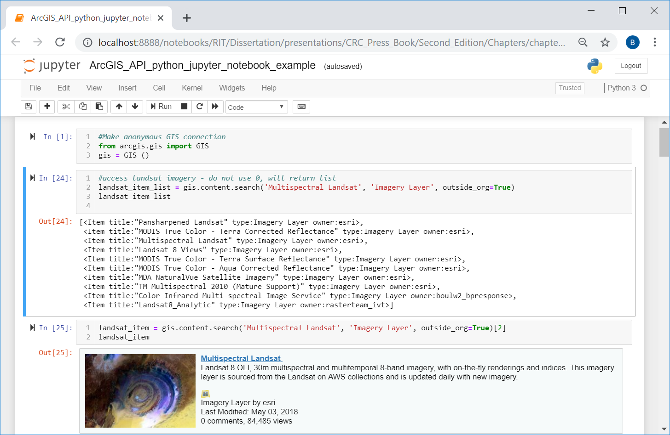
GIS Programming and Application Programming Interfaces APIs
GIS programming: use of computer programming languages to build ­custom software applications or tools to accomplish tasks that out -of -the -box GIS software might not be able to accomplish
Important computer programming languages to know:
JavaScript (web)
Python (scripting/analysis)
Java, C# or .Net (desktop/native mobile device)
QML (native cross platform app)
ArcGIS API for Python running inside a Jupyter Notebook.

Slide 18
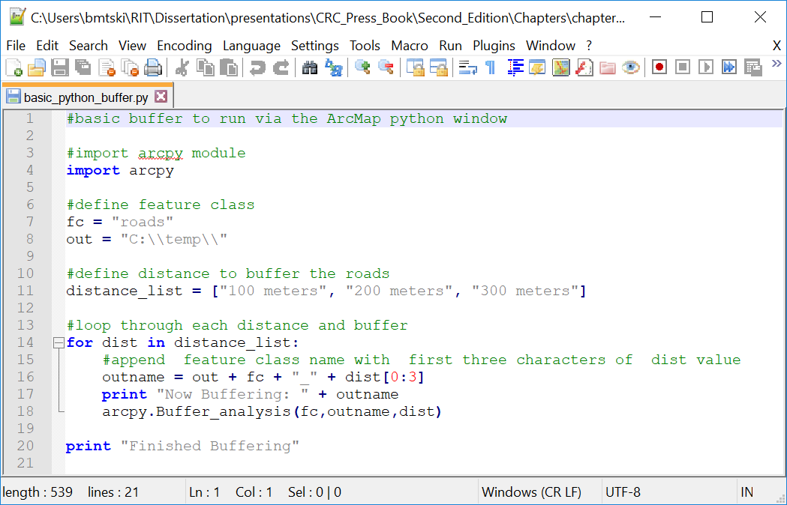
GIS Programming and Application Programming Interfaces APIs
Exercises 3-2 and 3-3 specifically focus on Python scripting in ArcGIS Pro and QGIS
Python code written to use the ArcPy python library of ArcGIS Pro.

Slide 19
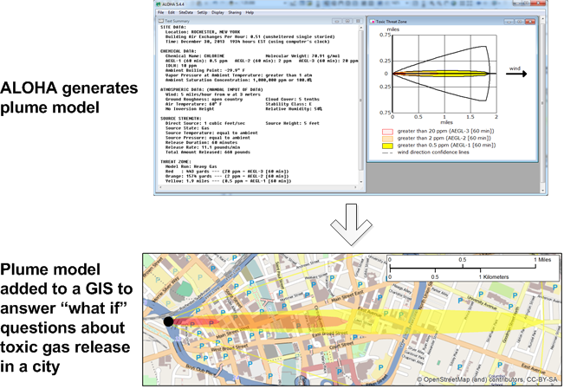
Spatial Modeling
Modeling in GIS: simulate conditions in the real world to answer what -if questions
Tweak parameters within a model to evaluate different conditions and test relationships between different model parameters (Maguire, Batty, and Goodchild 2005)
A plume generated in ALOHA (top of figure) that is then imported as a KML file into a GIS and layered on a map to show how the plume would affect the area of interest.

Slide 20
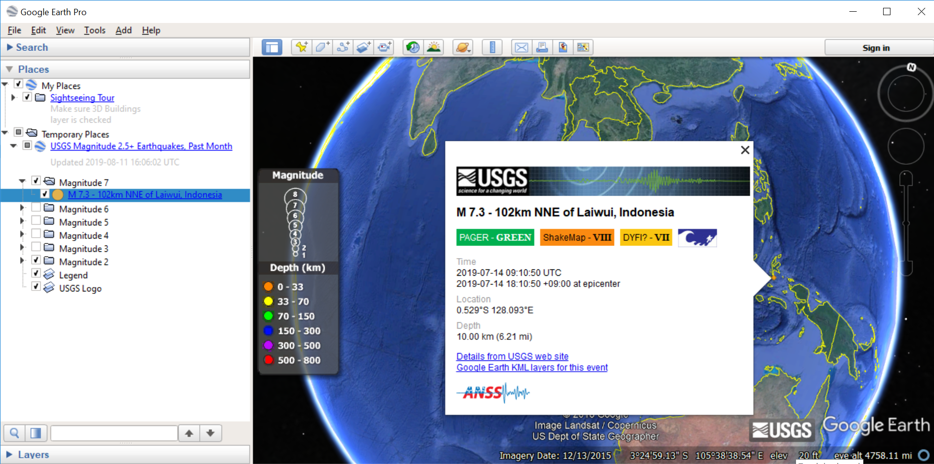
Cartography, Visualization, and Map Production
Map production: final process related to the other functions previously discussed
Online mapping tools Google Maps: changing long -held conventions about cartography and map production
Restrictions and opportunities to quickly make maps
Viewing a USGS Earthquake KML feed inside of Google Earth.
https://www.google.com/permissions/geoguidelines/

Slide 21
Geocoding
Taking text-based input such as a place name or street address and converting it to a coordinate representation
“1600 Pennsylvania Avenue, Washington, DC” geocoded to 38.897881, −77.036530 in decimal degree coordinates
Geocoding for disaster management: geocoding (or more accurately, geotagging) picture locations, geocoding tax parcels in relation to flood zones, and address searching for missing people

Slide 22
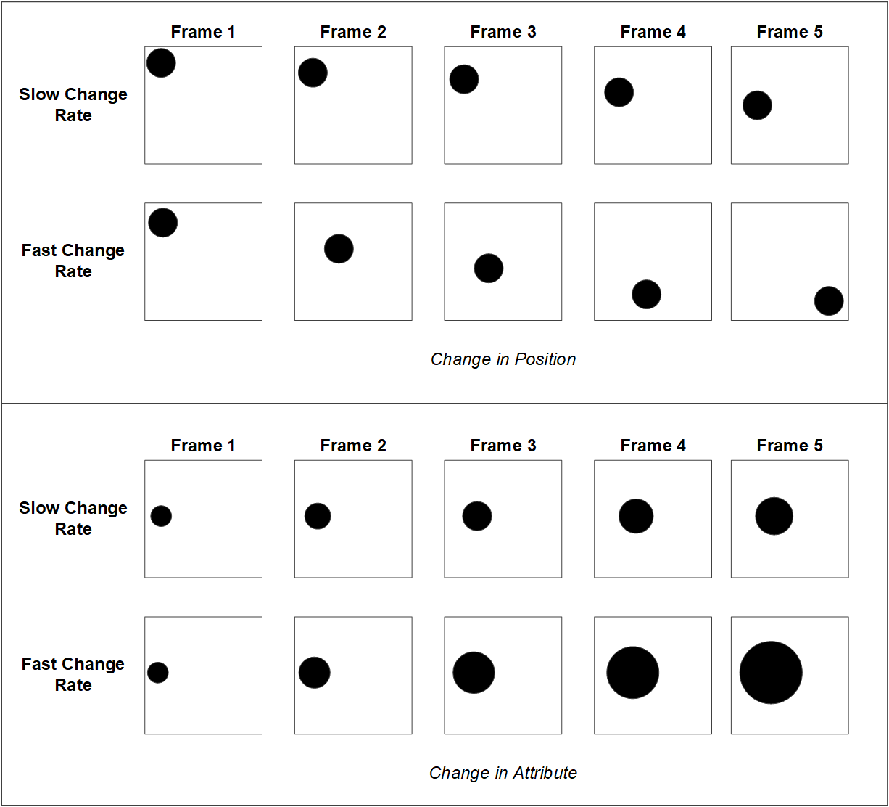
Animation and 3D
Dynamic Visual Variables
Duration
Rate of change
Order
Display Date
Frequency
Synchronization
Rate of change dynamic visual variable. Figure by Brian Tomaszewski based on Slocum et al. 2008; DiBiase et al. 1992.

Slide 23
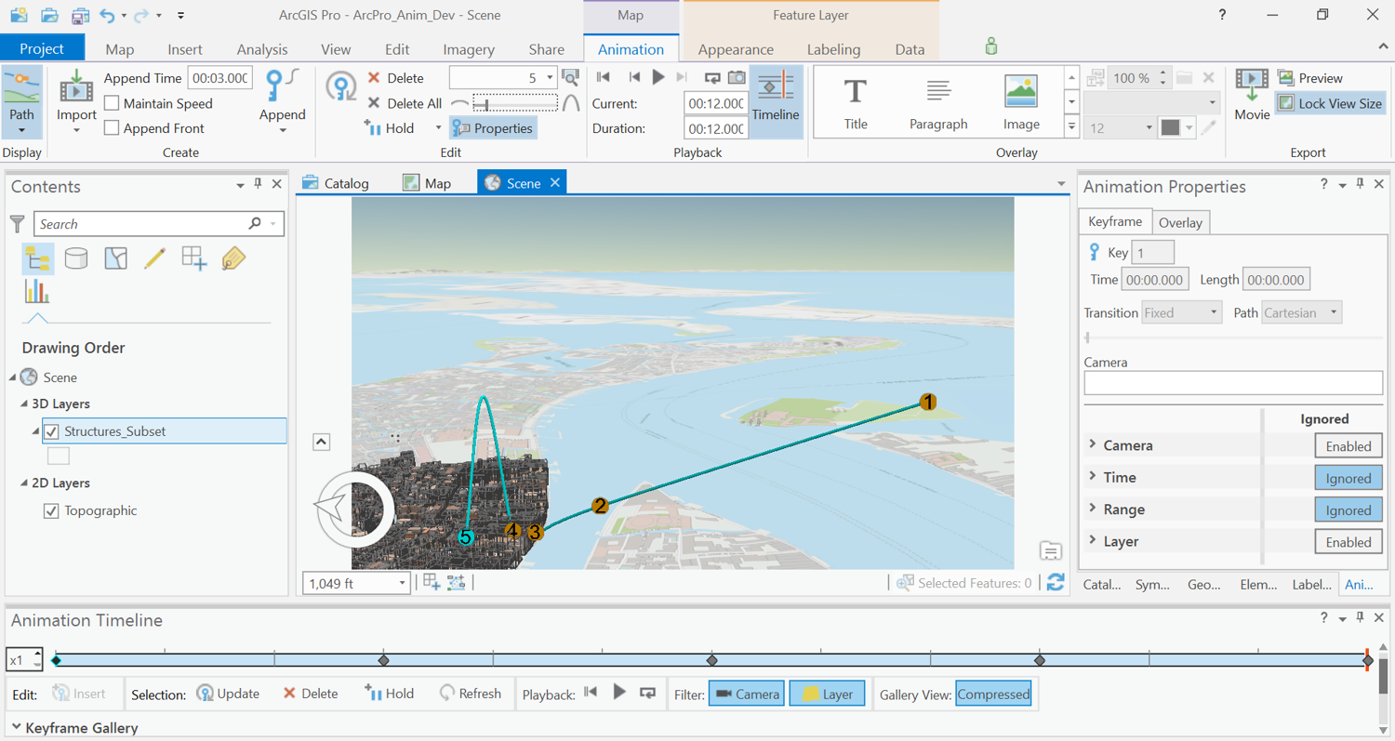
Animation and 3D
Animation tools of ArcGIS Pro. (Figure Copyright © 2019 Esri and its licensors. All rights reserved.)

Slide 24
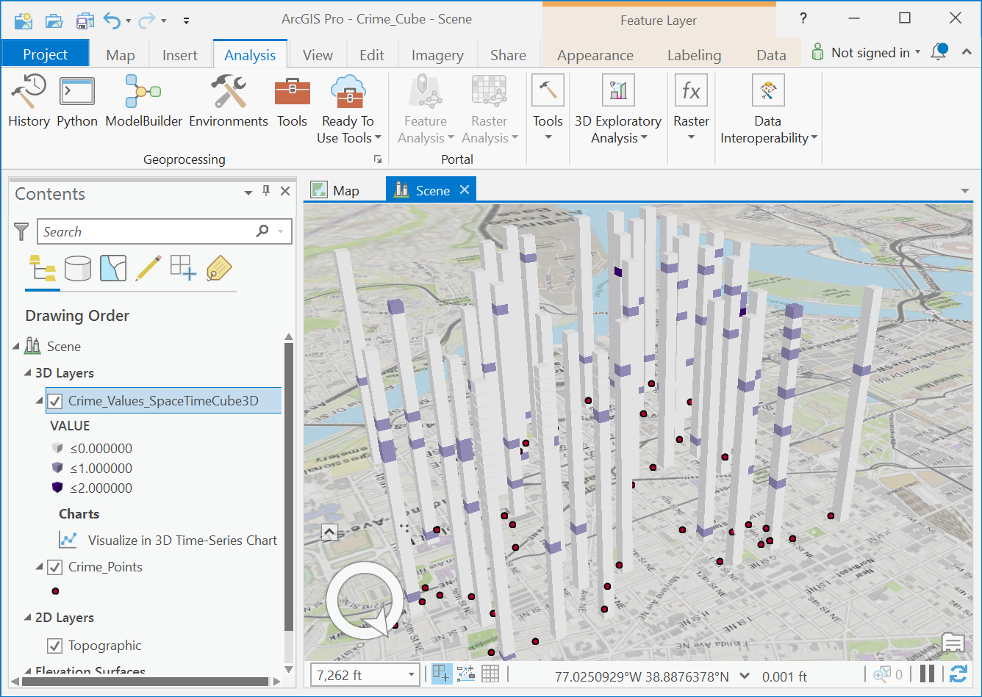
Animation and 3D
3D GIS data: z values are stored along with (x,y) values
3D GIS data can be anything
Example: z values is to store time values as they relate to (x,y) values
A 3D space–time cube created in ArcGIS Pro. (Figure Copyright © 2019 Esri and its licensors. All rights reserved.)

Slide 25
Mobile GIS and Field Data Collection
Field data collection via mobile GIS platforms is critical to geographic data collection and maintenance
Collector for ArcGIS and Open Data Kit (ODK) Collect
Wide variety of platforms: tablet computers, smartphones, and field computers
Teaching Congolose refugees how to use Collector for ArcGIS on a smart phone to map a refugee camp in Rwanda. Photo by Brian Tomaszewski.

Slide 26
Limitations of GIS
GIS software is not a miracle technology that can automatically answer all questions
The acquisition, creation, editing, and duration of data is the most costly aspect of GIS

Slide 27
Understanding GIS Data Models
GIS data model: a way in which geographic-scale features or phenomena are represented in a digital manner
Data models: address representational issues in a variety of manners (and varying degrees of success)

Slide 28
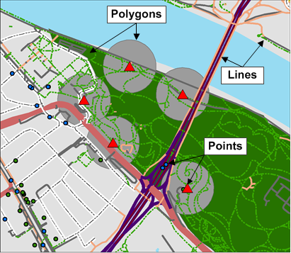
Vector Models
Discrete, vertex-based shapes
Representing geographic features that have discrete boundaries
Points, lines, and polygons
An example of vector points, lines, and polygons in a disaster management context. Map by Brian Tomaszewski.

Slide 29
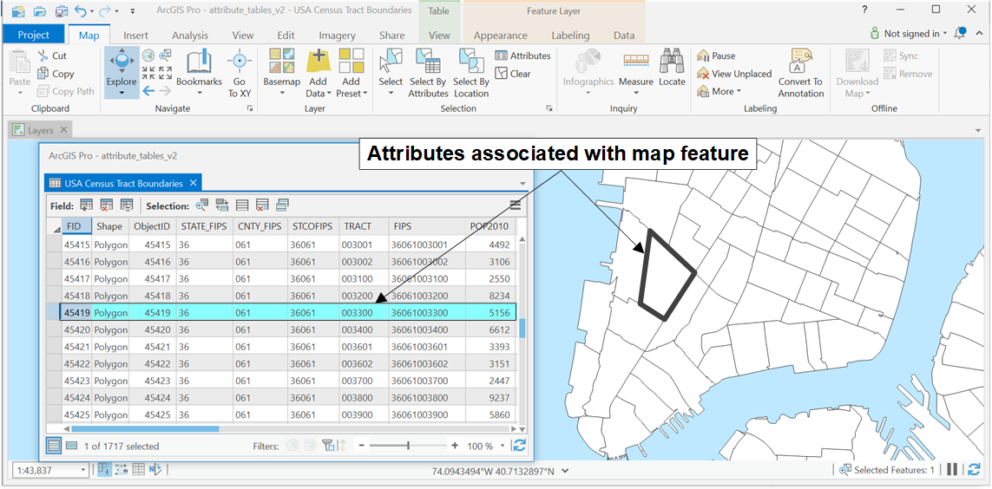
Vector Models: Attributes
Attributes associated with a vector polygon. (ArcMap screenshot Copyright © 2019 Esri and its licensors. All rights reserved.)

Slide 30
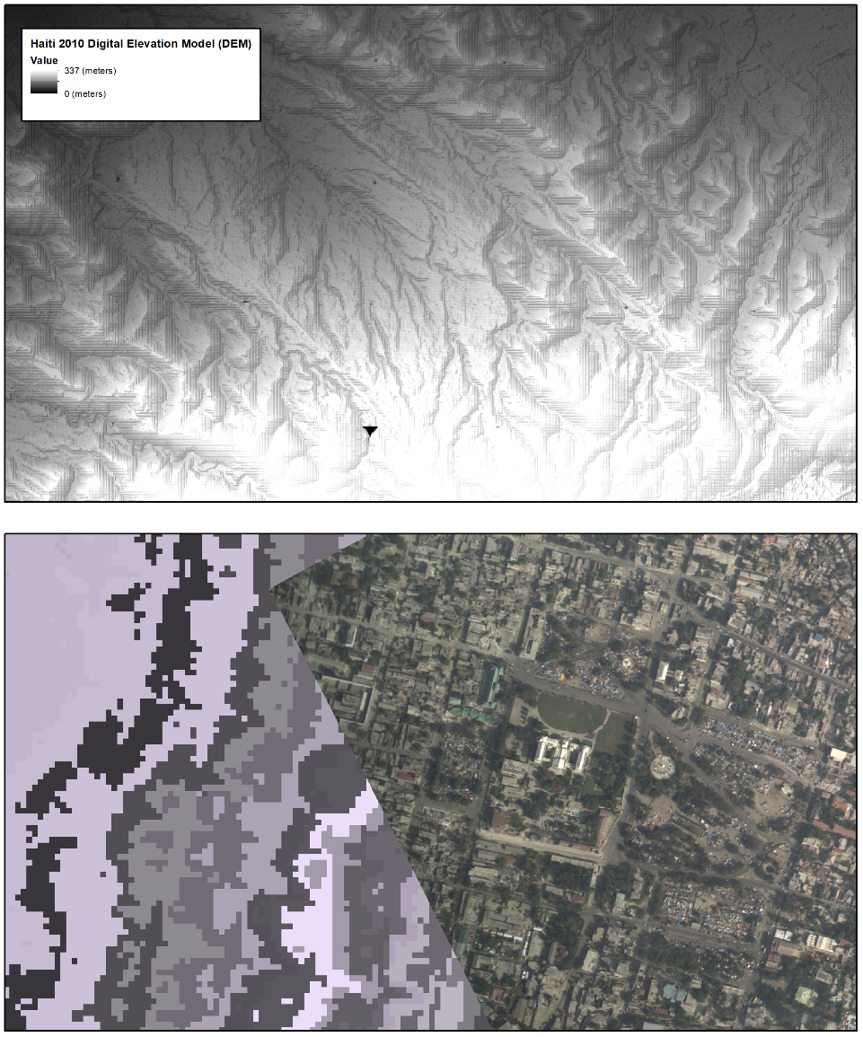
Raster Models
Grid of individual cells
Entities that are continuous in nature
No discreet boundaries or edges
Imagery, temperature and elevation
Disaster management raster data examples. Figure by Brian Tomaszewski.

Slide 31
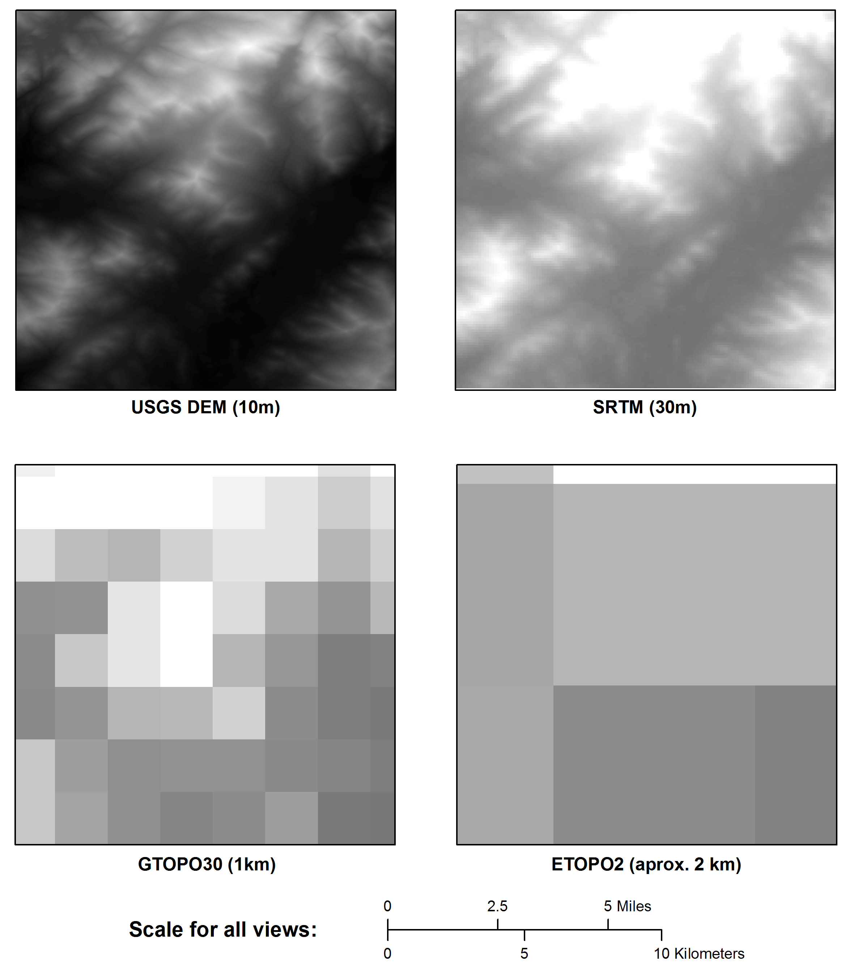
Spatial Resolution
Fineness of detail of a raster dataset
Based on the size of each cell within the grid
Examples of different raster dataset spatial resolutions. Figure by Brian Tomaszewski.

Slide 32
Triangulated Irregular Networks (TIN)
Figure by Brian Tomaszewski.
Series of vertices of points triangulated together.
Series of connected through edges, forming a network of triangles.
Triangle network is non-overlapping and continuous

Slide 33
GIS Metadata
Metadata: data about data
Data records that describe the contents, characteristics, lineage, or anything else about another dataset
Important role in GIS for disaster management: coordination and collaboration activities
Example of HTML-based GIS metadata.

Slide 34
Specific GIS Technology
Criteria used for the specific GIS technology:
Around for at least ten years prior to publication of this book
Actively supported through ongoing maintenance and support by a corporation that sells it or an actively supported open-source software-development community
Documented use in disaster management practice

Slide 35
GIS Technology Platforms and Disaster Management
Important to distinguish technology platform appropriate for which aspect of disaster management work
Desktop computers: analytical and data management
Mobile platforms: access GIS data contained within larger systems and field data collection
Web platforms: accessed anywhere that there is an Internet connection

Slide 36
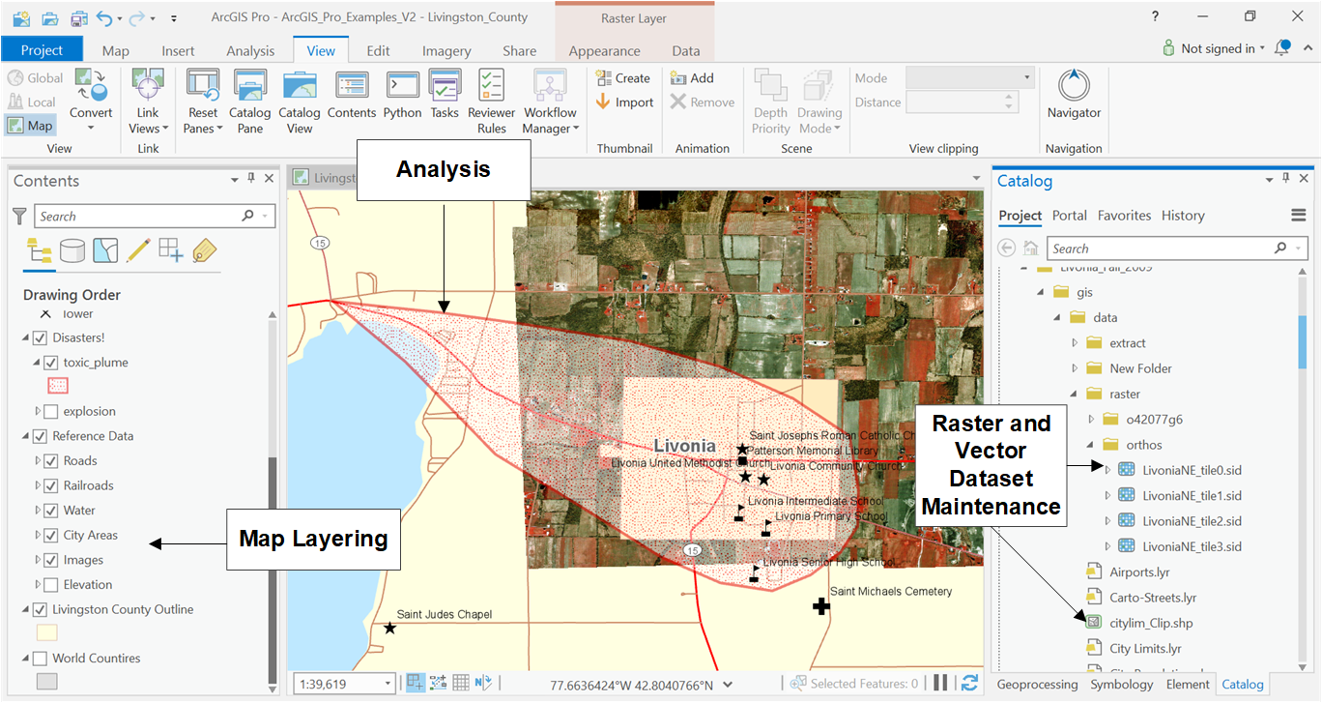
ArcGIS
A disaster management example of map layering, vector and raster datasets maintenance, and analysis in ArcGIS Pro. (Screenshot Copyright © 2019 Esri and its licensors. All rights reserved.)

Slide 37
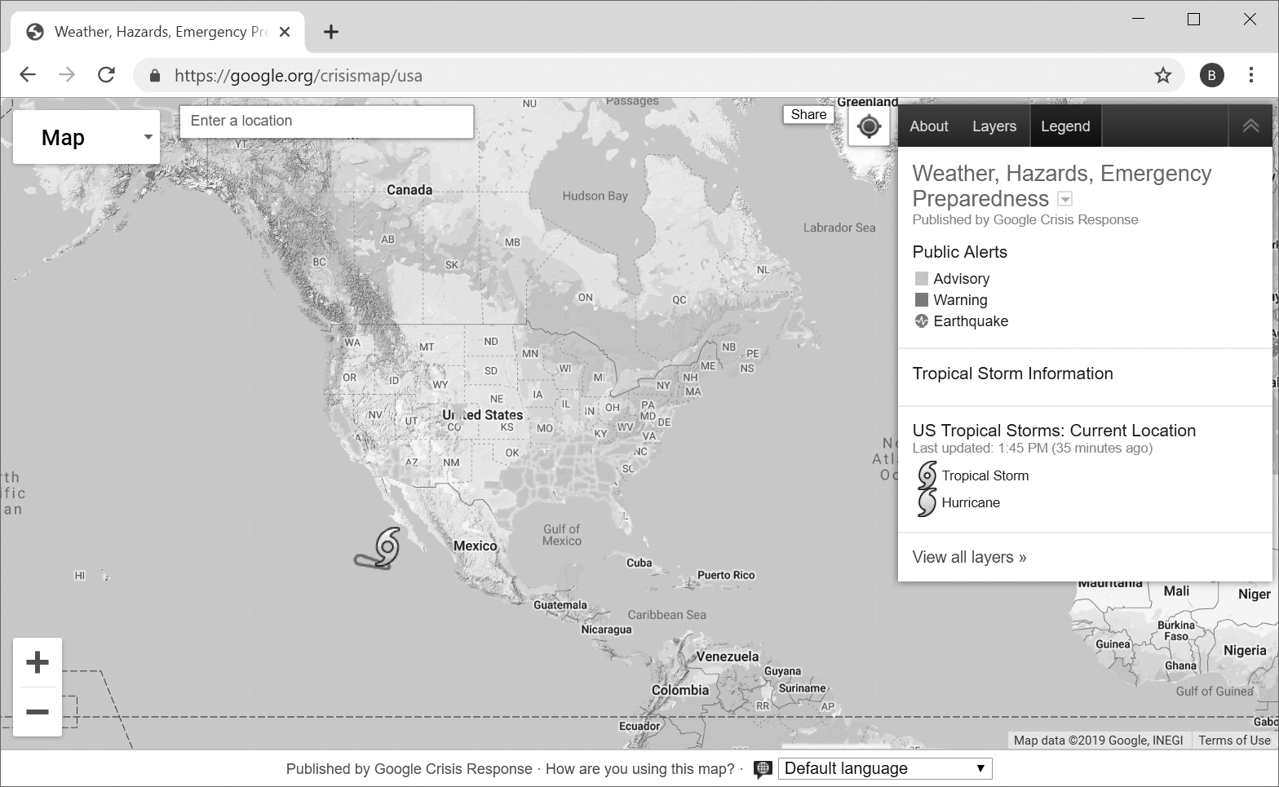
Google Maps and Other Google Geospatial Technology
Google crisis map.

Slide 38
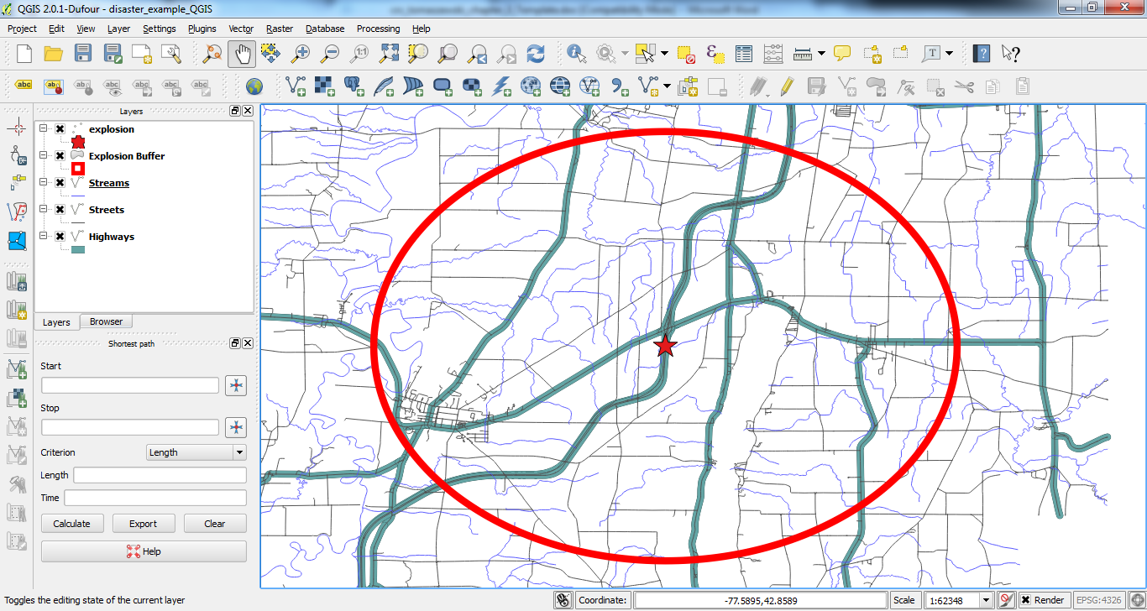
QGIS
Disaster management example in QGIS. QGIS is covered under Creative Commons Attribution-ShareAlike 3.0 license (CC BY-SA) http://creativecommons.org/licenses/by-sa/3.0/.)

Slide 39
Other Commercial, Free, and Open-Source or Openly Available GIS Technologies
OpenStreetMap (https://www.openstreetmap.org/) platform for users to create and edit a freely editable world map.
Leaftlet (https://leafletjs.com/) is an open-source, Web-based map client similar to the Google Maps API.
MapBox (www.mapbox.com/) is a free commercial map service that utilizes OpenStreetMap data and places particular emphasis on cartography and design of maps created in the MapBox system.
MapServer (https://mapserver.org/) is a free and open-source publishing service that allows map data to be served over the Web.
GeoServer (http://geoserver.org/) is similar to MapServer in that it is a free and open-source service to publish map-based data over the Web.
postGIS (http://postgis.net/) is an open-source spatial database that works with postgreSQL (www.postgresql.org/) to provide geographic objects and spatial queries.
NASA WorldWind (https://worldwind.arc.nasa.gov/) is an open-source Virtual Globe tool that is particularly suited for viewing datasets created by NASA, such as the Landsat series.

Slide 40
Free and Open-Source Datasets Relevant to Disaster Management
Open Data: data published and made freely accessible to anyone so as to choose to use them and redistribute them
Open data for the government
Value of open data efforts to disaster management is incalculable
Access to reliable data such as infrastructure, environmental conditions, and population characteristics can literally be a matter of life and death: disaster response and recovery
World Bank Global Facility for Disaster Reduction and Recovery (GFDRR) and GRID³ examples of open data in developing countries that can feed directly into disaster management efforts

Slide 41
Free and Open-Source Reference and Thematic GIS datasets
The National Map (www.usgs.gov/core-science-systems/national-geospatial-program/national-map) provides access to numerous reference and thematic data layers for the United States.
USGS Global Visualization Viewer (https://glovis.usgs.gov/) provides free access to numerous NASA and USGS products such as LANDSAT, MODIS, ASTER, and TERRA.
Global Administrative Areas (https://gadm.org/) provides free access to worldwide administrative boundaries.
Geonames (www.geonames.org/) provides free worldwide gazetteer (place name) data, a good source for geocoding applications.
FEMA GIS Data Feeds (https://gis.fema.gov/DataFeeds.html) provides a collection of FEMA’s disaster declarations and support offices relative to the United States.
US Census Bureau (https://data.census.gov/cedsci/). Relevant to the United States and can be used to find a wide variety of census indicator data (discussed again in Chapter 9).
USGS Earthquake Hazards Program (https://earthquake.usgs.gov/earthquakes/feed/v1.0/) A variety of feeds (including KML and GeoJSON) related to worldwide earthquake instances.
World Bank Data (https://data.worldbank.org/) provides economic and social country-level indicators; data are in CSV, XML, and Excel formats
Humanitarian Data Exchange (https://data.humdata.org/) is a central location for humanitarian datasets managed by OCHA’s Centre for Humanitarian Data.
Homeland Infrastructure Foundation Level Data (HIFLD) program provides “National foundation-level geospatial data within the open public domain that can be useful to support community preparedness, resiliency, research, and more” (https://hifld-geoplatform.opendata.arcgis.com/).
United Nations Second Administrative Level Boundaries (www.unsalb.org/data).
Open Data for Resilience Index “aims at improving risk information through better access to data” (https://index.opendri.org/).

Slide 42
How to Choose the Right GIS Technology for Disaster Management
No single guideline or set of principles to determine the right GIS technology to use for disaster management
Cost
Capacity
Task change over time
Organizational importance of GIS

Slide 43
Getting Started with GIS Technology and GIS Technology Configuration Ideas
Brand new: free tool like Explorer for ArcGIS: www.esri.com/en-us/arcgis/products/explorer-for-arcgis
21-day free trial version of ArcGIS (www.esri.com/en-us/arcgis/trial) or QGIS (https://qgis.org/)

Slide 44
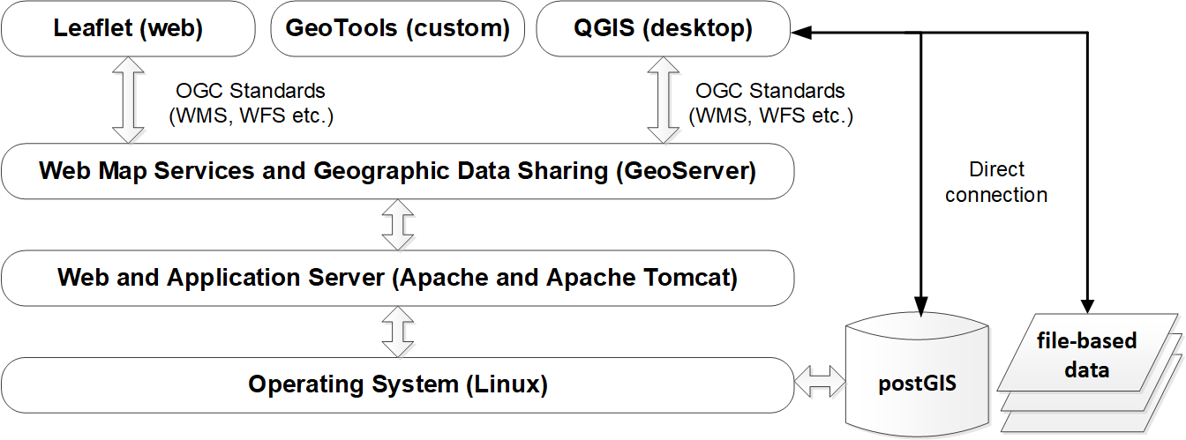
Open-source GIS Technology Stack
Figure by Brian Tomaszewski.

Slide 45
Summary
GIS on conceptual and technical levels
Individual components of the system that comprises GIS
Functions of GIS
GIS data models
Specific technologies relevant to disaster management
Free and open-source datasets relevant to disaster management

Slide 46
Discussion Questions
What, if anything, might you add to the components of GIS in terms of disaster management areas?
With the further increase of 3D virtualization worlds like Google Earth, do you think the concept of map layers is still relevant for disaster management?
What other types of GIS data-storage formats can you find, besides the ones listed in this chapter, that are used for disaster management applications?
From what you’ve learned about GIS and disaster management so far, what other GIS disaster management analysis scenarios you can think of?
What other GIS limitations you can think of, and how might those limitations be relevant to disaster management?
What are some disaster management features you would represent as vector? As raster? Are there disaster management cases you can think of where either raster or vector could be used?
Why is metadata important?
If you could use any technology, which GIS technologies might you use for specific disaster management tasks and why?
Try downloading some of the datasets listed at the end of this chapter. What were your experiences? For example, were the datasets easy to find and download, or did you have problems?

Slide 47
Chapter 3 Exercises
Exercise 3.1 – Basic Table Join
How to perform a basic table join using desktop GIS software
A video walkthrough tutorial of this exercises is available from the book’s companion website: http://gisfordisastermanagement.com
Exercise 3.2 – Basic Python Scripting with ArcGIS Pro and ArcPy
Basic GIS programming concepts and algorithm development

Slide 48
References used in the Slides
DiBiase, David, Alan M. MacEachren, John B. Krygier, and Catherine Reeves . “Animation and the Role of Map Design in Scientific Visualization.” Cartography & Geographic Information Systems 19, no. 4 (1992): 201–214.
Maguire, D.J., M. Batty, and M.F. Goodchild . GIS, Spatial Analysis and Modelling, ESRI. Redlands, CA: ESRI Press, 2005.
Slocum, Terry A., Robert B. McMaster, Fritz C. Kessler, and Hugh H. Howard . Thematic Cartography and Geovisualization . 3rd ed. Upper Saddle River, New Jersey: Prentice Hall, 2008.

