Slide 1
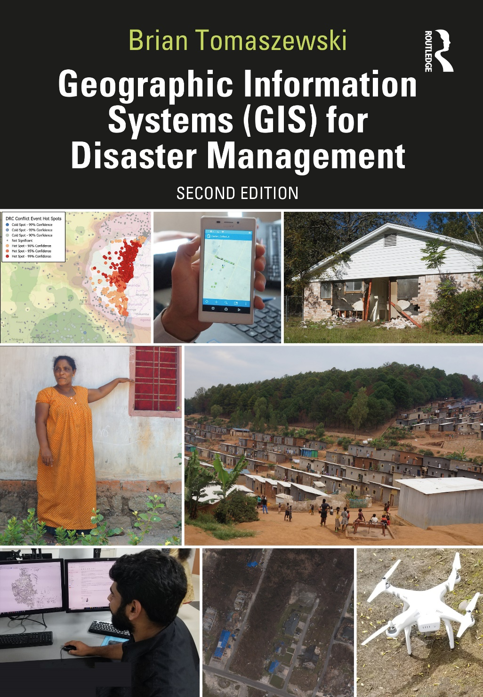
Chapter 2 Fundamentals of Geographic Information and Maps for additional materials, see: http://gisfordisastermanagement.com/ Recommended Citation: Tomaszewski, B. 2020. Chapter 2: Fundamentals of Geographic Information and Maps. In: Geographic Information Systems for Disaster Management (Second Edition), pp. 31-92. Oxfordshire and New York: Routledge.
Notes:
V1.3

Slide 2
Chapter 2 Objectives
Understand the difference between data and information
Describe the concept of map scale and how map scale is represented
Understand what map projections are and discern the differences between different map projection types
Be familiar with common map coordinate systems
Understand mapping principles such as data measurement, visual variables, and figure/ground relationships
Discern the differences between reference and thematic maps
Be familiar with common map design elements and
Identify common errors when first learning to use Geographic Information Systems (GIS) to create maps

Slide 3
Introduction
Important scientific principles related to the fundamentals of geographic information and maps
Maps scale, map projections, coordinate systems, and datums
Mapping topics focus on cartographic concepts and map design

Slide 4
Data vs. Information
Data and information often used interchangeably
Data: raw facts or observations
Information: data with context or making sense of data so that it is actionable or useful
Examples of each?

Slide 5
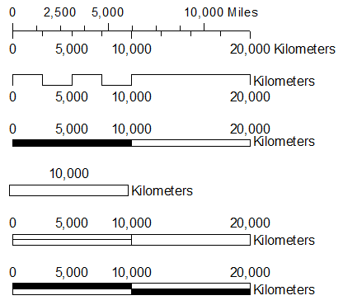
Scale
Map scale is a ratio (or proportion) between measurements on the map and corresponding measurements on the ground
Three common ways of representing map scale
Representative Fraction
Verbal Statement
Graphic Bar
A non-exhaustive collection of graphical scale bars
(Figure by Brian Tomaszewski)

Slide 6
Scale
Small -scale maps show a larger area with less detail
A large -scale map shows a smaller area with more detail
Examples of each?
Why Scale Matters: Detail and Accuracy
data detail is scale dependent
accuracy is scale dependent

Slide 7
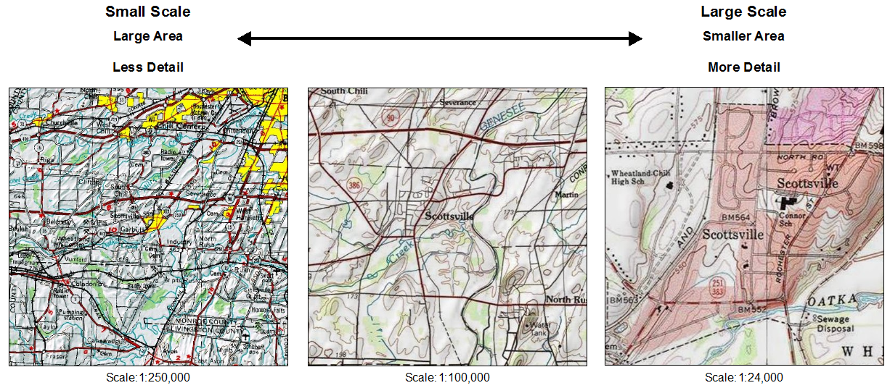
Large- vs. Small-Scale Maps
(Figure by Brian Tomaszewski)

Slide 8
Map Projections
Projections are mathematical transformations
Scale is true only in certain places
Many different types of projections have been devised
All map projections distort
Distortion characteristics vary among projection types
Some types are better for some applications than others
A few types are used widely

Slide 9
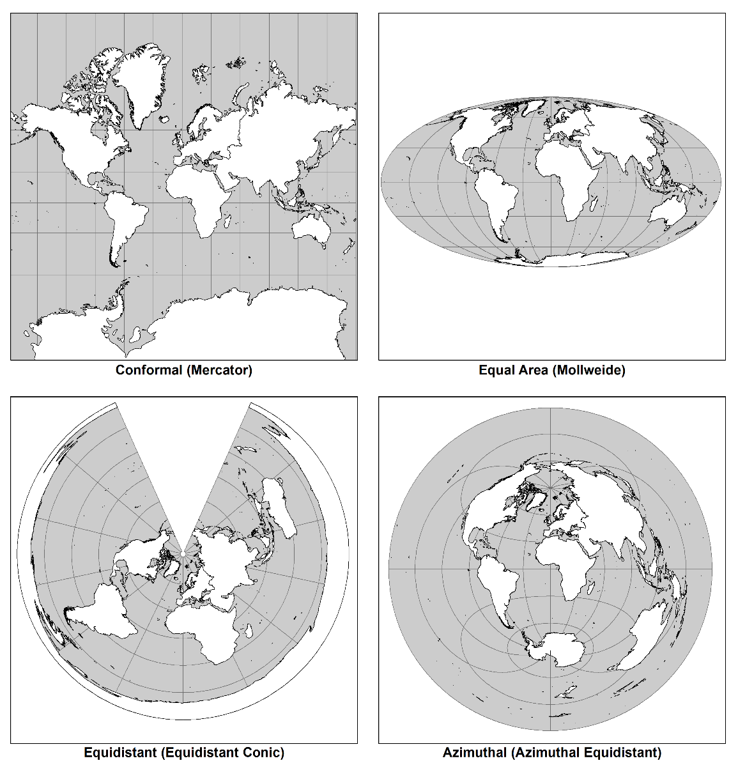
Map Projections
Map projections and the trade-offs they make in distortions of various spatial properties
Conformal: preserves shape and angles
Equal area (equivalent): preserves area and size
Equidistant: preserves true distances in some directions from the projection center or along special lines
Azimuthal: this projection preserves true direction (azimuths or angle measurements) from a reference point
(Figure by Brian Tomaszewski)

Slide 10
Coordinate Systems
Latitude and longitude coordinates: spherical coordinates, use the measures of angles (degrees) from both the center of the earth for latitude and from the prime meridian (or zero degrees) for longitude
The latitude and longitude coordinate system. Lines of latitude (also known as ­parallels) are measured from north to south based on their position in relation to the equator. Lines of longitude (also known as meridians) are measured east to west from the prime meridian. Figure by Brian Tomaszewski

Slide 11
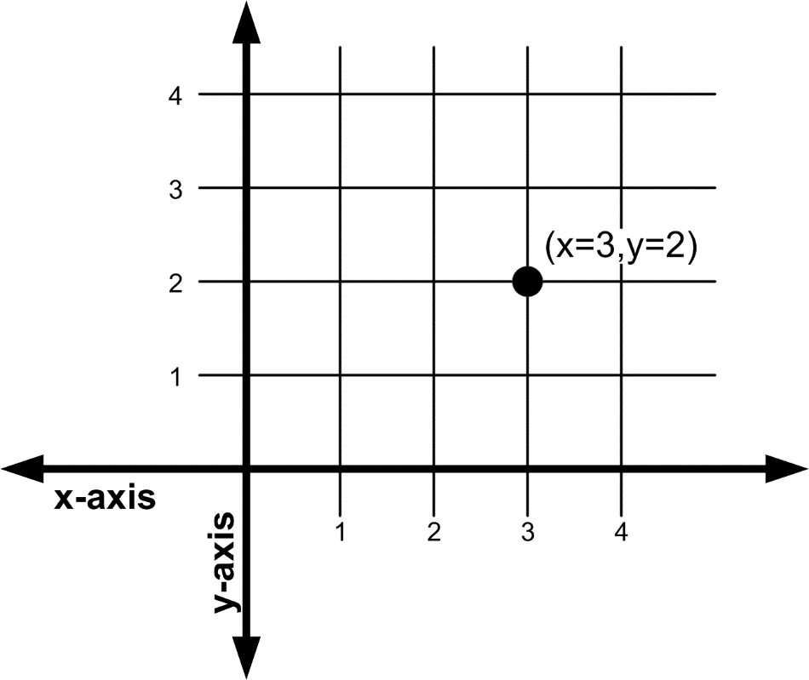
Planar Coordinates
Planar coordinates are based on the ideas of the Cartesian space and referenced on an x,y grid
x -axis are east-to-west coordinate values
y -axis is north-to-south coordinate values
Figure by Brian Tomaszewski

Slide 12
Universal Transverse Mercator
The Universal Transverse Mercator (UTM) coordinate system: international standard planar coordinate system
UTM system: earth is divided into 60 zones that span 6° of longitude each (60 zones * 6° = 360° total covering the entire earth)
Each UTM zone is divided into a north and south section
A single UTM zone. Figure by Brian Tomaszewski

Slide 13
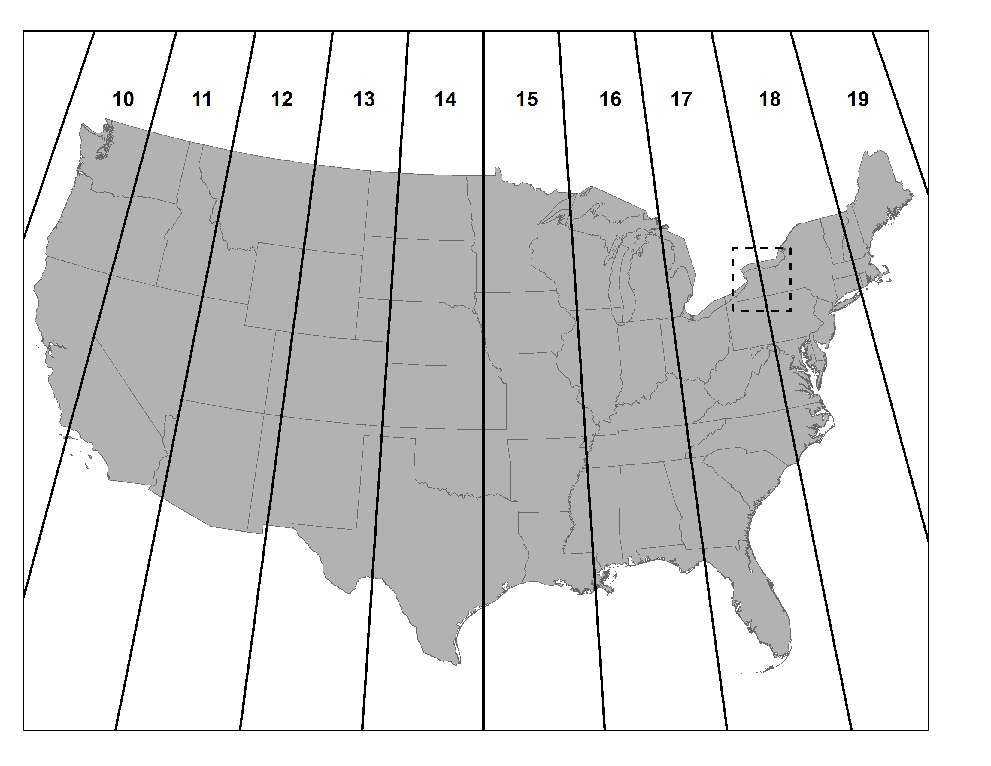
Universal Transverse Mercator Issues
60 zones of the UTM system do not conform to political boundaries or jurisdictions
Can be unusable in situations where a geographical referencing system is needed across an entire political or jurisdictional
Figure by Brian Tomaszewski

Slide 14
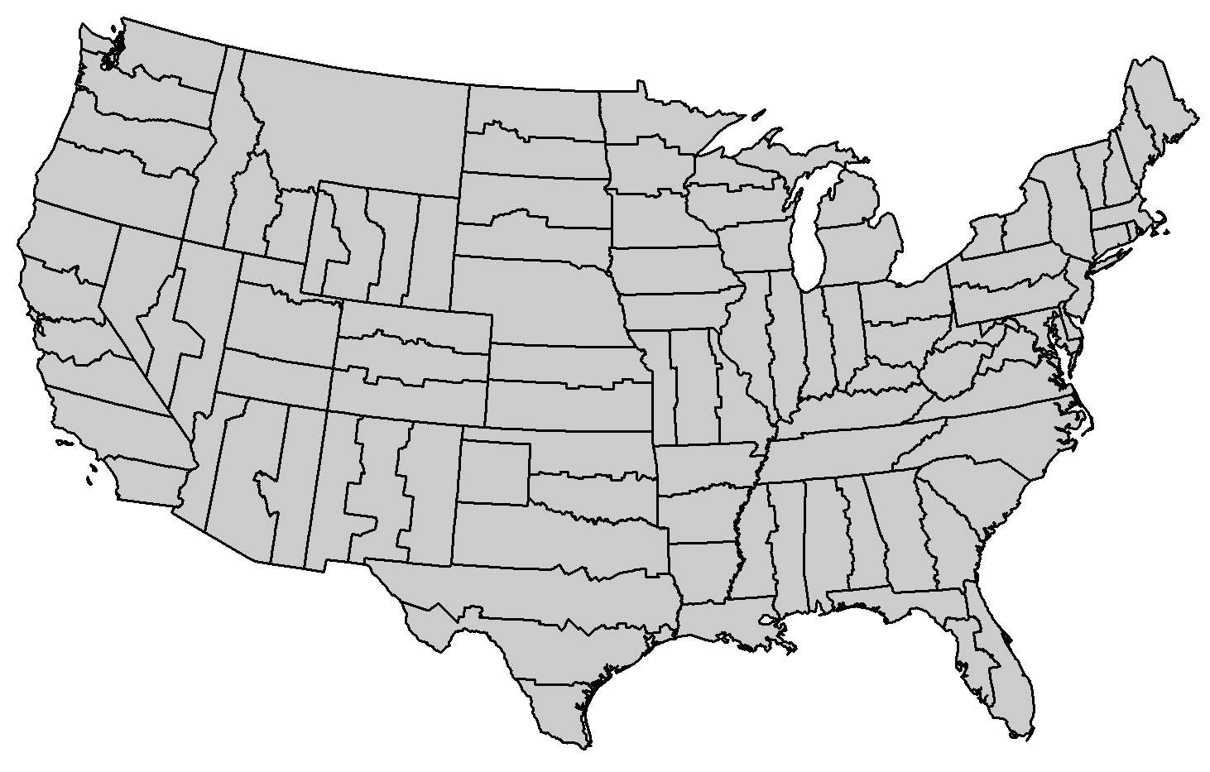
State Plane Coordinate (SPC) system
State Plane Coordinate (SPC): based on a series of specialized map projections that define specialized zones. SPC: all of the zones are within the United States and defined within political boundaries
Figure by Brian Tomaszewski

Slide 15
United States National Grid
An important coordinate system used in disaster management in the United States is the United States National Grid (USNG)
Grid/Zone designations and coordinates
Figure by Brian Tomaszewski

Slide 16
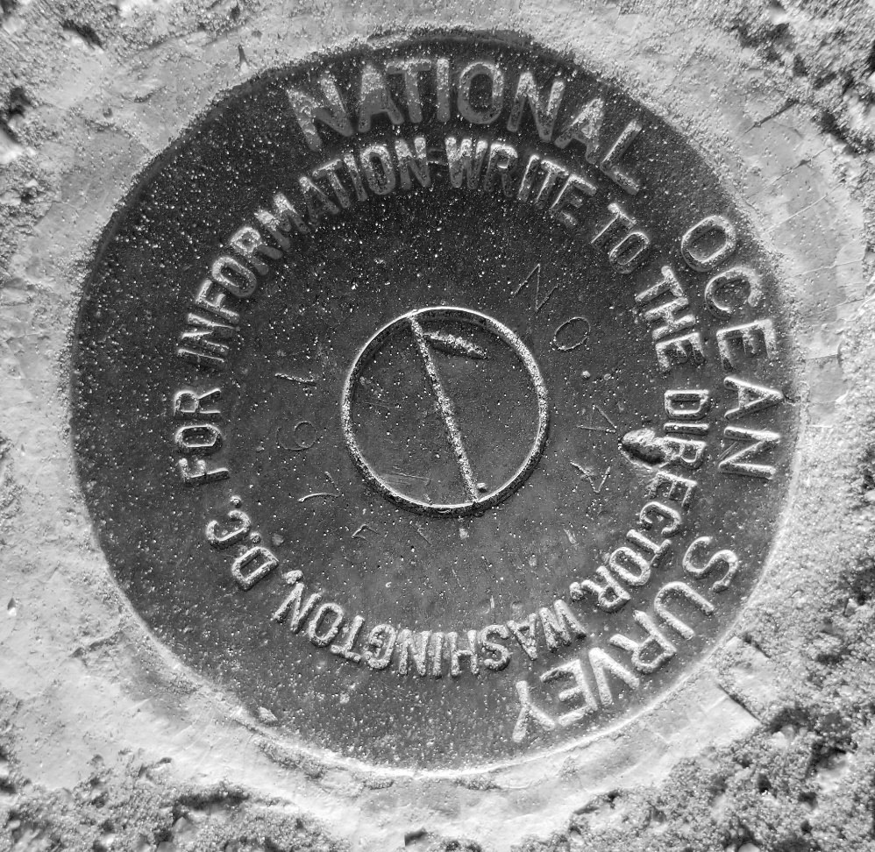
Datums
A horizontal datum (which would derive coordinates in the X,Y plane) consists of two elements —a reference ellipsoid and accurately known control points
Reference ellipsoids are mathematical approximations of the earth’s shape
Control points are accurately measured locations used as reference points
Control point, Picture by Brian Tomaszewski

Slide 17
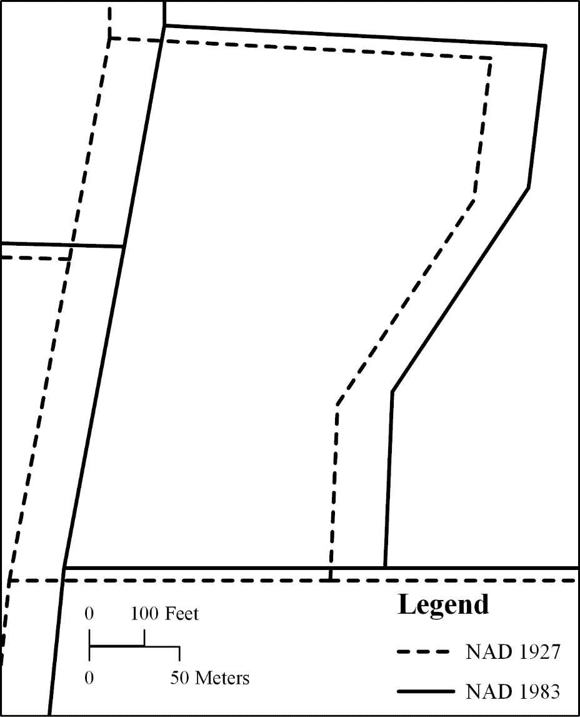
The Importance of Datums
Common GIS datums: North American Datum of 1983 (or NAD 83) and the World Geodetic System 1984 datum (or WGS 84)
Important to know what the datum is when working with GIS
Different datums can cause the same location to have significantly different coordinate values
An example of the same GIS dataset being referenced in different datums and the issues this can cause. Figure by Brian Tomaszewski

Slide 18
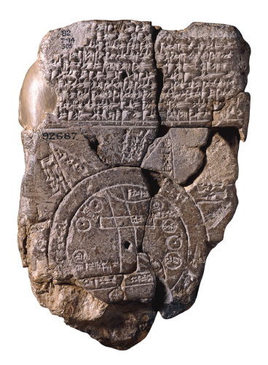
Basic Principles of Cartography
Maps have existed in human societies as long as there has been recorded history
The Imago Mundi, one of the world’s oldest surviving maps from ancient Babylonia. Note the cuneiform writing on the top and the graphical depiction of Babylon and several surrounding islands and landmasses. (From British Museum. https://en.wikipedia.org/wiki/Babylonian_Map_of_the_World#/media/File:20180506_145606-babylon-map.jpg)

Slide 19
Mapping Principles: Data Measurement
Raw data are measured in four standard ways for map-based presentation:
Nominal
Ordinal
Interval
Ratio
Describe examples of each?

Slide 20
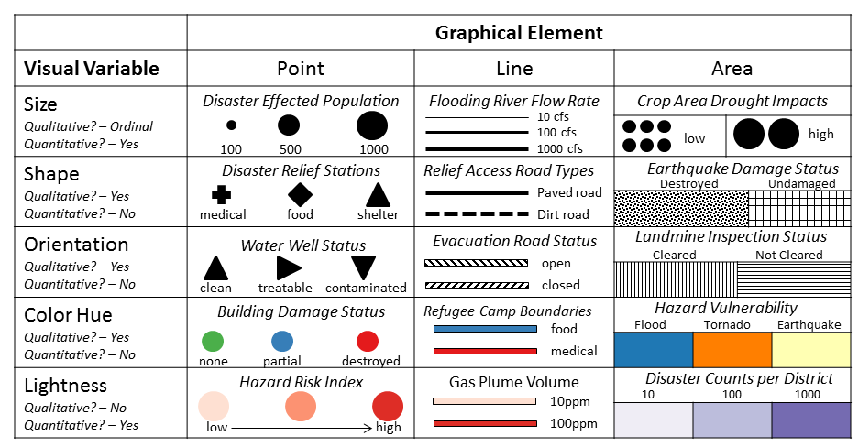
Visual Variables
Maps are generally created using points, lines, areas and text
From this, data and map feature representation communicates through visual variables
Figure by Brian Tomaszewski

Slide 21
Other Mapping Principles
Visual Hierarchy: map features are presented in a manner that implies the relative importance of each feature
Figure and Ground Relationships: the visual display of information , elements intended to be the map’s focus of attention, or the figure(s), are visually contrasted from map elements that provide context, or ground, to the figure elements

Slide 22
Reference Maps
Convey a specific message or distributions of one or more attributes or relationships among several attributes
How would you use a map like this for disaster management?
USGS topographic reference map

Slide 23
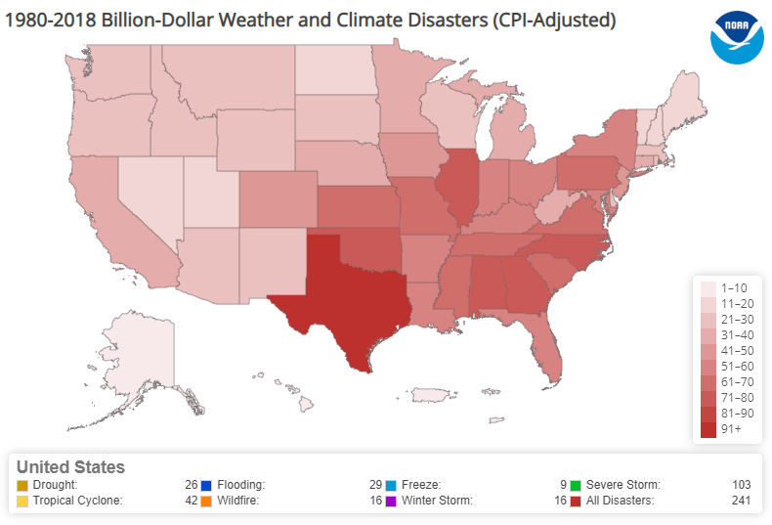
Thematic Maps
Shows numerous features and does not convey a particular message or communicate specific information
Develop insights into geographical patterns and trends
What patterns do you see in this map?
A thematic map example – counts of billion dollar weather and climate disasters between 1980 and 2018. (Map from Smith [2019].)

Slide 24
More on Thematic Maps
Choropleth map: aggregates data for display in a preexisting region such as a state or country
Data are displayed in two ways
Qualitative distinction between entities such as different color hues
Quantitative distinction where magnitudes of data are shown using different levels of color lightness (or saturation)
Examples of each?

Slide 25
Data Classification Methods
Each map is based on the same underlying data but look significantly different based on the data classification method used to make each map. How do the methods differ?
Figure by Brian Tomaszewski

Slide 26
More on Thematic Maps
Proportional Symbol Map: use symbols of varying sizes that are proportional to the value or magnitude being shown
Isarithmic Map: use line symbols to display phenomena that are continuous in nature
Dot density Map: distribution of an observation or observations at specific points
Examples of each kind?

Slide 27
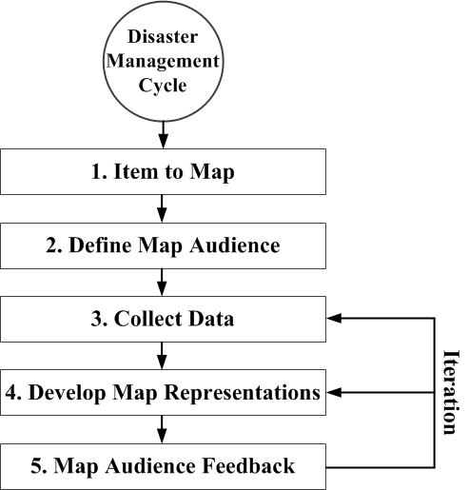
Designing Usable Maps in a GIS context
Map making in general is often viewed as an iterative process
The map-making process. (Figure by Brian Tomaszewski, adapted from Slocum, Terry A., Robert B. McMaster, Fritz C. Kessler, and Hugh H. Howard. 2008. Thematic Cartography and Geovisualization, 3rd edition, Prentice Hall.)

Slide 28
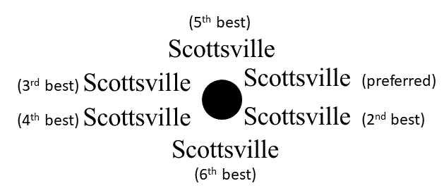
Map Design Elements
Basic Typographic Guidelines: avoid strange fonts, different font families, size = feature importance, spel chek
Text Label Placement Strategies
Best text label positions. Figure by Brian Tomaszewski

Slide 29
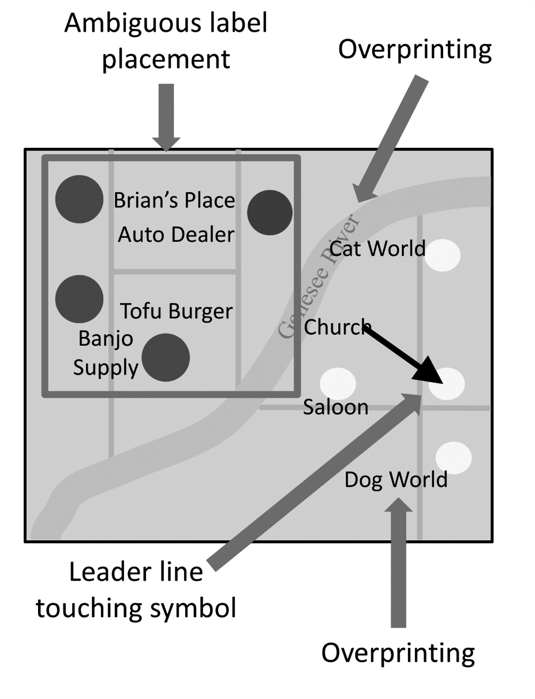
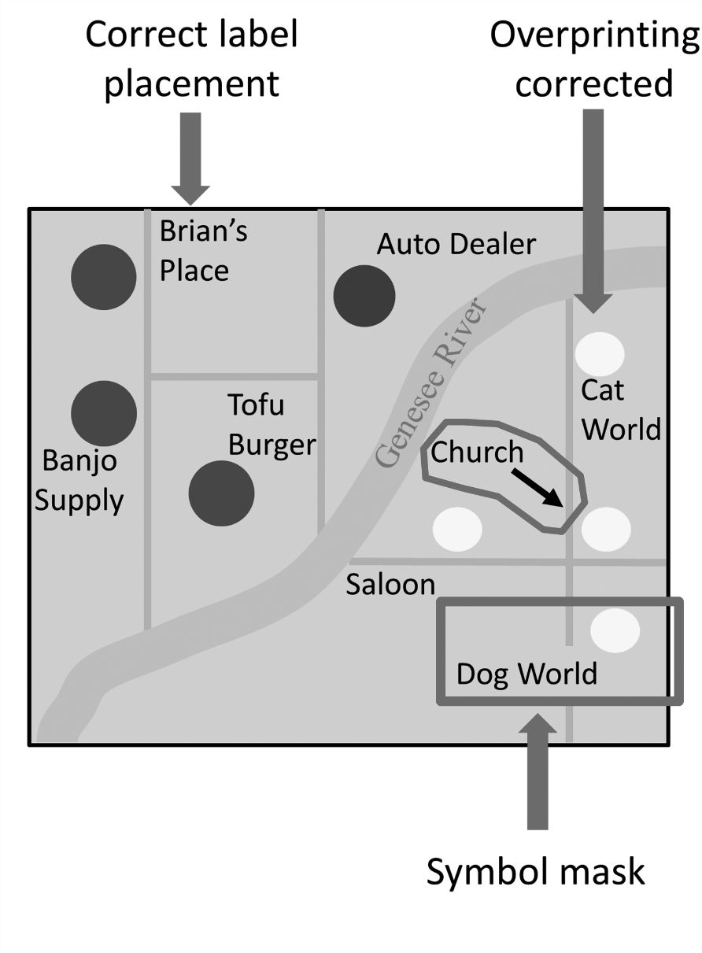
Label Placement
Examples of poor label placement and how to correct

Slide 30
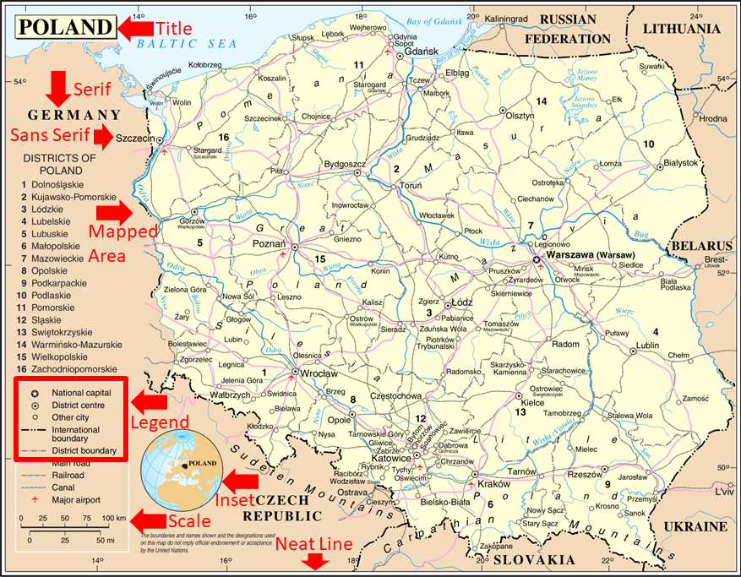
Common Map Elements
Example of common map elements
Public Domain: https://en.wikipedia.org/wiki/List_of_cities_and_towns_in_Poland#/media/File:Un-poland.png

Slide 31
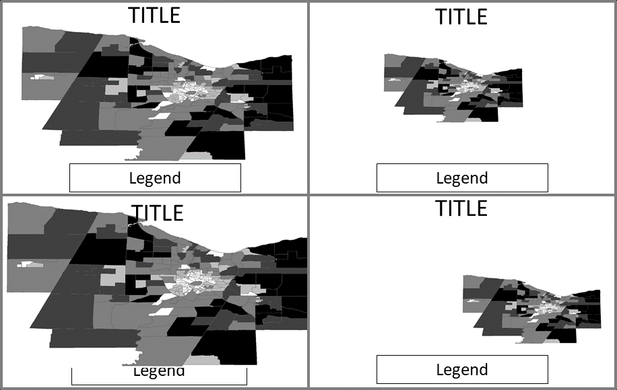
Sizing and Positioning of Map Elements
Sizing and positioning examples
(Figure by Brian Tomaszewski, adapted from Slocum, Terry A., Robert B. McMaster, Fritz C. Kessler, and Hugh H. Howard. 2008. Thematic Cartography and Geovisualization, 3rd edition, Prentice Hall.)

Slide 32
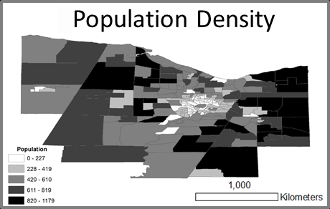
Map Balance
Correctly Balanced Map
Figure by Brian Tomaszewski

Slide 33
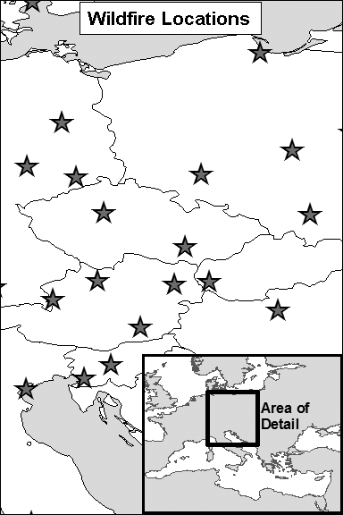
Insets
Small maps inside of a larger map layout: provide context
Can be used to locate the primary mapped area
Can also use to enlarge important areas or show areas that are congested with large number of features
Figure by Brian Tomaszewski

Slide 34
Common Examples of Poorly Made Maps Created With a GIS
Describe the design issues with these images

Slide 35
Summary
Data is different than information
Three ways of representing scale
Difference between large- and small -scale maps
Map projections: trade-offs
Coordinate systems: Lat/Long, UTM, SPC, National Grid
Principles of cartography: data measurement, visual variables, figure–ground relationships
Reference and Thematic Maps
Map design: typographic guidelines, text label placement, common elements, sizing and positioning, balance, insets
Common new map makers problems

Slide 36
Discussion Questions
What scale would you approximately need to use for the following types of emergencies and disasters: (1) a neighborhood blackout, (2) a snow storm affecting a small (<250,000 people) city, (3) a hurricane hitting the east coast of the United States, and (4) a major tsunami in the western Pacific ocean?
What types of classes of map projections might you use for the scenarios listed in Question 1 and why?
What types of disaster situations would lend themselves to choropleth mapping?
How might you combine different visual variables for multivariable mapping. For example, size and lightness?
Suppose you have to make a disaster map and differing color hue is not an option due to lack of a color printer. How would you reconsider the use of visual variables?
Referring back to Figure 2.49 (Common Legend Issue 4), what other issues can you find with this legend?

Slide 37
Chapter 2 Exercises
Exercise 2.1 – Fundamentals of Geographic Information
Mechanics of how geographic maps work as communication devices and to understand basic principles of geographic information as represented in paper maps
Exercise 2.2 – Basic Thematic Map Making with GIS Software
Cartographic design by constructing a basic thematic map related to disaster management using either ArcGIS Pro or QGIS, build a basic thematic map to investigate the relationship between earthquakes, population levels and roads categories in California, USA
A video walkthrough tutorial of this exercises is available from the book’s companion website: http://gisfordisastermanagement.com

Slide 38
References Used in the Slides
Smith, Adam B. 2018's Billion Dollar Disasters in Context 2019 [cited 5 August 2019]. Available from https://www.climate.gov/news-features/blogs/beyond-data/2018s-billion-dollar-disasters-context.

