Slide 1
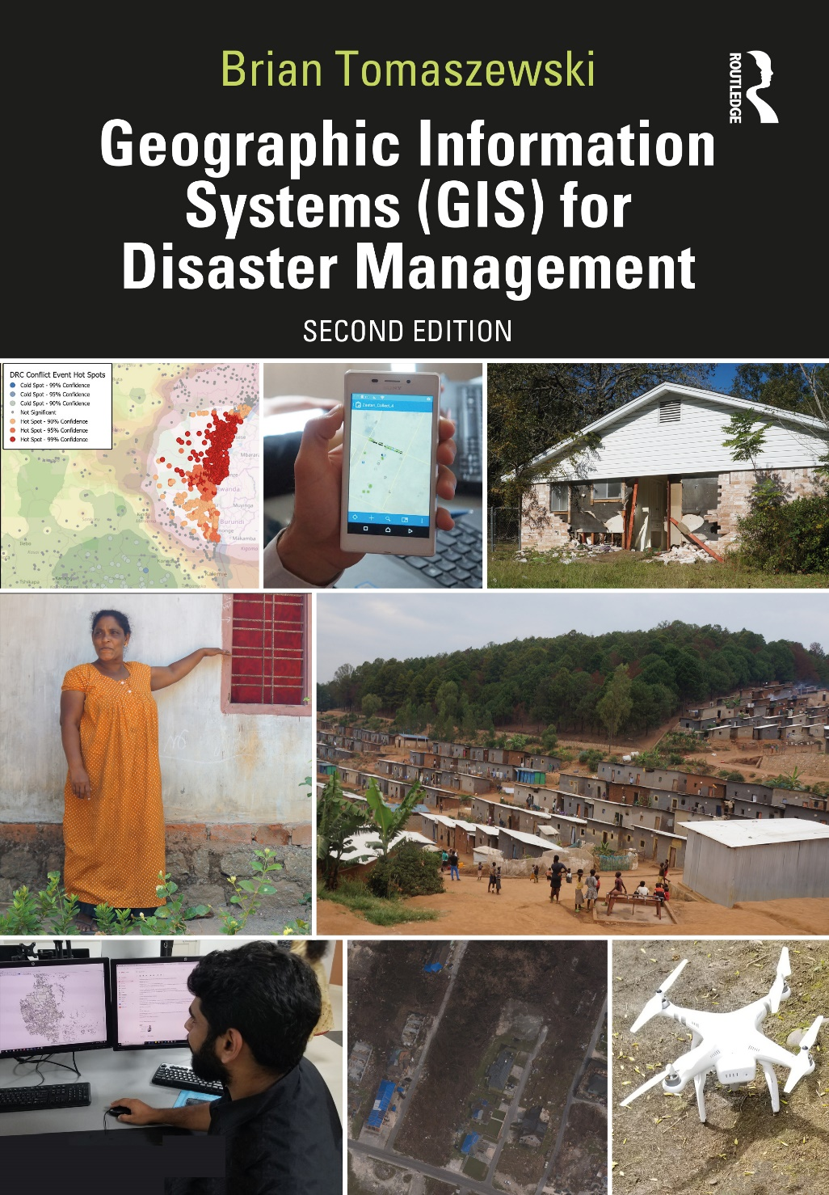
Chapter 1 A Survey of GIS for Disaster Management for additional materials, see: http://gisfordisastermanagement.com/ Recommended Citation: Tomaszewski, B. 2020. Chapter 1: A Survey of GIS for Disaster Management. In: Geographic Information Systems for Disaster Management (Second Edition), pp.1-30. Oxfordshire and New York: Routledge.
Notes:
V1.2

Slide 2
Chapter 1 Objectives
Understand the role of maps in disaster management
Describe how maps provide geographic context for disaster management and recognize how Geographic Information Systems (GIS) can be used for understanding geographic context
Be familiar with the concept of situation awareness
Discern the problems associated with the continued need for GIS in disaster management
Recognize the opportunities that exist with continued awareness and advocacy of GIS and mapping for disaster management;
Understand the importance of spatial thinking in disaster management practice

Slide 3
Introduction
Book assumes no previous knowledge of GIS or disaster management
Supplemental material: (slides and hands-on exercise video walkthroughs) books companion website - gisfordisastermanagement.com
Chapter 1 survey of GIS and Disaster Management

Slide 4
GIS and Geographical Context
GIS critical decision support and information management
Geographical context of a disaster can be thought of much like a news reporter asking for the basic “who, what, where, why, and how” aspects a disaster situation
A 1969 tracking map of hurricane Camille (Source: (US Department of Commerce 1969).

Slide 5
GIS and Geographical Context
Who are the people impacted?
What is the extent of the flood?
Where are buildings damaged?
Why was recovery in one area slower than in other area?
How did an area become vulnerable to a disaster?

Slide 6
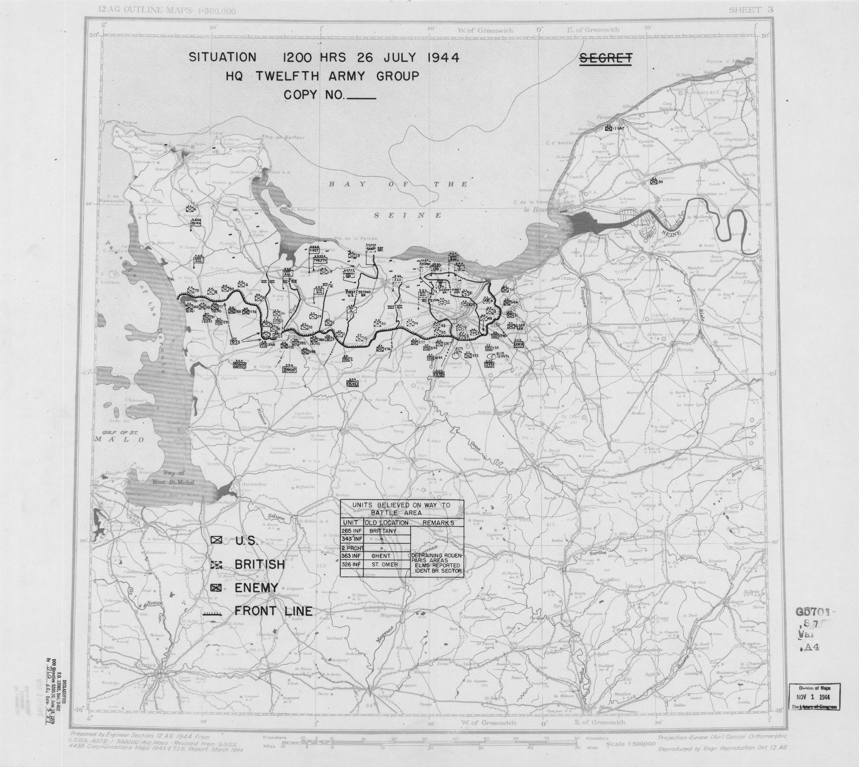
GIS and Situation Awareness (SA)
Situation awareness: knowing “what is going on”
GIS has essential role in managing the flow of geographic and other information needed for SA
A historic US military situation map from World War II and the Allied landings at Normandy, France, in 1944. (Public Domain)

Slide 7
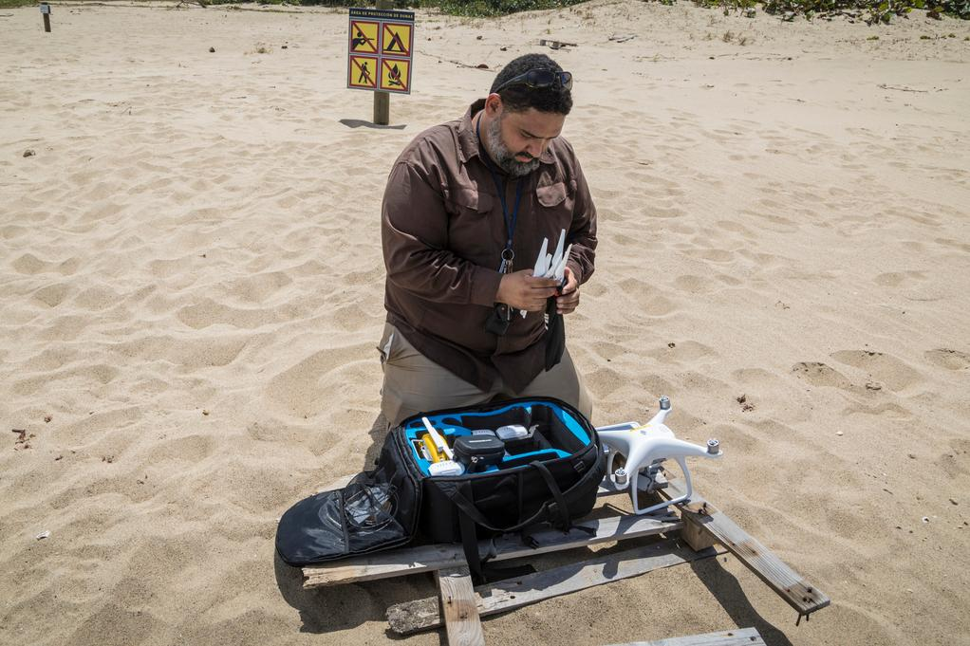
GIS and Situation Awareness (SA)
Disaster-management officials are making the role and functions of GIS more accessible during disasters
Real-time situation awareness
Unmanned Aerial Systems (UASs) or “drones” are becoming standard for real-time damage assessment
A 2018 picture of getting ready to use a drone to understand beach erosion in Puerto Rico after 2017’s Hurricane Maria. (Public Domain, www.fema.gov/media-library/assets/images/161181)

Slide 8
The Problem – The Continued Need for GIS in Disaster Management
Still need for improvement in terms of further utilizing GIS for disaster management
Scope, scale and intensity of disaster impacts continues to increase
Larger and increasingly diverse segments of society

Slide 9
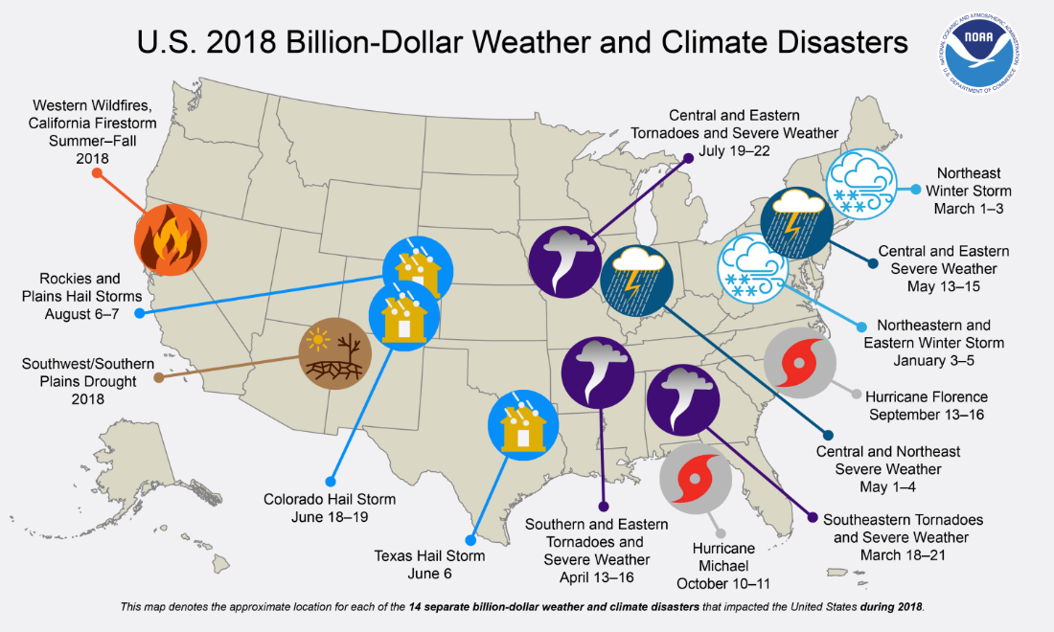
Natural Disasters and Climate Change
United States alone, 2018 saw 14 separate weather and climate events that exceeded over $1 billion USD
Overview of 14, billon-dollar weather and climate events in the United States in 2018 (figure source: Smith (2019))

Slide 10
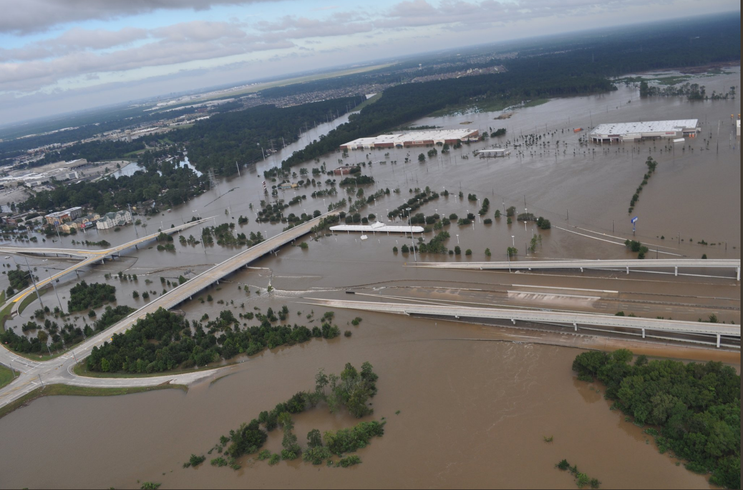
Natural Disasters and Climate Change
2017’s Hurricanes Harvey and Maria
Disasters are more intense, complex, and impacting larger geographical areas
Flooding from Harvey impacted over 300,000 structures, 500,000 cars, caused at least 68 direct deaths, and caused an estimated $90 to 160 billion dollars in damage (Blake and Zelinsky 2018)
Flooding around Harris County, Texas, USA, during 2017’s Hurricane Harvey. (Source: National Weather Service – Houston/Galveston (n.d.) www.weather.gov/images/hgx/projects/harvey17/HCSOTexasAirSupport_aug30_2.PNG)

Slide 11
Humanitarian Crisis and GIS – Conflict, Natural Disasters and Forced Displacement
United Nations Office for the Coordination of Humanitarian Affairs (UN-OCHA), estimated that 2018 would see over 128 million people around the world in need of some form of humanitarian assistance (United Nations Office for the Coordination of Humanitarian Affairs (UN-OCHA) 2017)
The Kigeme refugee camp in Rwanda, home to over 20,000 refugees from the Democratic Republic of Congo (DRC) and susceptible to landslides due to hilly terrain. (Photo by Brian Tomaszewski)

Slide 12
Progress and Challenges for Improved Coordination, Sharing, and Interoperability
Challenges still exist in the coordination, sharing, and interoperability of GIS resources:
data and trained staff
lack of comprehensive infrastructures for data sharing across local, state, Federal resources
Much progress since publication of Successful Response Starts With a Map: Improving Geospatial Support for Disaster Management (2007)

Slide 13
Continuing to Advocate for GIS in Disaster Management
Remains room for making disaster management practitioners—broader public—aware of the power and benefits of GIS and mapping in general
Geospatial in Baton Rouge during the Katrina :
One problem is that there are cultural differences between old and new school views. People who work in mitigation don’t see the use of the GIS tools available. Technology isn’t embraced. Mitigation and preparedness is generally done by local and state so FEMA cannot enforce it. (from (DeCapua 2007, :37)

Slide 14
The Opportunity – Increased Awareness and Advocacy of GIS and Mapping
As of 2011, all state-level emergency operation centers (EOCs) in the USA were utilizing GIS and remote sensing to varying degrees (Hodgson et al. 2013).
US Federal Emergency Management Agency (FEMA) has a well-established online course titled “IS-922: Applications of GIS for Emergency Management”
https://emilms.fema.gov/is922/index.htm

Slide 15
The Opportunity – Increased Awareness and Advocacy of GIS and Mapping
Geospatial technology capacity building efforts have also become part of international frameworks
United Nations Sendai Framework
https://www.undrr.org/publication/sendai-framework-disaster-risk-reduction-2015-2030

Slide 16
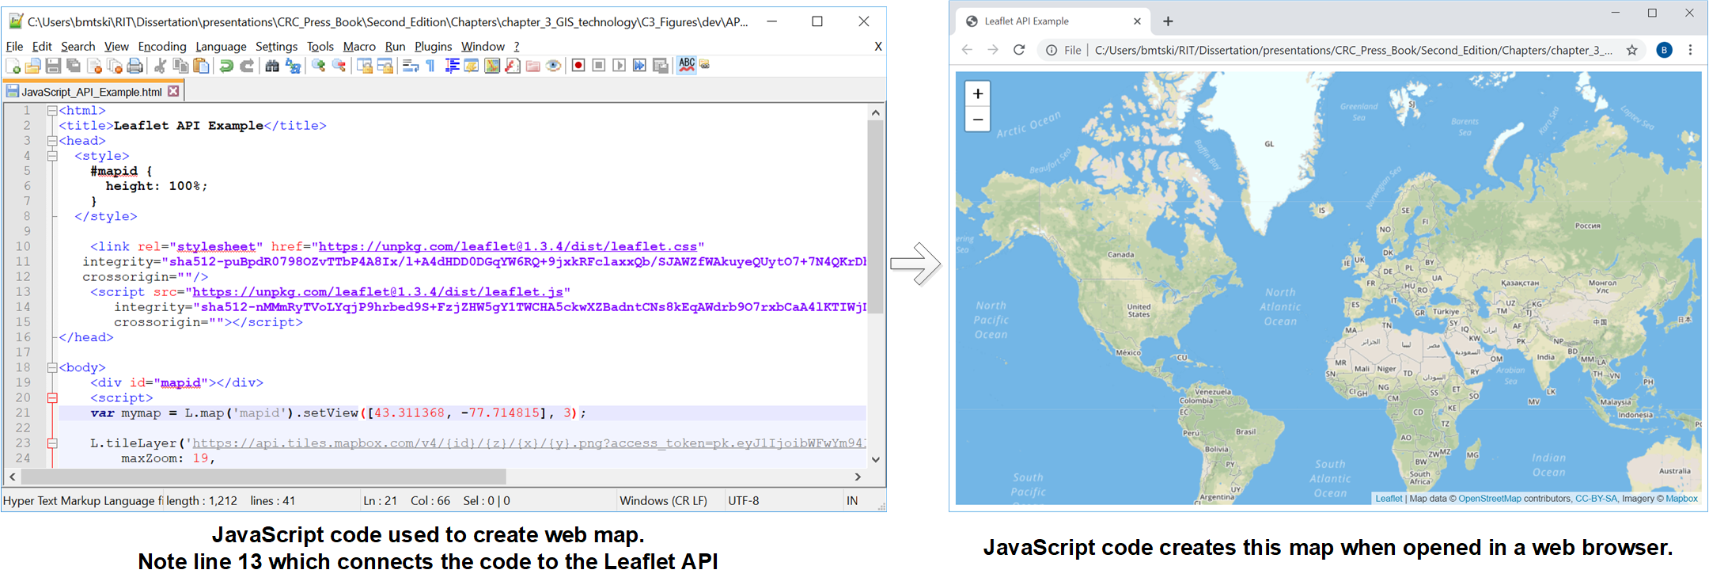
The Opportunity – Increased Awareness and Advocacy of GIS and Mapping
GIS and mapping - use by people typically not trained in traditional mapping science disciplines such as Geography
Example: Mapping Mashups and Open Data
Using the LeafletAPI to create a simple web-map using Open Street Map data.
Code based on example from: https://leafletjs.com/examples.html

Slide 17
Spatial Thinking and Disaster Management
GIS for disaster management means for developing spatial thinking skills
Spatial thinking:
using the properties of space (distance, direction)
visual representations (maps, diagrams)
reasoning processes to structure and solve problems (National Research Council 2006; Bednarz and Bednarz 2008)

Slide 18
Spatial Thinking and Disaster Management
Need to “think spatially” is perhaps the most important skill anyone interested in the application of GIS for disaster management can learn
Disasters are inherently spatial problems

Slide 19
Spatial Thinking and Disaster Management
Spatial Thinking Concept | GIS Tasks Based on Spatial Thinking Concepts | Representative disaster management spatial thinking operations
Concepts of space – e.g. Calculating Distance (miles vs. time ) | Networking and Routing (Chapter 8) | What is the fastest evacuation route in terms of time? in terms of distance?
Tools of representation – e.g. map projection effects, data representation | Cartography and Map Making (Chapter 2) | What is the most effective way to represent ground elevation – 2D contour lines, 3D hill shade etc.
Tools of representation – e.g. map projection effects, data representation | GIS data formats (Chapter 3); Spatial Data Management (Chapter 3) | What spatial data sets are relevant or should be combined?
Processes of Reasoning – e.g. structuring and solving spatial problems | Spatial Modeling, Site Selection (Chapter 9: GIS and Disaster Mitigation) | Who are the most vulnerable people and where are they located?
Processes of Reasoning – e.g. structuring and solving spatial problems | Spatial Modeling, Site Selection (Chapter 9: GIS and disaster mitigation) | Developing understanding of the spatial relationships between natural hazards and how they can potentially impact infrastructures in built environments
Processes of Reasoning – e.g. structuring and solving spatial problems | GIS layers and overlay (Chapter 3); Disaster Management and GIS organizations (Chapter 5) | Understanding abstract spatial relationships such as the interconnections between the physical environment and development and planning
Processes of Reasoning – e.g. structuring and solving spatial problems | GIS layers and overlay (Chapter 3) | When have past disasters happened?

Slide 20
Summary
GIS is critical to understanding the geographical context of disaster situations
Answering who, what, where, why, and how questions
Situation awareness: GIS is to what is happened during a disaster situation (maps)
Problems: larger and more intense disasters of international scope, coordination and sharing of geographic information, need for further GIS advocacy
Opportunities: Demonstrated value, jobs and career opportunities.
Spatial thinking: GIS supports spatial thinking and reasoning to make better informed decisions and judgments

Slide 21
Discussion Questions
1. What are some other specific examples of who, what, where, why, and how disaster-management geographic context questions that GIS could help answer?
2. What challenges are there with maintaining situation awareness, and how specifically can GIS support situation awareness?
3. Describe some other disaster-management operations and GIS concepts (as far as you know them from what was described in this chapter) related to the previous case studies that were not listed in Table 1.1.
4. What are some of the main coordination and sharing issues with GIS in disaster-management practice?
5. Why are there problems with awareness of GIS in disaster-management practice?
6. Describe some of the opportunities that are emerging for GIS and disaster management.
7. Explain the importance of spatial thinking to disaster-management practice

Slide 22
Chapter 1 Exercise
Exercise 1.1 – Compile and Critically Examine Disaster Management Maps
Find and critically examine maps related to disaster management in terms of how those maps provide geographic context

Slide 23
References Used in the Slides
Bednarz, Robert S, and Sarah W Bednarz. 2008. The importance of spatial thinking in an uncertain world. In Geospatial Technologies and Homeland Security: Springer.
DeCapua, Chelsea. 2007. Applications of geospatial technology in international disasters and during hurricane katrina. Oak Ridge National Laboratory.
Hodgson, Michael E, Sarah E Battersby, Shufan Liu, and Leanne Sulewski. 2013. Geospatial and Remote Sensing Data Use By States and Counties in Disaster Response and Recovery: A Nationwide Survey.
National Research Council. 2006. GIS as a Support System for Spatial Thinking. In Learning to Think Spatially: GIS as a Support System in the K-12 Cirriculum, edited by National Research Council. Washington, DC: The National Academies Press.
National Research Council. “GIS as a Support System for Spatial Thinking.” In Learning to Think Spatially: GIS as a Support System in the K-12 Curriculum, edited by National Research Council. Washington, DC: The National Academies Press, 2006, pp. 217–226.
National Research Council. 2007. Successful Response Starts With a Map: Improving Geospatial Support for Disaster Management. Edited by Committee on Planning for Catastrophe: A Blueprint for Improving Geospatial Data Tools and Infrastructure. Washington, D.C.: National Academies Press.
Smith, Adam B. 2018's Billion Dollar Disasters in Context 2019 [cited 5 August 2019]. Available from https://www.climate.gov/news-features/blogs/beyond-data/2018s-billion-dollar-disasters-context.
United Nations Office for the Coordination of Humanitarian Affairs (UN-OCHA). Global Humanitarian Overview 2018 2017 [cited 18 June 2018]. Available from https://interactive.unocha.org/publication/globalhumanitarianoverview/.
US Department of Commerce. “Hurricane Camille - August 14-22 1969 (Preliminary Report).” 1969.

