Slide 1
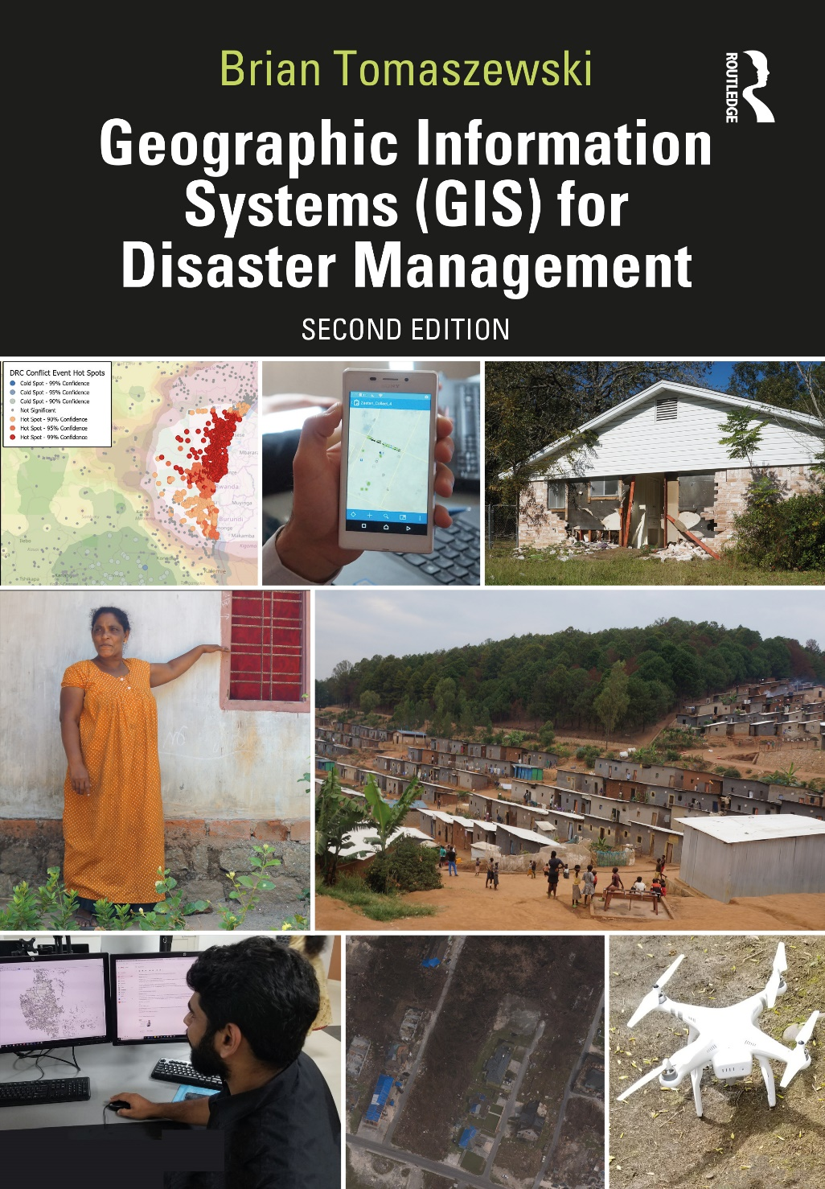
Chapter 10 Special Topics, Future Technology, Professional Career Options, and Geographic Information Systems Trends for additional materials, see: http://gisfordisastermanagement.com/ Recommended Citation: Tomaszewski, B. 2020. Chapter 10: Special Topics, Future Technology, Professional Career Options, and Geographic Information Systems Trends. In: Geographic Information Systems for Disaster Management (Second Edition), pp. 407-444. Oxfordshire and New York: Routledge.
Notes:
V1.2

Slide 2
Chapter 10 Objectives
Understand selected special topics for geographic information systems (GIS) and disaster management
Develop an appreciation for the future of GIS for disaster management
Discern specific advice on building a career in GIS for disaster management
Understand how to stay current in the field of GIS for disaster management using a variety of mechanisms such as organizational membership, conferences, journals and magazines, training education, and volunteer opportunities

Slide 3
Introduction
Four areas:
Special topics in GIS for disaster management
Future of GIS for disaster management
Building a career and finding a job in GIS for disaster management
Advice on staying current in the field

Slide 4
Special Topics

Slide 5
“Big Data” and Disaster Management
Data volume, variety and velocity challenge thinking and existing techniques (Jacobs 2009; Gartner Inc. 2011)
Examples:
millions of location-tagged tweets and other social media artifacts
multiple decades’ worth of daily satellite imagery
massive amounts of imagery collected from heavily impacted disaster areas
massive amounts of volunteer geographic information
Social Media: data trust and the reliability, privacy of citizens, better understanding between volunteer groups that create relevant big data and government organizations that use such data (Crowley 2013)

Slide 6
Controlling Rumors and False Information
Rumors: decisive role in collective perceptions, attitudes, and actions (DiFonzo and Bordia 2007)
Knowledge/ideas about real or imagined items: first manifested and transmitted as rumors
Social media: rapid dissemination of rumors
A 2017 presentation by the Harris County Joint Information Center on rumor control during Hurricane Harvey as part of the Hurricane Harvey after-action briefing. Picture by Brian Tomaszewski.

Slide 7
Technologies for Big Data in GIS for Disaster Management Applications
Commercial and open-source technologies (Chapter 3)
Advanced statistical and other spatial analytical methods, combined with geographic visualization
mongoDB (www.mongodb.com/): noSQL database

Slide 8
Machine Learning and Artificial Intelligence
Machine Learning (ML): “a set of data-driven algorithms and techniques that automate the prediction, classification, and clustering of data” (Bennett 2017)
Artificial Intelligence (AI): “makes it possible for machines to learn from experience, adjust to new inputs and perform human-like tasks” (SAS 2019)
ML is a subfield of AI – ML tools can be trained on large datasets and apply knowledge to tasks (Reese 2017)
Spatial aspects of GIS: relevant technology for both ML and AI

Slide 9
Machine Learning
Data Prediction: using known values to estimate unknown values (Bennett 2017); regression analysis
Data Classification: category an object should be placed in based on a training set (Bennett 2017); remote sensing datasets - analyzing and categorizing pixels
Data Clustering: clustering groups observations based on similar values or locations (Bennett 2017); Hot spot analysis

Slide 10
Spatial Data Science
Data science: “field of study that combines domain expertise, programming skills, and knowledge of mathematics and statistics to extract meaningful insights from data” (Datarobot 2020)
Spatial data science: look specifically at spatial patterns and process by drawing upon machine learning, artificial intelligence and deep learning algorithms
Jupyter notebook environment (Chapter 3): spatial data science process

Slide 11
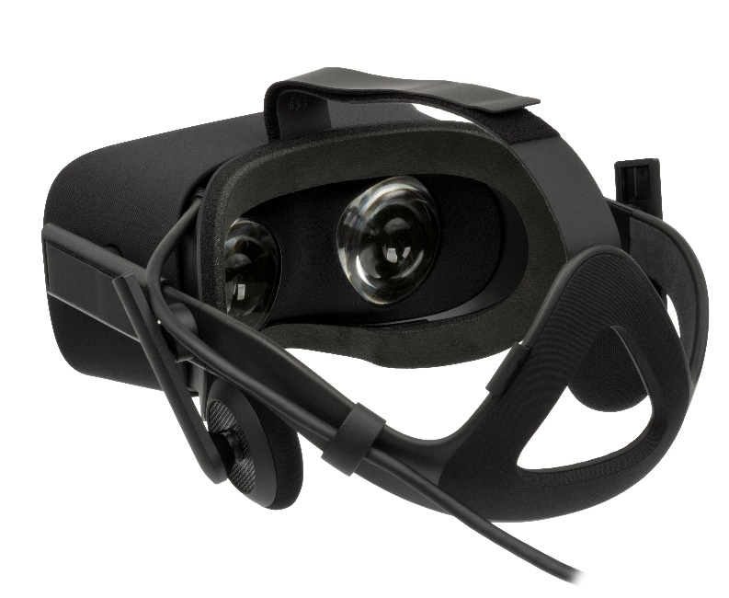
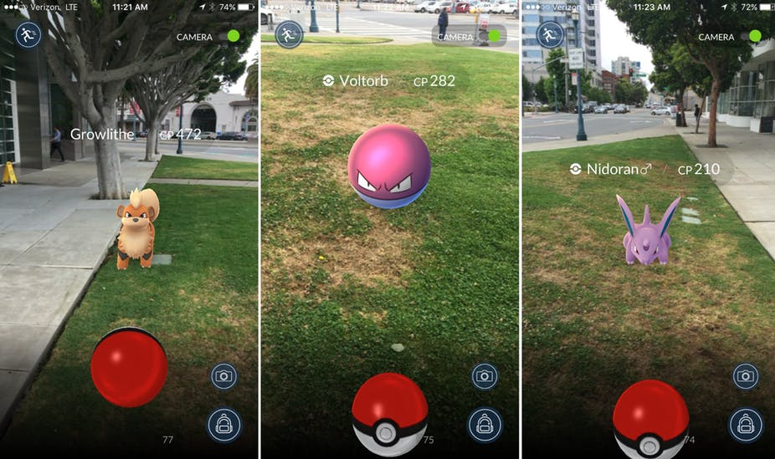
Virtual and Augmented Reality
Virtual reality (VR): completely digital, virtual world that a person immerses themselves in with something like a special pair of goggles
Augmented reality (AR): digital artifacts are placed on top of real-world scenes
Oculus Rift virtual reality glasses. Public Domain: https://en.wikipedia.org/wiki/Oculus_Rift#/media/File:Oculus-Rift-CV1-Headset-Front.jpg
Pokémon Go, an augmented-reality geo-game. https://theconversation.com/why-pokemon-go-became-an-instant-phenomenon-62412 CC BY 4.0: https://creativecommons.org/licenses/by/4.0/.

Slide 12
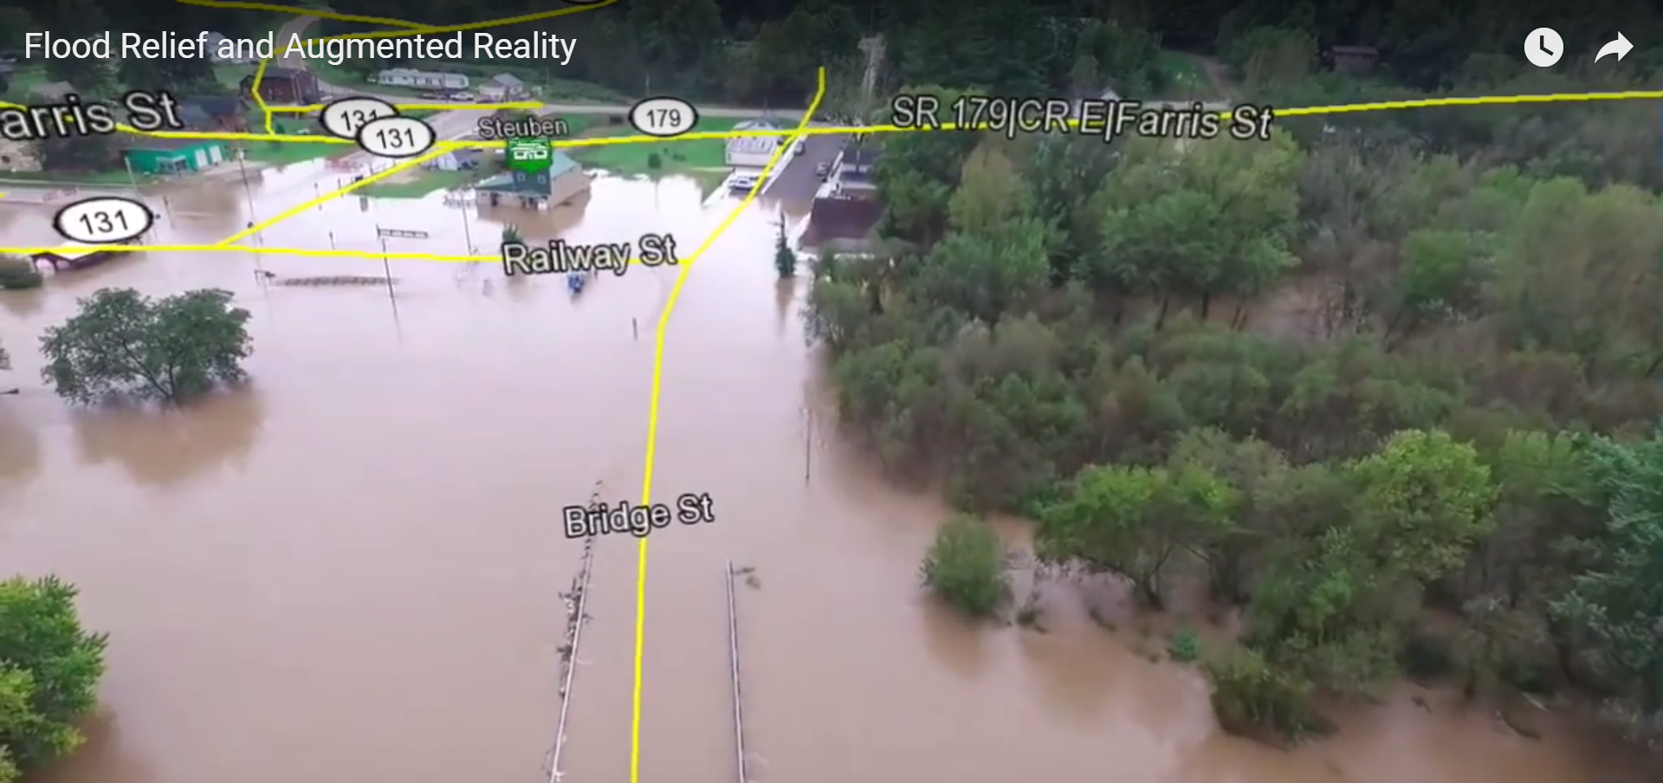
AR, VR, GIS, and Disaster Management
Combining AR with drone flight to determine landmarks and streets during a flood event. Image from www.youtube.com/watch?time_continue=8&v=uimSnxUPbIE.

Slide 13
Geographic Information Science and Disaster Management
Interdisciplinary field concerned with the underlying theory and methods of GIS, questions related to the nature of geographic information itself and the impacts of geospatial technology on society and individuals, and the impacts of society and individuals on geospatial technology (Mark 2003; DiBiase et al. 2006)
Seeks to develop the next generation of GIS technology through scientific inquiry in a wide variety of fields: computer science, information technology, spatial cognition, statistics, cartography, and any other discipline relevant to GISystems
University Consortium for Geographic Information Science, Geographic Information Science and Technology Body of Knowledge (UCGIS GIS&T BOK): https://gistbok.ucgis.org/all-topics

Slide 14
The Future of GIS for Disaster Management
More complex natural disasters and humanitarian situations
Massive volumes of big data: advanced analytics
Indoor mapping, Internet of Things (IoT), virtual reality and augmented reality, 3D GIS, etc” - How we consider the term “GIS” as both a technology and conceptual framework?
Important to not forget millions of people in the world who do not have access to even the most basic forms of GIS: technology, reliable datasets, and training - Geographic Information Capacity (Chapter 6)

Slide 15
Research Agenda
Develop new methods to gather, process, transform, analyze, integrate, and curate greater volumes of “traditional” geographic information (satellite/imagery, raster, vector etc.) along with new forms of geographic information (real-time drone imagery, IoT sensor data, indoor positioning and reference etc.)
Develop new forms of data-dissemination services; examine how existing data-dissemination services can allow larger and diverse amounts of geographic information to be more easily and quickly shared with a wider range of disaster management actors on a wider range of technology platforms
Examine, identify, and document specific, relevant disaster management products that can be created by GIS and determine how those products can be used at the right time, by the right people, for the right situation, and on the right technology platform or display format
Develop new educational and pedagogical approaches for teaching and raising the awareness of GIS capabilities and spatial thinking for disaster management to diverse groups of learners with diverse educational needs

Slide 16
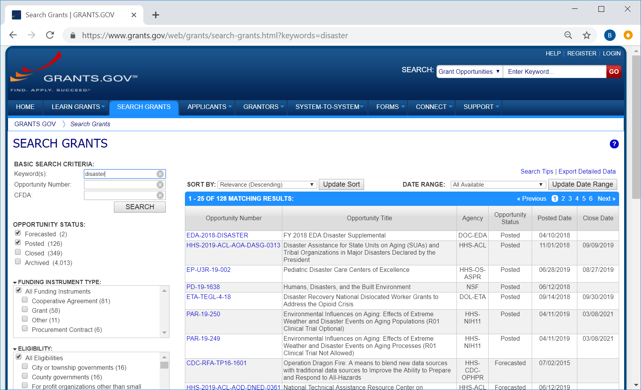
GIS for Disaster Management Research Funding Mechanisms
US National Science Foundation (NSF): www.nsf.gov/naturaldisasters/
Federal Emergency Management Agency (FEMA) Grants: www.fema.gov/grants
Other US Federal Grants and Funding: Grants.gov
A search on the term “disasters” in grants.gov reveals over 125+ funding opportunities.

Slide 17
Other Disaster Funding Mechanisms: Foundations and Other Grant Sources
Conrad N. Hilton Foundation: Disaster Relief & Recovery: www.hiltonfoundation.org/priorities/disaster-relief-and-recovery
Google Foundation: www.google.org
Microsoft Philanthropies: www.microsoft.com/en-us/philanthropies
Emergency Response: Bill & Melinda Gates Foundation: www.gatesfoundation.org/what-we-do/global-development/emergency-response
United Kingdom Department for International Development (UK DFID) International Development (UK DFID) funding: www.gov.uk/international-development-funding
EU Solidarity Fund: https://ec.europa.eu/regional_policy/en/funding/solidarity-fund/
European Civil Protection and Humanitarian Aid Operations (ECHO): https://ec.europa.eu/echo/funding-evaluations/funding-humanitarian-aid_en

Slide 18
Grant Proposal Writing Advice
Fully read the description of the funding opportunity
Study review criteria carefully in available
Obtain a copy of a proposal that was successfully funded: argument structure/shape
Carefully read your proposal: typos, common spelling mistakes, formatting issues
Most funding opportunities receive hundreds of proposals: only a small percentage actually selected for funding
Proposal is clear, concise, and gets to the point
Avoid using specific jargon and terms that might not be understood from people outside your specific discipline
Person reading and reviewing your proposal is likely reading several other proposals: limited amount of time on your proposal

Slide 19
Developing a GIS for Disaster Management Career
Be interdisciplinary: study a wide range of topics
Be open-minded: be flexible with opportunities that present themselves
Get involved: volunteer
Stand out and go the extra distance: go beyond learning out-of-the-box GIS skills (computer programming, Web development, and database management)

Slide 20
Staying Current in the GIS for Disaster Management Field
GIS constantly changing: keep up with current trends - skills and perspectives remain relevant
Disaster management: equally constant state of change, (i.e., new forms of data such IoT, drones, big data etc.); realities that disasters continue to grow in size, scope, complexity, and intensity
Organizations, academic and trade publication outlets, training and education opportunities, and volunteer opportunities: some not directly related to GIS for disaster management - either focused on disaster or emergency management specifically and GIS is a topic that can be found within them, or specifically focused on GIS and the topic of disaster or emergency management can be found within them

Slide 21
Summary
Four areas:
Special topics in GIS for disaster management
Future of GIS for disaster management
Building a career and finding a job in GIS for disaster management
Advice on staying current in the field

Slide 22
Discussion Questions
1. Based on what you read in this book, and your own research, what do you think the future of GIS for disaster management will look like and why?
2. If you are looking for a job in the GIS for disaster management field, review your resume and see if your resume matches some of the things that the people who provided advice on finding a job in the GIS for disaster management industry recommended. What, if any, potential gaps do you see in your experiences, and how might you fill those gaps if necessary?
3. As discussed in the section on staying current in the GIS for disaster management field, many of the items listed are not directly related to both GIS and disaster management. Take a look at some of those items, and see where you can find GIS embedded inside of a disaster management item, and the do the reverse of finding a disaster management item imbedded inside of a GIS item.

Slide 23
Chapter 10 Exercises
Exercise 10.1 – Classifying Hurricane Damage Imagery with Machine Learning
Use and evaluate a machine-learning algorithm (Support Vector Machine [SVM]) to classify imagery in a disaster-response context.
A video walkthrough tutorial of this exercises is available from the book’s companion website: http://gisfordisastermanagement.com

Slide 24
References Used in the Slides
Bennett, Lauren. What Do We Mean by Machine Learning? 2017. Accessed July 19, 2019. https://www.esri.com/arcgis-blog/products/analytics/analytics/machine-learning-in-arcgis/.
Datarobot. Data Science, 2020. Accessed July 24, 2020. https://www.datarobot.com/wiki/data-science/.
DiBiase, D., M. DeMers, A. Johnson, K. Kemp, A.T. Luck, B. Plewe, and E. Wentz . Geographic Information Science and Technology Body of Knowledge. Washington, DC: Association of American Geographers, 2006
DiFonzo, Nicholas, and Prashant Bordia . Rumor Psychology: Social and Organizational Approaches, Vol. 750. Washington, DC: American Psychological Association, 2007.
Crowley, John. Connecting Grassroots and Government for Disaster Response. Washington, DC: Commons Laboratory, Wilson Center, 2013.
Gartner Inc. Gartner Says Solving 'Big Data' Challenge Involves More than Just Managing Volumes of Data, 2011. Accessed March 26, 2014. http://www.gartner.com/newsroom/id/1731916.
Jacobs, Adam. “The Pathologies of Big Data.” Communications of the ACM 52, no. 8 (2009): 36–44.
Mark, D. “Chapter 1: Geographic Information Science: Defining the Field.” In Foundations of Geographic Information Science, edited by M. Duckham, M.F. Goodchild, and M. Worboys. Boca Raton, FL: CRC Press, 2003, pp. 3–18.
Reese, Hope. Understanding the Differences Between AI, Machine Learning, and Deep Learning, 2017. Accessed July 19, 2019. https://www.techrepublic.com/article/understanding-the-differences-between-ai-machine-learning-and-deep-learning/.
SAS. Artificial Intelligence - What It Is and Why It Matters, 2019. Accessed July 19, 2019. https://www.sas.com/en_us/insights/analytics/what-is-artificial-intelligence.html.

