Slide 1
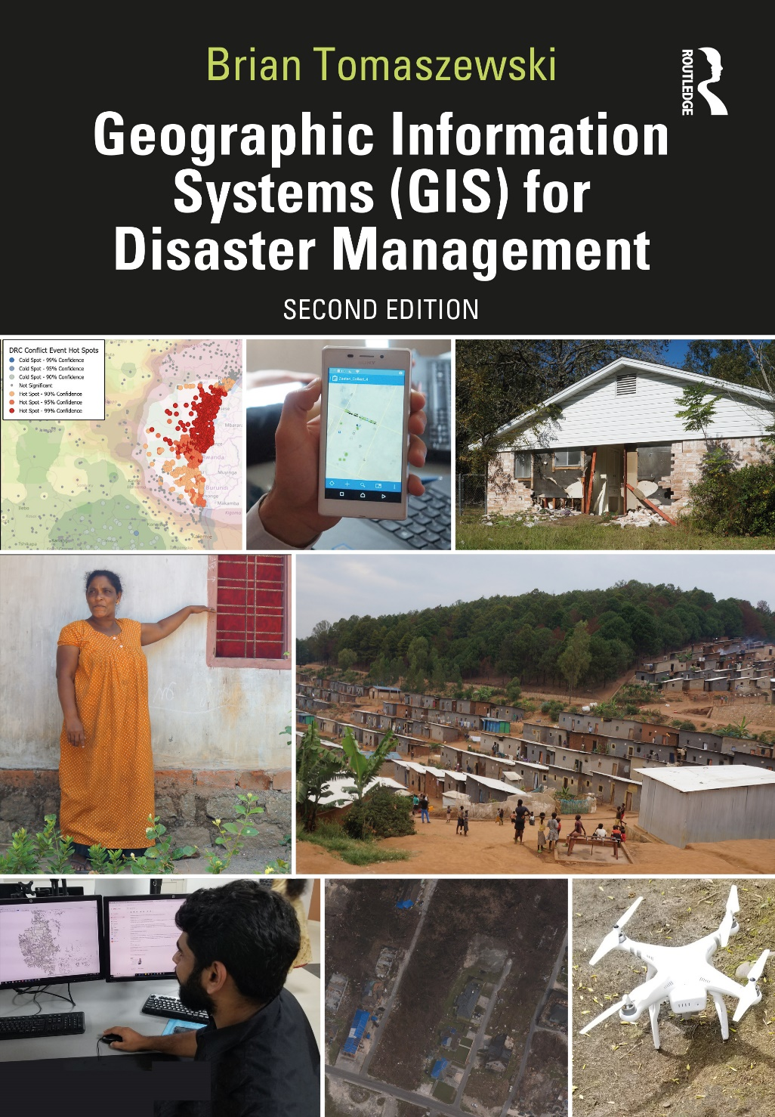
Chapter 6 Geographic Information Systems and Disaster Planning and Preparedness for additional materials, see: http://gisfordisastermanagement.com/ Recommended Citation: Tomaszewski, B. 2020. Chapter 6: Geographic Information Systems and Disaster Planning and Preparedness. In: Geographic Information Systems for Disaster Management (Second Edition), pp. 237-286. Oxfordshire and New York: Routledge.
Notes:
V1.2

Slide 2
Chapter 6 Objectives
Identify essential geographic information systems (GIS) datasets that should be acquired, developed, and curated during disaster-planning activities
Understand planning and preparedness organizational perspectives in terms of memorandums of understanding and cooperation agreements on the use of GIS datasets and other resources for disaster management
Discern how GIS can be used as a support tool for common disaster planning and preparation activities, such as evacuation route and zone planning
Understand the importance of scenario modeling for training purposes in the use of GIS to help answer what-if questions for disaster planning
Understand select spatial statistics methods for planning
Understand how GIS can be used for public outreach and citizen participation during disaster planning and preparation activities
Understand the nature of GIS and disaster management planning and preparation on an international scale
Understand the use of GIS by non-GIS professionals for disaster planning and preparation

Slide 3
Introduction
Geographic information systems for disaster preparedness and planning
Essential that proper plans are in place before an event occurs!
“Preparedness”: problematic, some measurable level that can be achieved?
Citizen preparedness
Use of GIS by non-GIS professionals

Slide 4
Geographic Information Capacity (GIC) for Disaster Management Preparedness
GIC: The overall ability of a community, society, government, or other organization to support disaster risk management initiatives by utilizing geographic information to make informed, evidence-based decisions and achieve agreed upon goals. This ability requires both awareness of and access to geographic information as well as the practical knowledge to use geospatial technologies effectively in its capture, analysis, and communication. (Tomaszewski et.al. 2020a:101643)
Persistent challenge: capacities vary
Recognized issue: United Nations Sendai Framework for Disaster Risk Reduction 2015–2030

Slide 5
Technology and Dataset Planning and Preparation

Slide 6
Essential Disaster Management Map Layers
Prepare and curate certain map datasets common to all disaster situation types
Reference data layers
Essential to maintain proper and updated metadata

Slide 7
Essential Disaster Management Map Layers
Geographic Information Framework Data Standard developed by the US Federal Geographic Data Committee (FGDC): Seven themes:
Cadastral data
Digital orthoimagery
Elevation
Geodetic control
Government units and other geographic area boundaries
Hydrography
Transportation (including road, rail, inland waterways, public transportation)

Slide 8
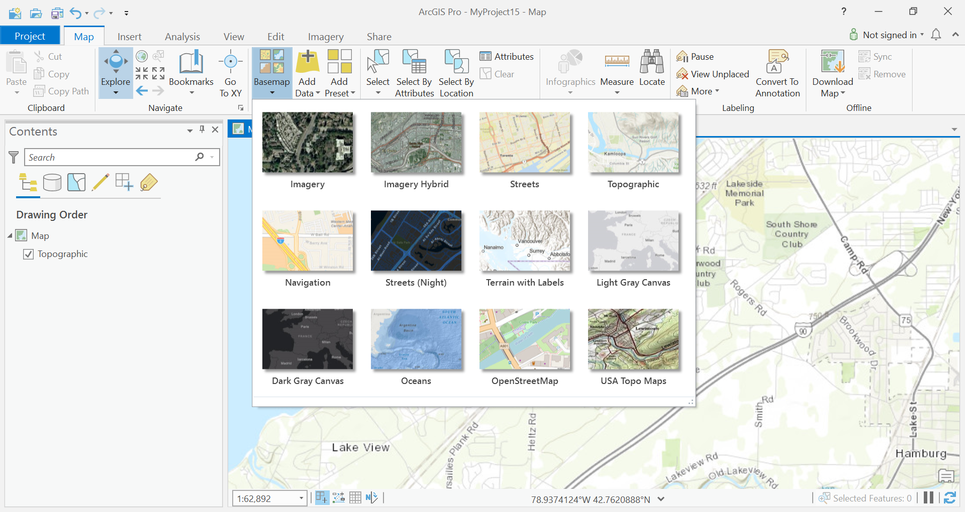
Essential Disaster Management Map Layers
Base maps available in software like ArcGIS Pro provide quick access to standard reference data themes. Copyright © 2019 Esri and its licensors. All rights reserved.

Slide 9
Additional Sources of Ideas for Essential Disaster Management Map Layers
Difficult, if not impossible: predefine all map layers needed for disaster management
Keep particulars of geographic context in mind
“Data Model”: describe how real-world entities are modeled in terms of database representations and relationships between entities and conceptual hierarchies

Slide 10
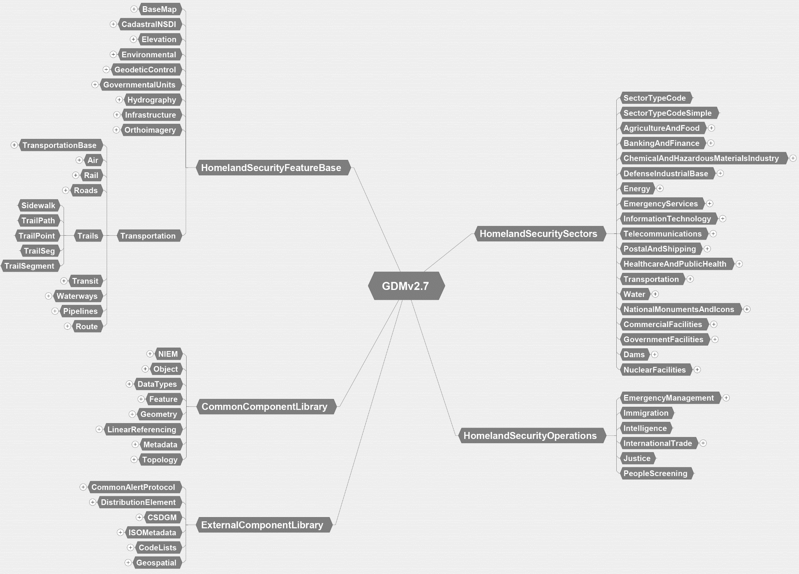
Department of Homeland Security Geospatial Data Model

Slide 11
Technology Planning and Preparation
Important that planning and preparation activities are conducted around GIS technology
Commercial GIS technology: regularly updated licenses
General IT computer issues: operating system upgrades, virus protection
Stay up to date on the newest trends in GIS technology (Chapter 10)

Slide 12
Organizational Perspectives
Develop organizations: able to collaborate and share data, people, tools, resources with one another
NIMS and the Sendai Disaster Reduction Framework
Memorandums of understanding (MOUs)
MOU example. ImageSource: Public Domain.

Slide 13
Using GIS to Support Planning and Preparation Activities

Slide 14
Spatial Perspectives on Broader Planning and Preparation Activities
Not all disasters are the same
Consider “geography”: people, the places they live, attachments to their communities, and relationships and interactions at multiple scales
GIS not final “word” on how a disaster management plan should be developed
GIS support device

Slide 15
Common GIS Tasks for Disaster Planning and Preparation Activities

Slide 16
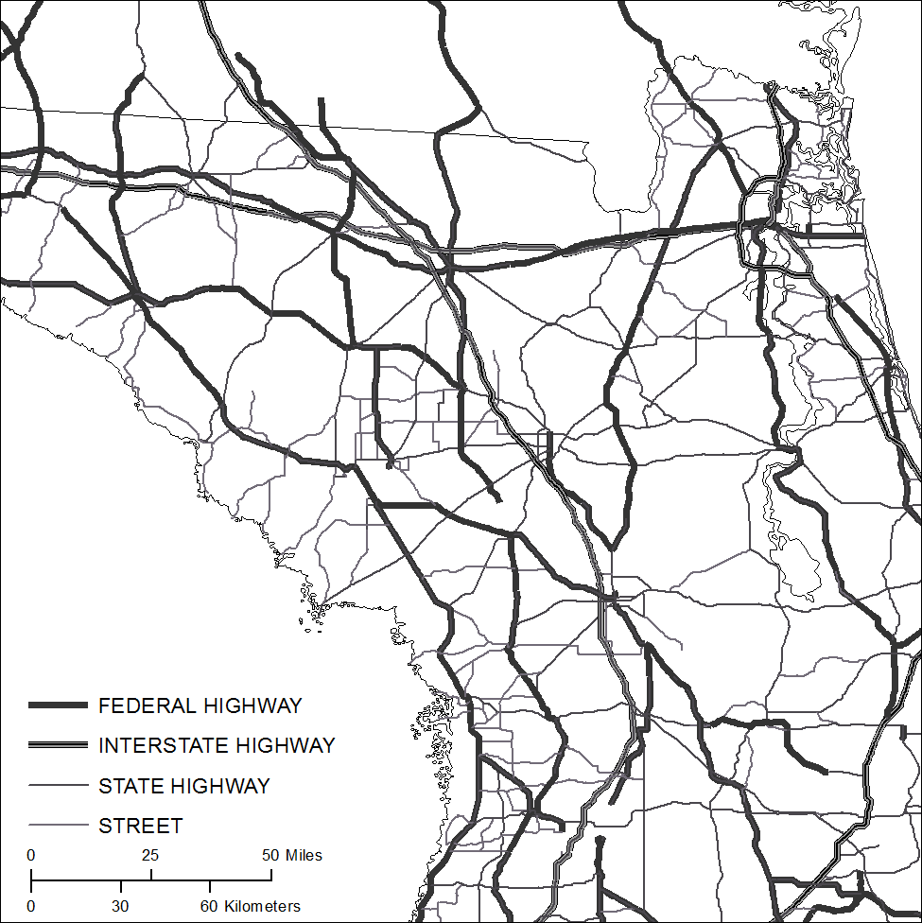
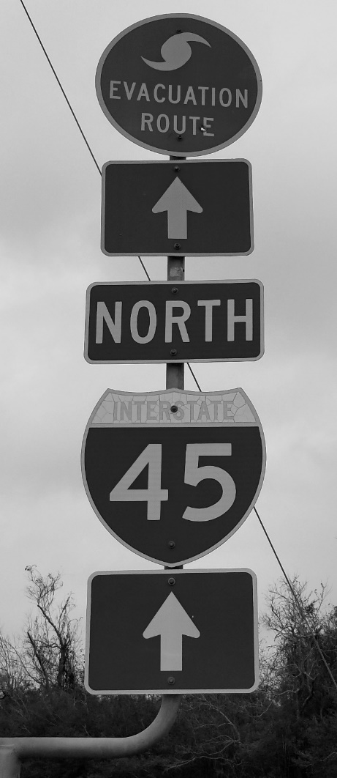
Evacuation Route Planning
Evacuation route planning framework.
Figure by Brian Tomaszewski.
Hurricane evacuation routes derived from FEMA data sources. Map by Brian Tomaszewski.
Hurricane evacuation route sign. Photo by Brian Tomaszewski.

Slide 17
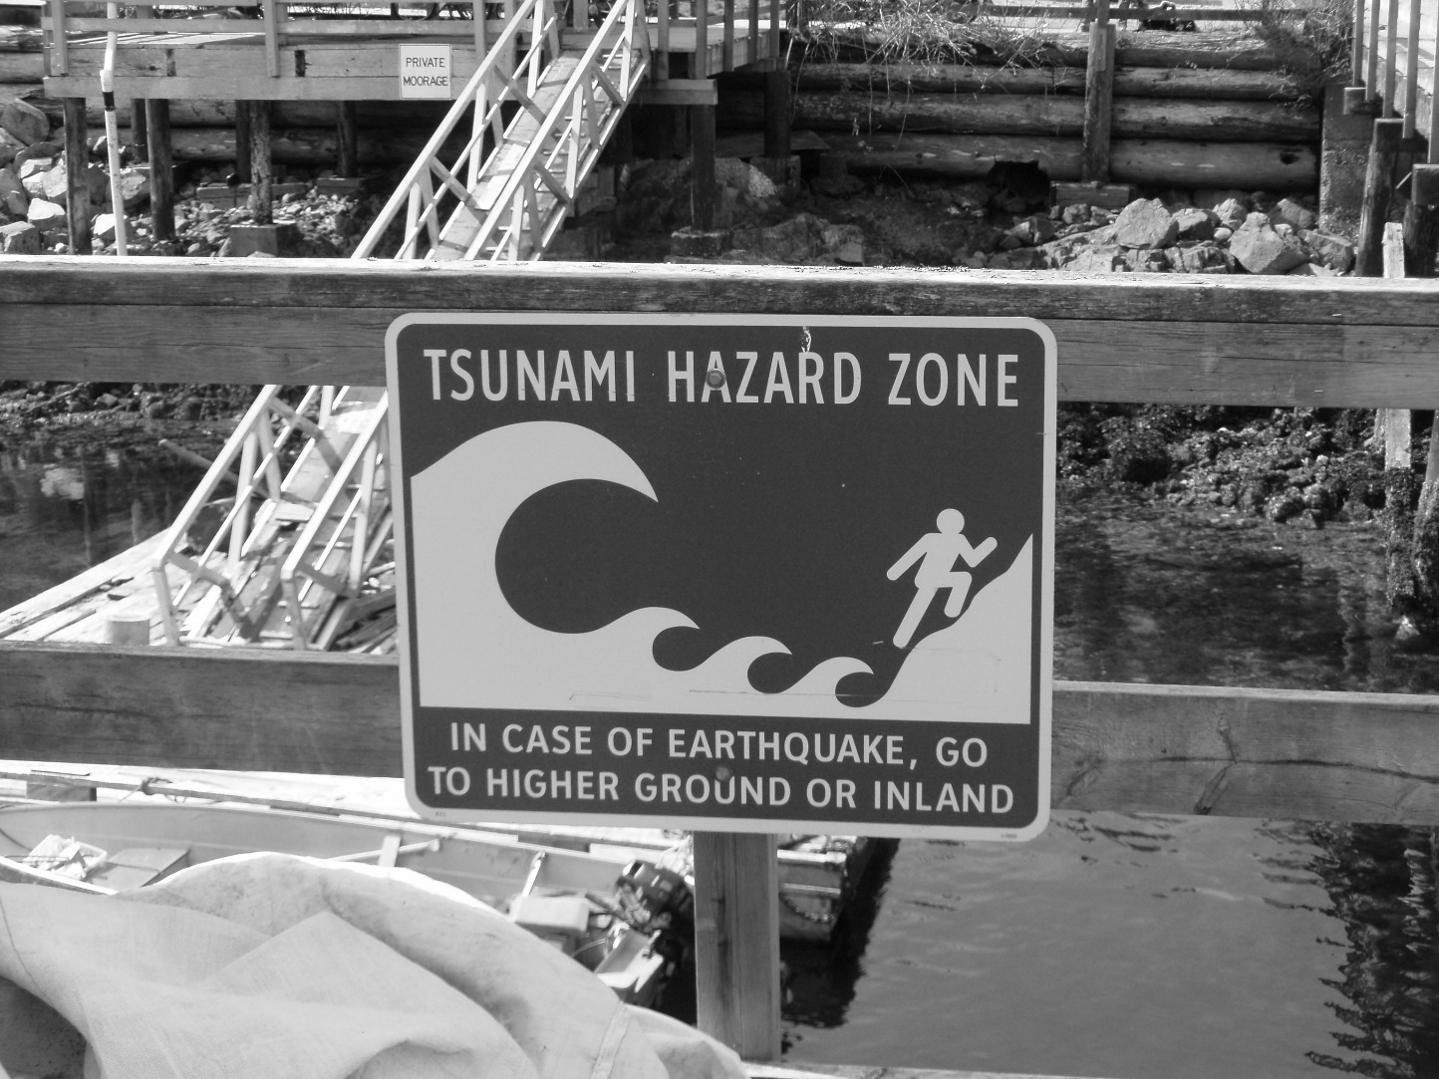
Evacuation Zone Planning
Define areas to evacuate from/to
Evacuation zone criteria: storm surge, elevation
Marking with signs
Tsunami hazard zone site. Source: Public Domain.

Slide 18
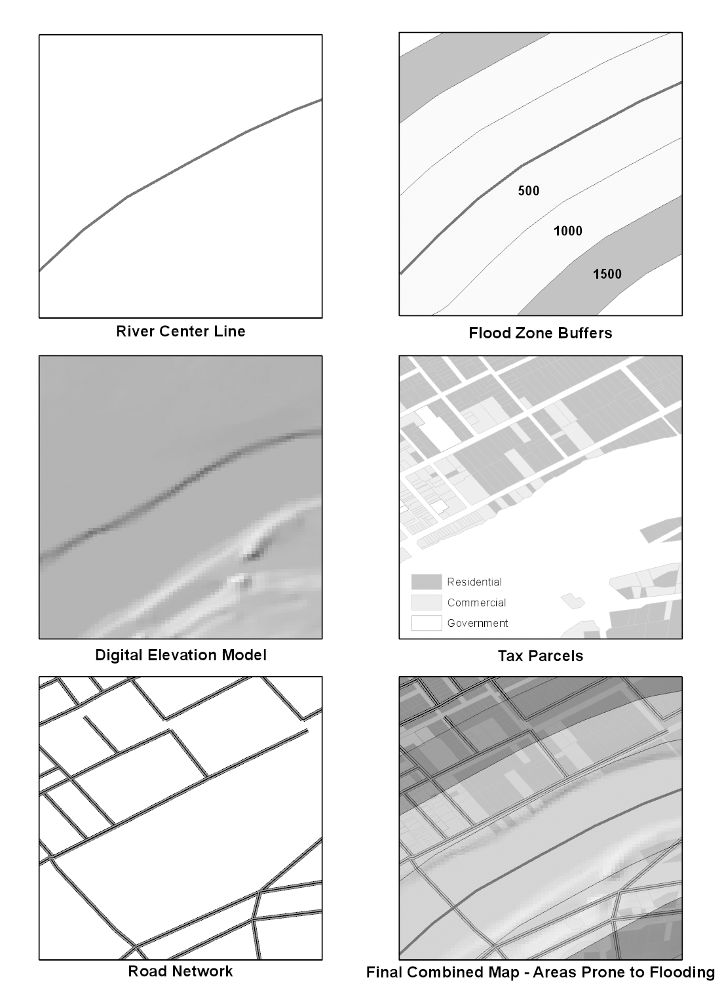
Evacuation Zone Planning
A hypothetical yet realistic flood evacuation zone analysis. Figure by Brian Tomaszewski

Slide 19
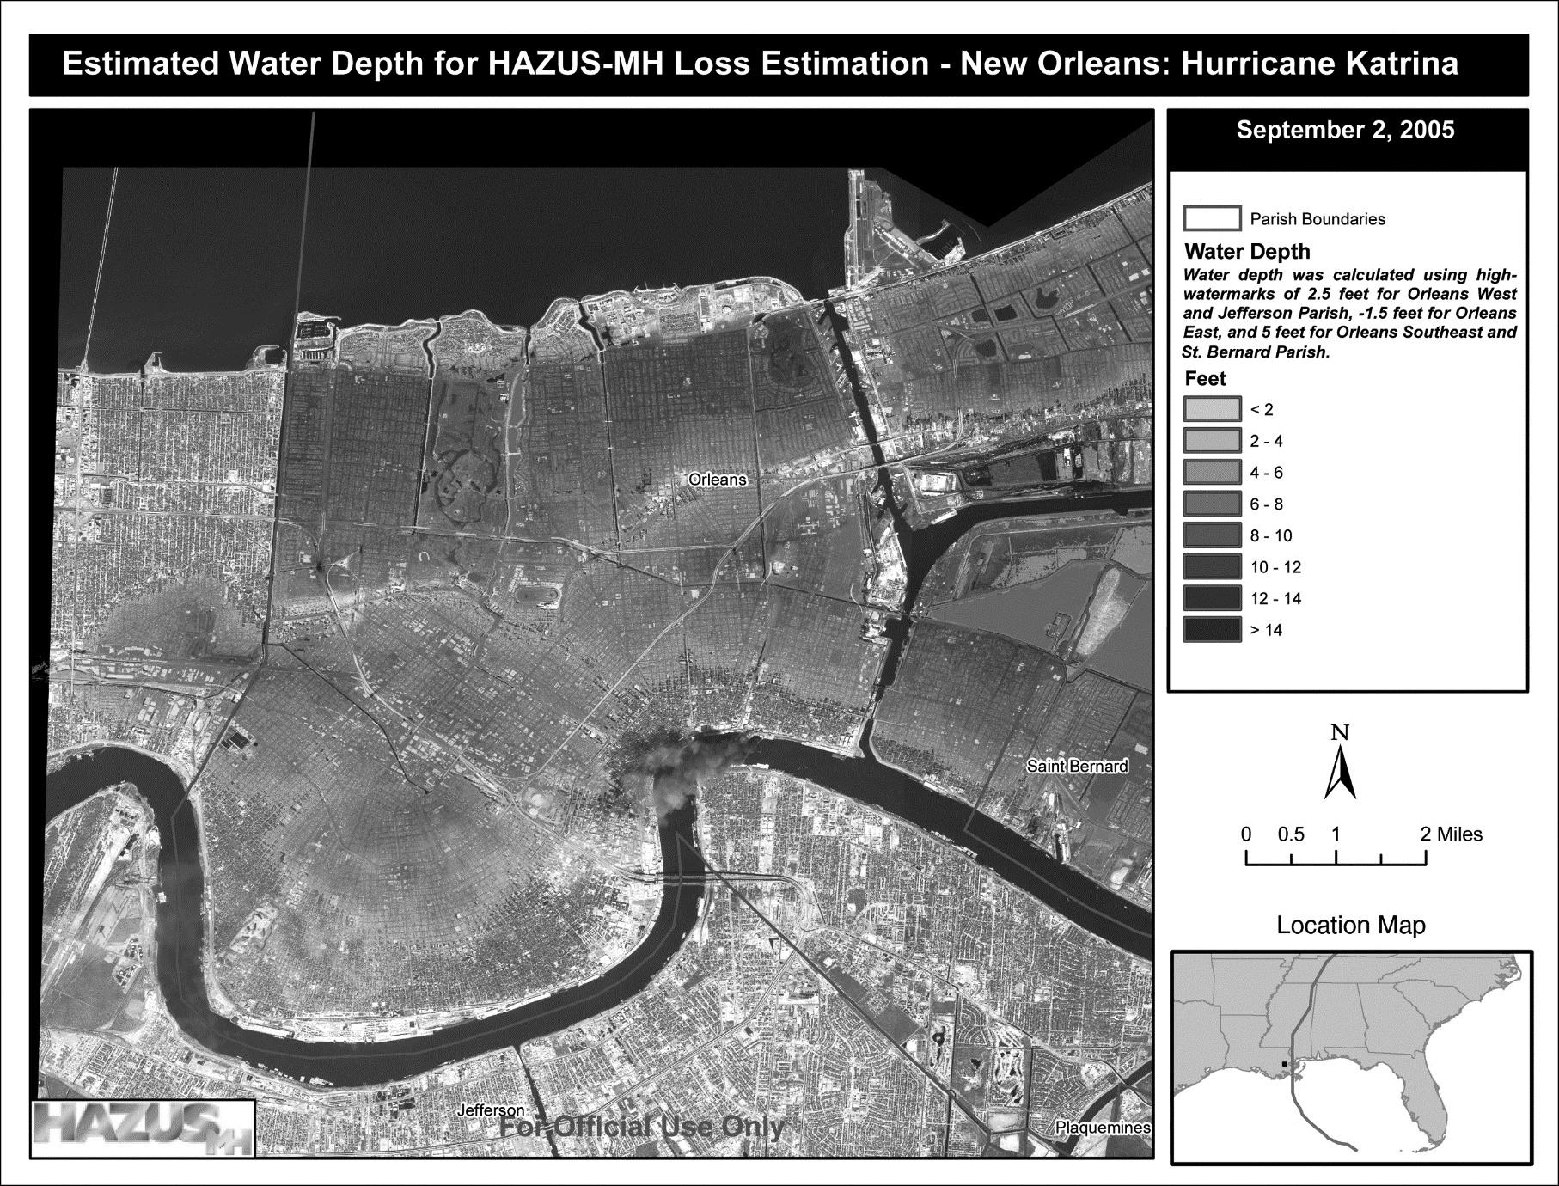
Scenario Modeling to Answer What-if Questions
Common use of GIS for planning: what-if questions
The example of a water depth estimation map developed using FEMA’s HAZUS tool. Source: Public Domain. www.fema.gov/media-library-data/20130726-1532-20490-7027/12_hazus_estwaterdepth_1_.pdf.)

Slide 20
Disaster-planning scenarios
Use of maps in a disaster-planning scenario. Each of these maps provides context and situation awareness as the scenario narrative unfolds. In this scenario, maps are used in the opening sequence of a fictitious news story about the unfolding events in the scenario such as day 3 after the impact of a category 5 hurricane along the east coast of the USA (left figure), followed by an earthquake and subsequent tsunami (middle figure), and the challenges of search and rescue with people ignoring evacuation orders (right figure). Images from Public Domain.

Slide 21
Scenario Planning 3D Serious GIS Game Case Study: Project Lily Pad
Screenshot from Project Lily Pad, a serious game built using 3D GIS, open-source data, and the Unity game engine. In this image, the game player is reading a map to help navigate in a realistic 3D simulation derived from an actual disaster event.

Slide 22
Spatial Statistics – Hotspot Mapping
Spatial statistics: techniques to investigate how the underlying spatial nature of phenomenon may or may not influence the statistics generated (which traditional statistics cannot account for)
Hot Spot Mapping: find statistically high (“hot”) or low (“cold”) value clusters
Hot spot mapping is not the same as heat mapping

Slide 23
Spatial Statistics – Hotspot Mapping
Closeup of showing Z-scores as per each individual census tract and their assignment to confidence intervals. Map by Brian Tomaszewski.

Slide 24
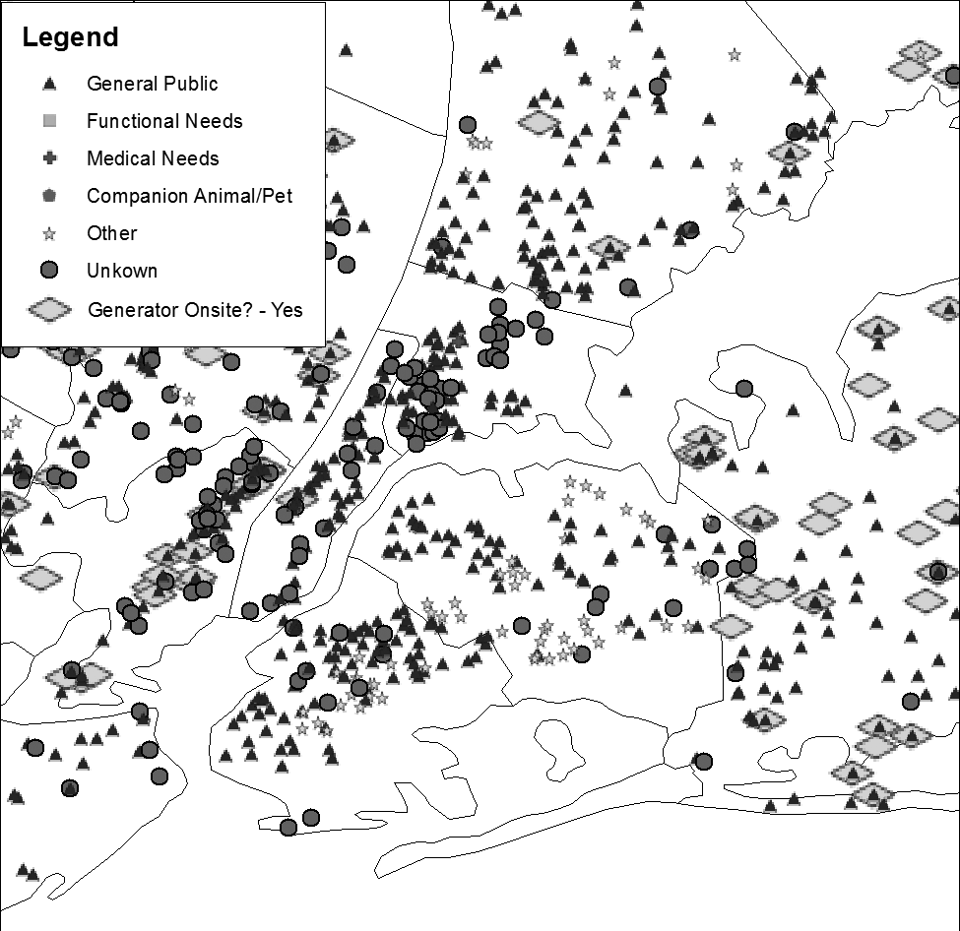
Public Outreach and Citizen Participation
Example: communication evacuation routes to the public in map-based formats
Example: communicating location of emergency shelters and characteristics
Map of shelter locations based on FEMA GIS data available through a Web service. In addition to being a general example showing shelter locations and their characteristics, it is also important to point out that this is a good example of designing a map that can be displayed in both color and black and white. For example, although all the points all have different colors associated with them, they also can communicate qualitative distinction through shelter shapes. By not relying solely on color, this map can be printed in black and white, and the meaning is not lost because of the use of the visual shape variable. Map created by Brian Tomaszewski with data obtained from https://gis.fema.gov/arcgis/rest/services/NSS/OpenShelters/FeatureServer

Slide 25
Crowdsourcing
Allow citizens to collect data about their neighborhoods and communities
Public participation GIS (PPGIS): series of techniques for utilizing GIS as a means of involving the public in discussions related to planning and decision-making
Preparing citizens to think spatially and understand how to use maps: no power or ability to use GPS or smartphones

Slide 26
GIS by Non-GIS Professionals

Slide 27
Counter-Mapping and Critical Cartography
Counter-mapping: use of mapping techniques to counter dominant power structures to achieve broader goals (Hodgson and Schroeder 2002)
Critical cartography: maps and the process of creating them as expressions of political process and power (Crampton and Krygier 2005)
Disaster management: Maantay and Maroko (2009) - minority groups underrepresented in urban population estimates, potentially exposing minority groups to flood hazard risk due to undercounting and subsequent misrepresentation maps

Slide 28
Non-Profit Groups
Non-profit groups: often vital to developing disaster resiliency and assisting vulnerable groups and/or disaster survivors (c.f. (International Federation of Red Cross and Red Crescent Societies 2019)
GIS: identifying potential donors, analyzing and communicating success stories, tracking service activities, support non-profit organization goals (USC GIS 2018)

Slide 29
Summary
Relationship between GIS and disaster planning and preparedness
Planning and preparation of GIS datasets and GIS technology
Organization perspectives
GIS as a support tool for planning and preparation activities: evacuation routes and zones
Developing scenarios and simulations: answer what-if questions
Public outreach and citizen participation
GIS by non-GIS professionals

Slide 30
Discussion Questions
1. Do you think the data themes represented in Table 6.1 are sufficient as reference layers for all-hazard and disaster types, or do you think other data themes should be included?
2. Using the Internet, do a search on “GIS training for disaster management.” Is what you’re finding comprehensive? If not, what do you think is missing?
3. Look through the Web pages of your local government and see if you can find any examples of memorandums of understanding, cooperation agreements, or anything else that can demonstrate how specifically your local government is planning for disaster activities and GIS. If you cannot find anything in your local government, look to your state government or even federal government.
4. Using the ideas presented in the evacuation zone planning section of this chapter, come up with a hypothetical disaster-planning scenario that can be supported with GIS. Try to think of things other than floods, because this was the example used in this chapter. Think about the local context where you live and the types of natural or other types of hazards that are relevant to that context.
5. What are some specific ways GIS could be used directly by citizens themselves as a disaster management planning tool?

Slide 31
Chapter 6 Exercises
Exercise 6.1 – Hot Spot Analysis and Visualization of Conflict Events
Conduct a Hot Spot Analysis using Getis-Ord Gi*
A video walkthrough tutorial of this exercises is available from the book’s companion website: http://gisfordisastermanagement.com

Slide 32
References Used in the Slides
Crampton, Jeremy W., and John Krygier . “An Introduction to Critical Cartography.” ACME: An International E-Journal for Critical Geographies 4, no. 1 (2005): 11–33.
Federal Geographic Data Committee. Department of Homeland Security Geospatial Data Model, n.d. Accessed April 28, 2019. https://www.fgdc.gov/organization/working-groups-subcommittees/hswg/dhs-gdm/index_html.
Hodgson, Dorothy L., and Richard A. Schroeder . “Dilemmas of Counter-Mapping Community Resources in Tanzania.” Development & Change 33, no. 1 (2002): 79–100.
International Federation of Red Cross and Red Crescent Societies. About Disaster Management, 2019. Accessed April 17, 2019. https://www.ifrc.org/en/what-we-do/disaster-management/about-disaster-management/.
Maantay, Juliana, and Andrew Maroko . “Mapping Urban Risk: Flood Hazards, Race, & Environmental Justice in New York.” Applied Geography 29, no. 1 (2009): 111–124.
Tomaszewski, B.M., Moore, E.A., Parnell, K., Leader, A.M., Armington, W.R., Aponte, O., Brooks, L., Herold, B.K., Meyers, B.S., Ruggero, T., Sutherby, Z., Wolters, M., Wu, S., Szarzynski, J., Greve, K. & Parody, R. “Developing a Geographic Information Capacity (GIC) Profile for Disaster Risk Management under United Nations Framework Commitments.” International Journal of Disaster Risk Reduction 47 (2020a): 101638.
Tomaszewski, B., Walker, A., Gawlik, E., Lane, C., Williams, S., Orieta, D., Mcdaniel, C., Plummer, M., Nair, A., San Jose, N., Terrell, N., Pecsok, K., Thomley, E., Mahoney, E., Haberlack, E. & Schwartz, D. “Supporting Disaster Resilience Spatial Thinking with Serious GeoGames: Project Lily Pad.” ISPRS International Journal of Geo-Information 9 (2020b): 405.
USC GIS. The Application of GIS Technology for Nonprofit Organizations, 2018. Accessed April 30, 2018. https://gis.usc.edu/blog/gis-technologies-in-the-nonprofit-sector/.

